Slide 1
A brief overview: Minimum Ignition Energy Transition in Biogas Mixtures, and Droplet-Laden Turbulent Flows
V.S. Papapostolou, G. Ozel-Erol, C. Turquand d’Auzay, N. Chakraborty
School of Engineering, Newcastle University, UK
UKCTRF PhD Student Conference, 2020
16th September 2019
Online

Slide 2
Motivation
Localised forced ignition (spark or laser) plays a dominant role in transportation and energy production
Internal Combustion (IC) engines and Gas turbines
Important from the point of view of accidental explosion and fire safety
Ignition not only initiates combustion but also influences subsequent burning
Biogas utilisation is a growing area of interest, particularly for developing countries
Used as a fuel alternative for personal and light commercial vehicles
However the efficiency and stability of biogas-fuelled engines are not as good as that obtained for the fuel for which the engine was originally designed to operate with
Demand for both micro (personal) and macro (governmental and institutional) level applications
1/11

Slide 3
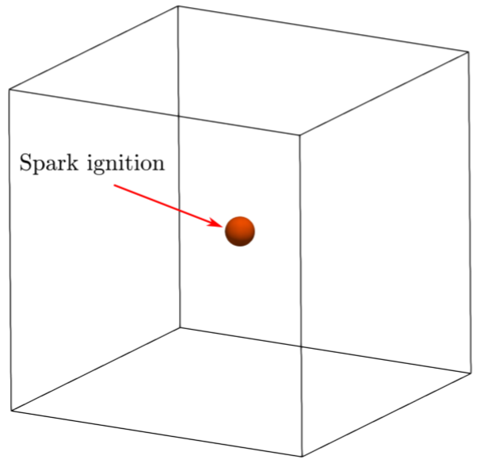
Numerical Implementation
Compressible 3D DNS code SENGA+$^{1}$
Uniform Cartesian grid
All boundaries are considered to be non-reflecting, pointwise inflow-outflow
Initial turbulent field is generated by a pseudo-spectral method$^{2}$ adhering to the Batchelor-Townsend Spectrum$^{3}$
Spatial differentiation – high order finite difference scheme
Time advancement – Explicit low-storage 3rd order Runge-Kutta scheme
y
x
z
Geometrical description of the domain
1 K.W. Jenkins, R.S. Cant, Proc. 2nd AFOSR Conference on DNS and LES (1999)
2 R.S. Rogallo, NASA Ames Research Centre (1990)
3 G.K. Batchelor and A.A. Townsend, Proceedings Royal Society London (1948)
2/11

Slide 4
Numerical Implementation
Three domain sizes used, dependent on the turbulence intensity, $4.8l_{t}^{3}$ $(44δ_{z}^{3}$), $7.4l_{t}^{3}$ $(66δ_{z}^{3}$) and $9.9l_{t}^{3}$ $(89δ_{z}^{3}$), where $δ_{z}^{0} = D_{0}/s_{l}^{0}$is the Zel’dovich flame thickness of the stoichiometric mixture
Cartesian grid of ${352}^{3}$, ${540}^{3}$ and ${720}^{3}$ respectively, ensures:
10 grid points across the thermal flame thickness
$η_{k}>Δx$ where$η_{k}$ is the Kolmogorov length scale
Spark location is at the centre of the domain
Energy deposition accounted for by addition of source term to energy equation
Energy deposition duration ($b_{sp}$) and width ($R_{sp}$) kept constant, only spark power ($a_{sp}$) is varied to find the MIE
y
x
z
Geometrical description of the domain
3/11

Slide 5
Numerical Implementation: Parameters investigated
To demonstrate and explain the influences of initial turbulence intensity ($u^{′}/s_{l}^{0}$) and level of dilution ($ψ^{u}$) on the Minimum Ignition Energy (MIE) of biogas-air mixtures.
MIE – the smallest amount of energy which can be deposited into the mixture for a successful ignition to occur
Biogas combustion has the following global reaction, with the Diluent being C$O_{2}$ to represent biogas:
$$CH_{4}+2\left(O_{2}+3.76N_{2}\right)+a⋅Diluent→CO_{2}+2H_{2}O+7.52N_{2}+ a⋅Diluent$$
Level of dilution ($ψ$) is defined following the definitions of Galmiche et al.$^{4}$
In the unburned mixture: $ψ^{u}=\frac{a}{a+1+2+7.52}=\frac{a}{a+10.52}$
In the fuel: $ψ^{f}=\frac{a}{a+1}$
4 Galmiche, B. et al., Effects of dilution on laminar burning velocity of premixed methane/air flames. Energy Fuels. 25(3), 948–954 (2011)
4/11

Slide 6
Numerical Implementation: Parameters investigated
Four levels of dilution investigated: $ψ^{u}= \{0.0, 0.025, 0.05, 0.10\}$
Stoichiometric mixture in all cases: $φ=1.0$
Isotropic decaying turbulence, initial turbulence intensities : $u^{′}/s_{l}^{0}$= [0 $−>$ 20]
Integral length scale ($l_{t}$) kept constant
Computational cost ~ 570 DNS cases at a cost of 5.85 $×{10}^{6}$ core hours
5/11

Slide 7
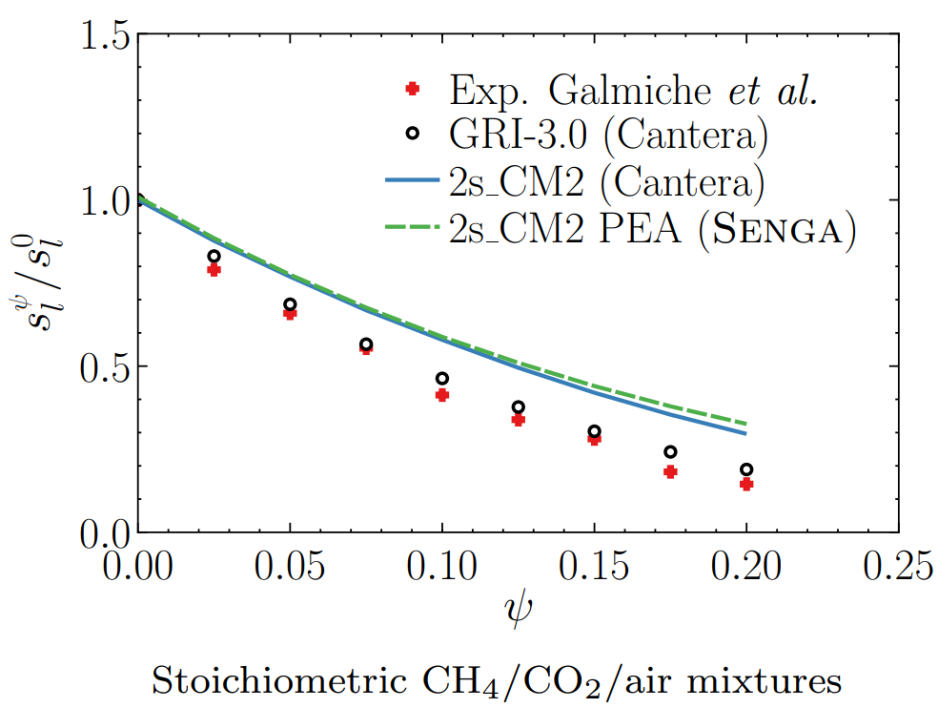
Numerical Implementation: Chemical Mechanism
Due to computational cost, a two-step chemical mechanism presented by Westbrook and Dryer $^{5}$ has been used
Compromise between single-step chemistry and more complex mechanisms
Pre-exponential adjustment (PEA) proposed by Bibrzycki and Poinsot$^{6}$ implemented
Validated for both $CH_{4}$ and $CH_{4}+CO_{2}$ mixtures, against experimental results$^{4}$ and other chemical mechanisms (2s_CM2$^{6}$and GRI-Mech 3.0 [43] and) and.
5 Westbrook, C.K., Dryer, F.L.: Simplified reaction mechanisms for the oxidation of hydrocarbon fuels in flames.. Combust. Sci. Technol.. 27 (1981).
6 Bibrzycki, J., Poinsot, T.: Reduced chemical kinetic mechanisms for methane combustion in O2/N2 and O2/CO2 atmosphere. CERFACS (2010).
7 Smith, G., Golden, D., Frenklach, M., Moriarty, N., Eiteneer, B., Goldenberg, M., Bowman, C., Hanson, R., Song, S., Gardiner, W., Lissianski, V., Qin, Z.,Gri-Mech 3.0. Accessed February 25. . , (2018).
6/11

Slide 8
Results: Dilution effects on MIE
Normalised energy deposited by the spark:
$${\left(Γ_{ψ^{u}}\right)}_{i/p}={\left(E_{i/p}\right)}_{ψ^{u}}/{\left(E_{p}\right)}_{ψ^{u}}^{L}$$
$E_{i/p}$ - is the MIE
$i/p$ - indicate values sufficient just for thermal runaway/self-sustained flame propagation, respectively
$ψ^{u}$ - indicates the dilution level
$L$ - indicates laminar quiescent conditions
7/11

Slide 9
Results: Dilution effects on MIE
Normalised energy deposited by the spark:
$ψ^{u}$ - Increases (left to right)
${CO}_{2}$ content increases
$${\left(Γ_{ψ^{u}}\right)}_{i/p}={\left(E_{i/p}\right)}_{ψ^{u}}/{\left(E_{p}\right)}_{ψ^{u}}^{L}$$
$E_{i/p}$ - is the MIE
$i/p$ - indicate values sufficient just for thermal runaway/self-sustained flame propagation, respectively
$ψ^{u}$ - indicates the dilution level
$L$ - indicates laminar quiescent conditions
7/11

Slide 10
Results: Dilution effects on MIE
Normalised energy deposited by the spark:
$ψ^{u}$ - Increases (left to right)
${CO}_{2}$ content increases
MIE requirement increases
$${\left(Γ_{ψ^{u}}\right)}_{i/p}={\left(E_{i/p}\right)}_{ψ^{u}}/{\left(E_{p}\right)}_{ψ^{u}}^{L}$$
$E_{i/p}$ - is the MIE
$i/p$ - indicate values sufficient just for thermal runaway/self-sustained flame propagation, respectively
$ψ^{u}$ - indicates the dilution level
$L$ - indicates laminar quiescent conditions
7/11

Slide 11
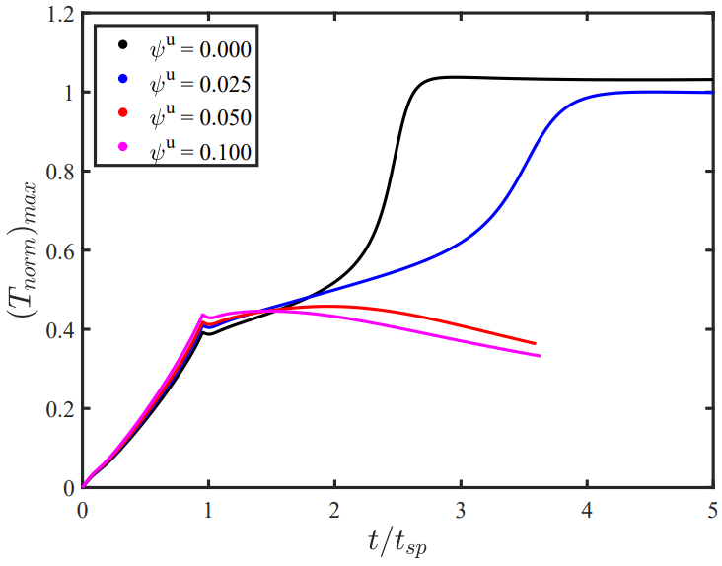
Results: Dilution effects on MIE
Non-dimensional temperature:
$$T_{norm}=\left(\hat{T}−T_{0}\right)/\left(T_{ad}^{ψ^{u}}−T_{0}\right)$$
$\hat{T}$ is the instantaneous dimensional temperature,
$T_{0}$ is the unburned gas temperature,
$T_{ad}^{ψ^{u}}$is the adiabatic flame temperature for the corresponding level of dilution
Temporal evolutions of the maximum value of $T_{norm}$ under laminar conditions with $ψ^{u}=0.0, 0.025, 0.05$ and $0.10$ as indicated by the legend for input energy equal to the MIE for $ψ^{u}=0.025$ under laminar conditions.
7/11

Slide 12
Results: Dilution effects on MIE
$a_{sp}$= 3.55
Laminar cases
Non-dimensional temperature:
$$T_{norm}=\left(\hat{T}−T_{0}\right)/\left(T_{ad}^{ψ^{u}}−T_{0}\right)$$
$\hat{T}$ is the instantaneous dimensional temperature,
$T_{0}$ is the unburned gas temperature,
$T_{ad}^{ψ^{u}}$is the adiabatic flame temperature for the corresponding level of dilution
Temporal evolutions of the maximum value of $T_{norm}$ under laminar conditions with $ψ^{u}=0.0, 0.025, 0.05$ and $0.10$ as indicated by the legend for input energy equal to the MIE for $ψ^{u}=0.025$ under laminar conditions.
7/11

Slide 13
Results: Dilution effects on MIE
$a_{sp}$= 3.55
Laminar cases
Non-dimensional temperature:
$$T_{norm}=\left(\hat{T}−T_{0}\right)/\left(T_{ad}^{ψ^{u}}−T_{0}\right)$$
$ψ^{u}$ = 0, 0.025
$a_{sp}$ > ${\left(a_{sp}\right)}_{ψ^{u}}^{L}$
$\hat{T}$ is the instantaneous dimensional temperature,
$T_{0}$ is the unburned gas temperature,
$T_{ad}^{ψ^{u}}$is the adiabatic flame temperature for the corresponding level of dilution
Temporal evolutions of the maximum value of $T_{norm}$ under laminar conditions with $ψ^{u}=0.0, 0.025, 0.05$ and $0.10$ as indicated by the legend for input energy equal to the MIE for $ψ^{u}=0.025$ under laminar conditions.
7/11

Slide 14
Results: Dilution effects on MIE
$a_{sp}$= 3.55
Laminar cases
Non-dimensional temperature:
$$T_{norm}=\left(\hat{T}−T_{0}\right)/\left(T_{ad}^{ψ^{u}}−T_{0}\right)$$
$ψ^{u}$ = 0, 0.025
$a_{sp}$ > ${\left(a_{sp}\right)}_{ψ^{u}}^{L}$
$\hat{T}$ is the instantaneous dimensional temperature,
$T_{0}$ is the unburned gas temperature,
$T_{ad}^{ψ^{u}}$is the adiabatic flame temperature for the corresponding level of dilution
$ψ^{u}$ = 0.05, 0.1
$a_{sp}$ < ${\left(a_{sp}\right)}_{ψ^{u}}^{L}$
Temporal evolutions of the maximum value of $T_{norm}$ under laminar conditions with $ψ^{u}=0.0, 0.025, 0.05$ and $0.10$ as indicated by the legend for input energy equal to the MIE for $ψ^{u}=0.025$ under laminar conditions.
7/11

Slide 15
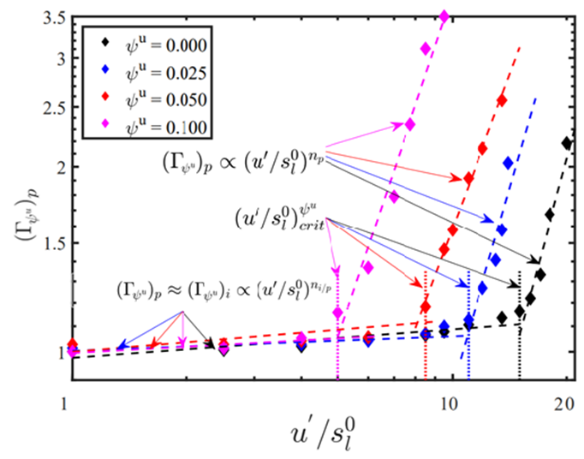
Results: MIE transition & Characterisation
MIE Transition – the drastic increase of the MIE requirement past a critical turbulence intensity
${u^{′}}/{s_{l}^{0}}<{\left({u^{′}}/{s_{l}^{0}}\right)}_{crit}$
Gradual increase, small MIE
${u^{′}}/{s_{l}^{0}}>{\left({u^{′}}/{s_{l}^{0}}\right)}_{crit}$
Drastic increase, large MIE
Variation of the normalised MIEs ${\left(Γ_{MIE}^{ψ^{u}}\right)}_{p}$with $u^{′}/s_{l}^{0}$ for different dilution levels $ψ^{u}$ .
8/11

Slide 16
Results: MIE transition & Characterisation
Self similar profiles obtained for all $ψ^{u}$ values
In agreement with experimental results
Same behaviour observed for droplet laden mixtures╪
Variation of the normalised MIEs ${\left(Γ_{MIE}^{ψ^{u}}\right)}_{p}$with $u^{′}/s_{l}^{0}$ for different dilution levels $ψ^{u}$ .
╪ Vassilios Papapostolou , Gulcan Ozel Erol , Charles Turquand d’Auzay & Nilanjan Chakraborty (2020): A Numerical Investigation of the Minimum Ignition Energy Requirement for Forced Ignition of Turbulent Droplet-laden Mixtures, Combustion Science and Technology
8/11

Slide 17
Results: MIE transition & Characterisation
Variation of the normalised MIEs ${\left(Γ_{MIE}^{ψ^{u}}\right)}_{p}$with $u^{′}/s_{l}^{0}$ for different dilution levels $ψ^{u}$ .
9/11

Slide 18
Results: MIE transition & Characterisation
8 Shy, S.S., Liu, C.C., Shih, W.: Ignition transition in turbulent premixed combustion. Combust. Flame. 157 (2), 341–350 (2010).
9 Cardin, C., et al.: Experimental analysis of laser-induced spark ignition of lean turbulent premixed flames: new insights Comb. Flame. 160 (8), 1414–1427 (2013).
10 Turquand d’Auzay, C., et al.: On the minimum ignition energy and its transition in the localised forced ignition of turbulent homogeneous mixtures. Comb. Flame.201, 104–117 (2019).
9/11

Slide 19
Results: MIE transition & Characterisation
10/11

Slide 20
Results: MIE transition & Characterisation
${\left(Γ_{ψ^{u}}\right)}_{p}∝{\left({u^{′}}/{s_{l}^{0}}\right)}^{3−3n_{Ξ}}$ , $Ξ\sim {\left({u^{′}}/{s_{l}^{ψ^{u}}}\right)}^{n_{Ξ}}\text{with} 0<n_{Ξ}<1$
Heat release must overcome the overall heat transfer rate
MIE transition attributed to bending effect
$Ξ$ varies linearly (i.e. $n_{Ξ}≈1.0$) with small turbulence intensities
$\text{F}\text{or} \text{large} \text{turbulence} \text{intensities} Ξ$ becomes less sensitive to the changes in $u^{′}$ with $n_{Ξ}<1$.
10/11

Slide 21
Results: MIE transition & Characterisation
8 Shy, S.S., Liu, C.C., Shih, W.: Ignition transition in turbulent premixed combustion. Combust. Flame. 157 (2), 341–350 (2010).
9 Cardin, C., et al.: Experimental analysis of laser-induced spark ignition of lean turbulent premixed flames: new insights Comb. Flame. 160 (8), 1414–1427 (2013).
10 Turquand d’Auzay, C., et al.: On the minimum ignition energy and its transition in the localised forced ignition of turbulent homogeneous mixtures. Comb. Flame.201, 104–117 (2019).
10/11

Slide 22
Conlusions
The MIE of stoichiometric biogas-air mixtures with varying levels of $CO_{2}$ dilution have been numerically evaluated under homogeneous isotropic decaying turbulence for a wide range of initial turbulence intensities using three-dimensional DNS.:
The MIE for uniformly dispersed mono-sized n-heptane droplet-laden mixtures under homogeneous isotropic decaying turbulence has been numerically evaluated for a range of different initial turbulence intensities, droplet diameters and overall equivalence ratios, following similar methodology to that described above for the biogas.
11/11

Slide 23
Conclusions
Good agreement with existing experimental results
11/11

Slide 24
Conclusions
Good agreement with existing experimental results
MIE transition observed for all levels of $ψ^{u}$, and for droplet laden mixtures
11/11

Slide 25
Conclusions
Good agreement with existing experimental results
MIE transition observed for all levels of $ψ^{u}$, and for droplet laden mixtures
Scaling analysis and flame wrinkling statistics explained the power law nature of MIE transition. The power law exponent was not significantly affected by the presence and level of dilution.
11/11

Slide 26
Conclusions
Good agreement with existing experimental results
MIE transition observed for all levels of $ψ^{u}$, and for droplet laden mixtures
Scaling analysis and flame wrinkling statistics explained the power law nature of MIE transition. The power law exponent was not significantly affected by the presence and level of dilution.
Stochasticity of the ignition and flame propagation events for the MIE values explained in terms of the competition between the heat release and thermal diffusion rates. Same behaviour was observed for droplet laden mixtures as well.
11/11

Slide 27
Conclusions
Good agreement with existing experimental results
MIE transition observed for all levels of $ψ^{u}$, and for droplet laden mixtures
Scaling analysis and flame wrinkling statistics explained the power law nature of MIE transition. The power law exponent was not significantly affected by the presence and level of dilution.
Stochasticity of the ignition and flame propagation events for the MIE values explained in terms of the competition between the heat release and thermal diffusion rates. Same behaviour was observed for droplet laden mixtures as well.
First order effect: initial turbulence intensity
11/11

Slide 28
Conclusions
Good agreement with existing experimental results
MIE transition observed for all levels of $ψ^{u}$, and for droplet laden mixtures
Scaling analysis and flame wrinkling statistics explained the power law nature of MIE transition. The power law exponent was not significantly affected by the presence and level of dilution.
Stochasticity of the ignition and flame propagation events for the MIE values explained in terms of the competition between the heat release and thermal diffusion rates. Same behaviour was observed for droplet laden mixtures as well.
First order effect: initial turbulence intensity
Increase $of ψ^{u}$:
Increases the MIE demand
Decreases critical turbulence intensity
11/11

Slide 29
Conclusions
Good agreement with existing experimental results
MIE transition observed for all levels of $ψ^{u}$, and for droplet laden mixtures
Scaling analysis and flame wrinkling statistics explained the power law nature of MIE transition. The power law exponent was not significantly affected by the presence and level of dilution.
Stochasticity of the ignition and flame propagation events for the MIE values explained in terms of the competition between the heat release and thermal diffusion rates. Same behaviour was observed for droplet laden mixtures as well.
First order effect: initial turbulence intensity
Increase $of ψ^{u}$:
Increases the MIE demand
Decreases critical turbulence intensity
Increase of initial droplet diameter
Decrease of initial global equivalence ratio
11/11

Slide 30
Thank you for your time and attention
Questions ?
Droplet-laden Mixtures
Combustion Science and Technology
V.Papapostolou et al. (2020): A Numerical Investigation of the Minimum Ignition Energy Requirement for Forced Ignition of Turbulent Droplet-laden Mixtures, Combustion Science and Technology
V.Papapostolou et al. (2020): A numerical investigation of the effects of fuel composition on the minimum ignition energy for homogeneous biogas-air mixtures, Flow, Turbulence and Combustion (under review currently)
The financial support of British Council, EPSRC, and the computational support of Rocket, Cirrus and ARCHER are gratefully acknowledged.

Slide 31
Results: MIE transition & Characterisation
heat release must overcome the overall heat transfer rate
$\int_{V}{{\dot{w}}_{T} dV}$
Scales as: $\sim ρ_{0}s_{l}^{ψ^{u}}A_{T}\left(Y_{Fu}−Y_{Fb}\right)H_{φ}^{ψ^{u}}Σ′$
$Σ′$ is the flame surface area to volume ratio
$H_{φ}^{ψ_{u}}$ is the heat of combustion
$A_{T}$ is the actual flamelet area
$A_{p}$ is the projected flame surface
Which also scales as: $\sim q_{eff}A_{p}$
$q_{eff}$ is the effective diffusive thermal flux
Scales as: $q_{eff}\sim ρ_{0}C_{p}(D+D_{t})(T_{ad}^{ψ^{u}}−T_{0})/R_{crit}$
$D_{t}$ is the eddy diffusivity
$D_{t}≫D$
Turbulent diffusion >> than the molecular diffusion rate
$R_{crit}$ is the critical radius of the hot gas kernel
${R>R}_{crit}$ for self-sustained propagation
$R_{crit}\sim \frac{u^{′}l_{t}}{S_{L}^{ψ^{u}}({A_{T}}/{A_{p}})}$
By substituting $C_{p}\left(T_{ad}^{ψ^{u}}−T_{0}\right)=H_{φ}^{ψ^{u}}\left(Y_{Fu}−Y_{Fb}\right)$
$D_{t}\sim u^{′}l_{t}$
$A_{T}/A_{p}$ is by definition is the wrinkling factor $Ξ$
$Ξ\sim {\left({u^{′}}/{s_{l}^{ψ^{u}}}\right)}^{n_{Ξ}}\text{w}\text{ith} 0<n_{Ξ}<1$
$\text{MIE}\sim ρ_{0}\left({4πR_{crit}^{3}}/3\right)C_{p}(T_{ad}^{ψ_{u}}−T_{0})$)
${\left(Γ_{ψ^{u}}\right)}_{p}\sim {\left({l_{t}}/{δ_{z}^{0}}\right)}^{3}{\left({u^{′}}/{s_{l}^{0}}\right)}^{3−3n_{Ξ}}{\left({s_{l}^{0}}/{s_{l}^{ψ^{u}}}\right)}^{3−3n_{Ξ}}$
${\left(Γ_{ψ^{u}}\right)}_{p}∝{\left({u^{′}}/{s_{l}^{ψ^{u}}}\right)}^{3−3n_{Ξ}}$
${\left(Γ_{ψ^{u}}\right)}_{p}∝{\left({u^{′}}/{s_{l}^{0}}\right)}^{3−3n_{Ξ}}$
For a certain $ψ^{u}$ - ${s_{l}^{0}}/{s_{l}^{ψ^{u}}}$and ${δ_{z}^{0}}/{δ_{z}^{ψ^{u}}}$constants

Slide 32
Results: MIE transition & Characterisation
$D_{t}\sim u^{′}l_{t}$
$A_{T}$ is the actual flamelet area
$A_{p}$ is the projected flame surface
$A_{T}/A_{p}$ is by definition is the wrinkling factor $Ξ$
$Ξ\sim {\left({u^{′}}/{s_{l}^{ψ^{u}}}\right)}^{n_{Ξ}}\text{with} 0<n_{Ξ}<1$
$n_{Ξ}≈1.0$ is consistent with small values of $n_{p}$ for small turbulence intensities
$n_{Ξ}=1/3$ yields ${\left(Γ_{ψ^{u}}\right)}_{p}∝{\left({u^{′}}/{s_{l}^{0}}\right)}^{2}$ for large values of ${u^{′}}/{s_{l}^{0}}$
For $\left(u^{′}/s_{l}^{0}\right)>$ ${\left(u^{′}/s_{l}^{0}\right)}_{crit}$
8 Shy, S.S., Liu, C.C., Shih, W.: Ignition transition in turbulent premixed combustion. Combust. Flame. 157 (2), 341–350 (2010).
9 Cardin, C., et al.: Experimental analysis of laser-induced spark ignition of lean turbulent premixed flames: new insights Comb. Flame. 160 (8), 1414–1427 (2013).
10 Turquand d’Auzay, C., et al.: On the minimum ignition energy and its transition in the localised forced ignition of turbulent homogeneous mixtures. Comb. Flame.201, 104–117 (2019).
12/13

Slide 33
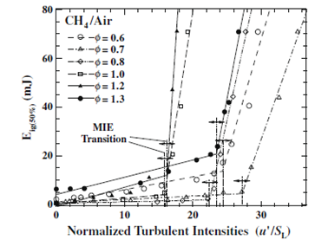
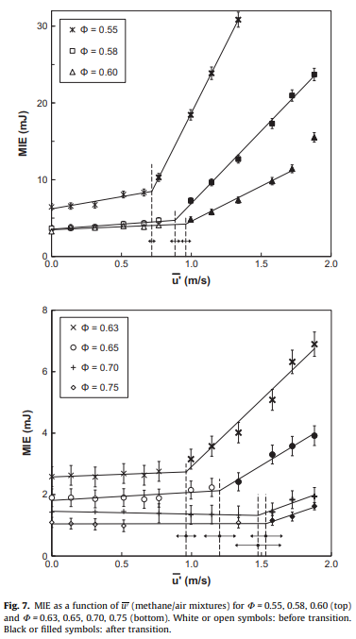
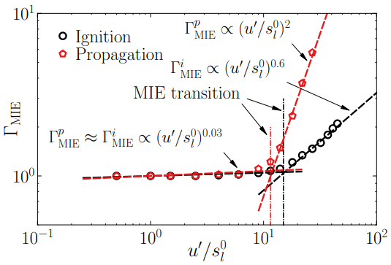
Results: Existing Findings

Slide 34
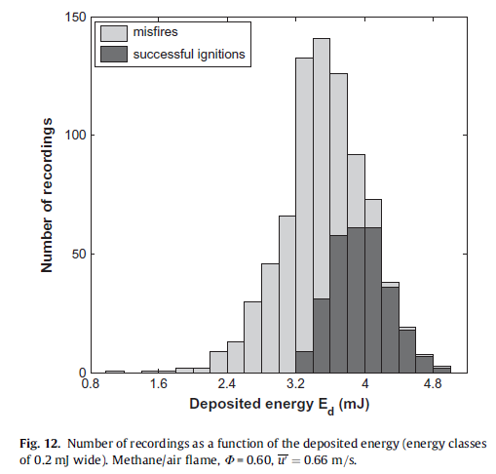
MIE – Probabilistic Variable
Ignition is a stochastic phenomenon. MIE is determined as a probabilistic variable.
Experimentally it is determined by:
First estimate the amount of energy to achieve more than 0% probability of successful ignition, and then the energy required to achieve 100% ignition.
Numerous experimental realisations required, to ascertain ‘upper’ and ‘lower’ limits.
Then the energy which leads to 50% ignition probability is taken to be the MIE.
Experimental methodology cannot be followed using DNS due to the associated computational cost.
Fig. R1.1: Number of recordings as a function of deposited energy (energy classes of 0.2mJ wide) methane-air flame, $φ=0.6$, $u^{′}=0.66m/s$. Figure taken from Cardin et al. [1].

Slide 35
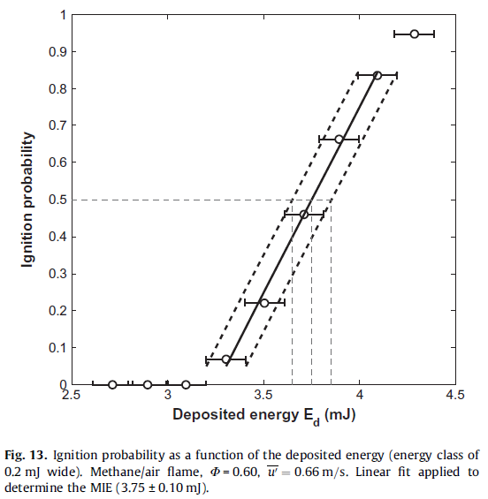
MIE – Probabilistic Variable
Computationally the MIE is determined by:
Increasing the amount of energy to achieve more than 0% probability of successful ignition whilst the turbulent realisation is unaltered.
The MIE value obtained corresponds to a non-zero ignition probability as a successful event has occurred.
Two further turbulent realisations are considered.
A successful event was observed for one of these two, and an unsuccessful event for the other realisation
Thus the reported MIE value corresponds to the ignition probability greater than 0% and smaller than 100%.
Fig. 2: Ignition probability as a function of the deposited energy (energy classes of 0.2mJ wide) methane-air flame, $φ=0.6$, $u^{′}=0.66m/s$. Linear fit applied to determine the MIE (3.75$±$0.1 mJ). Figure taken from Cardin et al. [1].

Slide 36
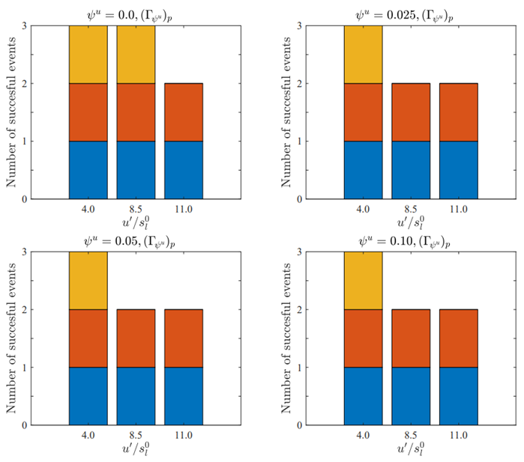
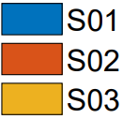
Results: Flame-turbulence interaction
Figure 8. Number of successful events out of three different turbulent realisations (S01, S02, S03) across selected turbulent cases for $ψ^{u}=0.0, 0.025, 0.05$ and $0.10$ for the input ignition energy corresponding to ${\left(Γ_{ψ^{u}}\right)}_{p}$.
15/16

Slide 37
Results: Ignition/Propagation Definitions
Simulations carried out to evaluate the MIE for both Ignition and Propagation
Successful Ignition - refers to a situation where $T_{max}$surpasses $T_{ad}$ at any point in time. If $T_{max}$ does not reach $T_{ad}$, it is referred to as a misfire. Simulations run until a successful ignition is observed ($t \sim 3t_{sp}$).
Successful Propagation – obtained when the flame kernel burns without the aid of the ignitor after a successful ignition. It is determined by evaluating the temporal evolution of the burned gas volume, and if its temporal derivative is positive at $t = 10t_{sp}$ , a successful self sustained propagation is obtained, otherwise it is considered to be quenched. (Comparable to experiments)
11/13

Slide 38
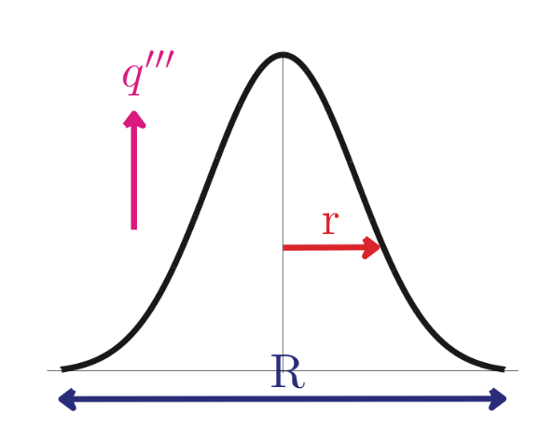
Mathematical Background
Gaseous Phase:
Eulerian Approach is used to solve for gas phase combustion.
Addition of a source term to the energy equation to account for the energy deposition by the spark
$$\frac{∂}{∂t}ρe+\underset{−C_{1}}{\underbrace{\frac{∂}{∂x_{k}}ρu_{k}e}}=\underset{P_{1}}{\underbrace{−\frac{∂}{∂x_{k}}u_{k}p}}+\underset{D_{1}}{\underbrace{\frac{∂}{∂x_{k}}τ_{ki}u_{i}}}+\underset{D_{2}}{\underbrace{\frac{∂}{∂x_{k}}\left[λ\frac{∂\hat{T}}{∂x_{k}}\right]}}\underset{D_{3}}{\underbrace{−\frac{∂}{∂x_{i}}ρ\sum_{k=1}^{N}{h_{s,k}Y_{k}V_{k,i}}}}+\underset{P_{2}}{\underbrace{{\dot{w}}_{T}}}+\underset{P_{3}}{\underbrace{q^{′′′}}}$$
The source term (spark energy) follows a Gaussian profile$^{5}$
$$q^{′′′}=A_{q}exp\left(−\frac{r^{2}}{2R_{sp}^{2}}\right)$$
$$\dot{Q}=a_{sp}ρ_{0}C_{P}τT_{0}\left(\frac{4}{3}πl_{f}^{3}\right)\left[\frac{H\left(t\right)−H(t−t_{sp})}{t_{sp}}\right]$$
$$\dot{Q}=\int_{V}^{ }{q^{′′′} dV}$$
$$t_{sp}=b_{sp}t_{f}$$
$a_{sp}$-Total ignition energy input parameter
$b_{sp}$ - Energy deposition duration parameter
$τ=(T_{ad(φ=1.0)}−T_{0})/T_{0}$
$R_{sp}$ - Characteristic width parameter
3/13

Slide 39
Results: MIE transition & Characterisation
${\left(Γ_{ψ^{u}}\right)}_{p}∝{\left({u^{′}}/{s_{l}^{0}}\right)}^{3−3n_{Ξ}}$
Heat release must overcome the overall heat transfer rate
MIE transition attributed to bending effect
$Ξ$ varies linearly (i.e. $n_{Ξ}≈1.0$) with small turbulence intensities
$\text{F}\text{or} \text{large} \text{turbulence} \text{intensities} Ξ$ becomes less sensitive to the changes in $u^{′}$ with $n_{Ξ}<1$.
$D_{t}\sim u^{′}l_{t}$
$A_{T}$ is the actual flamelet area
$A_{p}$ is the projected flame surface
$A_{T}/A_{p}$ is by definition is the wrinkling factor $Ξ$
$Ξ\sim {\left({u^{′}}/{s_{l}^{ψ^{u}}}\right)}^{n_{Ξ}}\text{with} 0<n_{Ξ}<1$
For $\left(u^{′}/s_{l}^{0}\right)>$ ${\left(u^{′}/s_{l}^{0}\right)}_{crit}$
8 Shy, S.S., Liu, C.C., Shih, W.: Ignition transition in turbulent premixed combustion. Combust. Flame. 157 (2), 341–350 (2010).
9 Cardin, C., et al.: Experimental analysis of laser-induced spark ignition of lean turbulent premixed flames: new insights Comb. Flame. 160 (8), 1414–1427 (2013).
10 Turquand d’Auzay, C., et al.: On the minimum ignition energy and its transition in the localised forced ignition of turbulent homogeneous mixtures. Comb. Flame.201, 104–117 (2019).
12/13

Slide 40
Contents
1. Motivation
2. Mathematical Background and Numerical Implementation
3. Results
4. Conclusions
1/13

