Slide 1
Soot emissions prediction in aero-engine combustors using
Incompletely Stirred Reactor Network modelling
UKCRTF meeting
16 Sept 2020
Savvas Gkantonas*, Andrea Giusti**, Epaminondas Mastorakos*
* University of Cambridge, UK
** Imperial College London, UK
Contact/Presenter: Savvas Gkantonas
(sg834@cam.ac.uk)

Slide 2
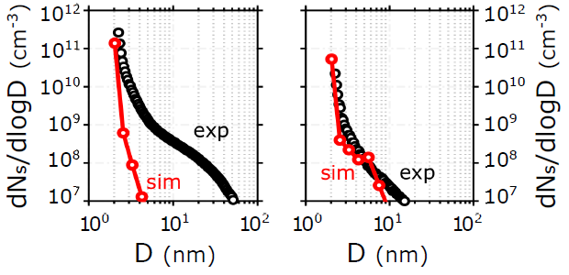
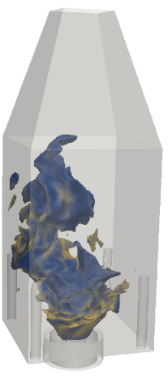
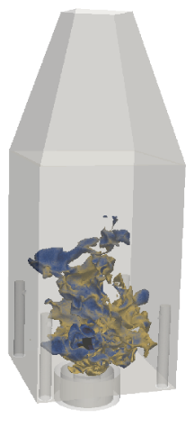

Introduction
Cost: O(10⁶) CPUh
0% dilution
40% dilution
Soot emissions are a threat ^{[1]}
We need methodologies for the soot particle size distribution (PSD) ^{[2]}
Predicting soot is very hard even in laminar flames ^{[2]}
CFD approaches are required but are expensive
Cambridge Rich-Quench-Lean (RQL) burner ^{[3]}
[1] D’Anna, A. (2009). Proc. Comb. Inst. 32, 593–613.
[2] Rigopoulos, S. (2019). Flow Turbulence Combust. 103, 565–604.
[3] Gkantonas, S., Sirignano, M., Giusti, A., D’Anna, A., Mastorakos, E. (2020). Fuel 270, 117483.

Slide 3
Motivation and Objectives
Motivation
Develop inexpensive approaches:
Test many chemical schemes and soot models
Model many geometries and combustors
Provide estimates of soot emission and the exit PSD
Specific objectives
Develop an efficient Incompletely Stirred Reactor Network (ISRN) approach to post-process CFD simulations
Demonstrate efficiency and accuracy on model aero-engine combustors

Slide 4



Incompletely Stirred Reactor (ISR) theory
Generalisation of the PSR (WSR)
Based on the Conditional Moment Closure (CMC) combustion model
stream 1 (e.g. fuel)
ISR
V
inlet
outlet
stream 2 (e.g. air)
core
$$τ_{r}≡\frac{ρ^{∗∗}V}{\dot{m}}$$
$$Y_{a}≠constant$$
Can be used as a post-processing step ^{[1-3]}
$$Q_{a}≡\left\langle Y_{a} | ξ=η\right\rangle =constant$$
mixture fraction
[1] N.S.A. Smith. PhD thesis, University of Sydney (1994).
[2] Klimenko, A.Y., Bilger, R.W. (1999). Prog. Energy Combust. Sci. 25
[3] Mobini, K., Bilger, R.W. (2004). Combust. Sci. Technol. 176.

Slide 5
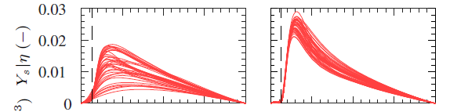


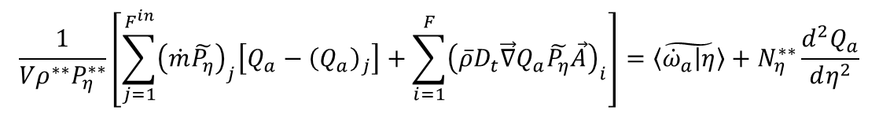
Extension to a network approach
Conditional soot related quantities show strong spatial dependence
Cover the combustor with many interconnected ISRs → ISRN
CFD
1st order
modelling
inlets (advection)
turbulent flux
source
micro-mixing
$$\frac{1}{{Vρ}^{∗∗}P_{η}^{∗∗}}\left[\sum_{j=1}^{F^{in}}{{\left(\dot{m}\tilde{P_{η}}\right)}_{j}\left[Q_{a}−{\left(Q_{a}\right)}_{j}\right]+\sum_{i=1}^{F}{{\left(\overline{ρ}D_{t}\vec{∇}Q_{a}\tilde{P_{η}}\vec{A}\right)}_{i}}}\right]=\tilde{\left\langle {\dot{ω}}_{a} | η\right\rangle }+N_{η}^{∗∗}\frac{d^{2}Q_{a}}{dη^{2}}$$
ISRN equation:
Point 1
Point 2
Example of predicted soot conditional quantities
(Cambridge RQL burner, C₂H₄, two-equation soot model)

Slide 6
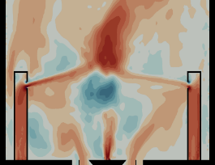
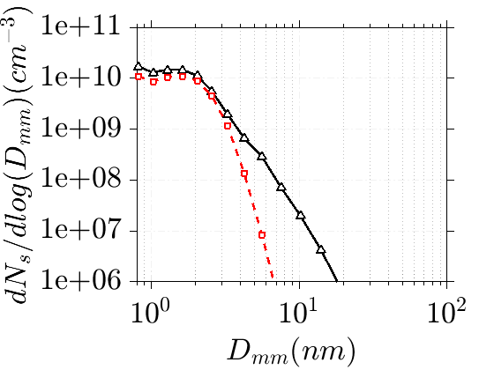


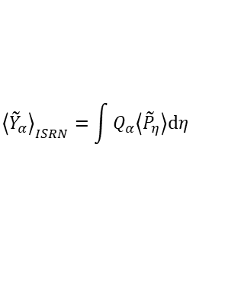





ISRN solution strategy
CFD input
Averaging
_{Decoupled flow & ISRN}
ISRN solver
$$u_{x} (m/s)$$
Find ISRN quantities
$$…=\tilde{\left\langle {\dot{ω}}_{a} | η\right\rangle }+N_{η}^{∗∗}\frac{d^{2}Q_{a}}{dη^{2}}+…$$
$$40$$
ISR spacing
Results
$$−40$$
FDF-based data transfer
$${\left\langle {\tilde{Y}}_{α}\right\rangle }_{ISRN}=\int{Q_{α}\left\langle {\tilde{P}}_{η}\right\rangle dη}$$
ISR
$$\tilde{Y_{OH}}$$
PSD prediction at exit
$$0.065$$
LEAN
ISR
Model A
Model B
ISR
ISR
QUENCH
ISR
_{Preprocessing}
$$0$$
ISR
ISR
ISR
RICH
ISR
ISR
Example from Cambridge RQL
ISR
ISR
Various soot formation/oxidation rates

Slide 7
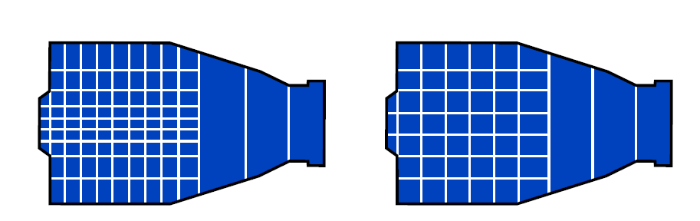
Computational cost ^{[1]}
Compare with detailed CFD with detailed chemistry: O(10⁵)-O(10⁶) CPUh
Approach | Average ISRN runtime (s) 32 CPUs |  | Total cost (CPUh)
 | Coarse | Fine | Coarse | Fine
HU-2EQN | 0.51 | 0.76 | 45.3 | 67.5
HyChem-2EQN | 4.8 | 9.1 | 427 | 809
HyChem-NAPS | 14.4 | 31.5 | 1,280 | 2,800
complexity
Coarse
Fine
Polyhedral, 78 ISRs
Polyhedral, 154 ISRs
gas
HU: Heidelberg Uni. dodecane scheme
HyChem: Jet-A1 Hybrid Chemistry
2EQN: Leung et al. two-equation model
NAPS: Napoli sectional model for C₂H₄
soot
[1] Gkantonas, S., Sirignano, M., Giusti, A., D’Anna, A., Mastorakos, E. (2020). Fuel 270, 117483.

Slide 8
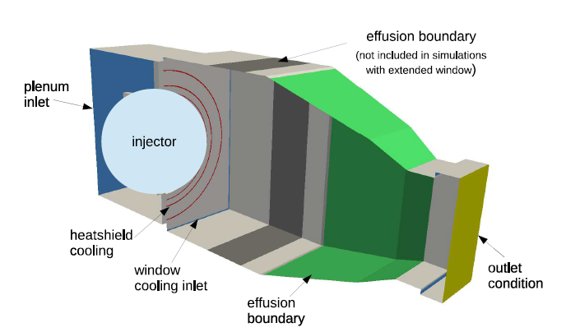
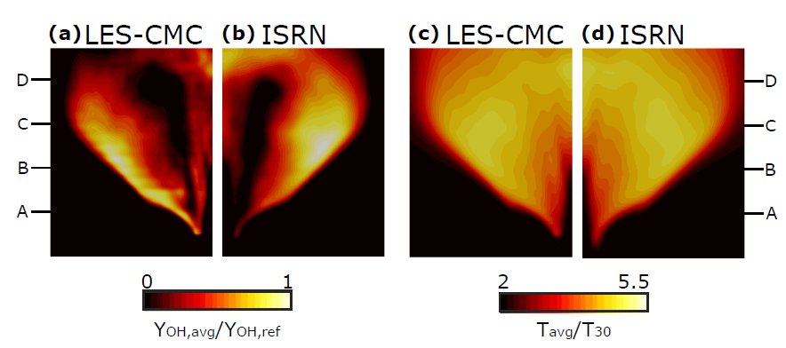
Application 1: Kerosene combustor
Big Optical Single Sector Combustor
Airblast atomisers (main+pilot)
Effusion cooling
Condition at pilot-only mode (low power)
Simulated with LES-CMC, two-equation soot model and a dodecane scheme
OH
Temperature
LES-CMC
ISRN
LES-CMC
ISRN
ISR spacing
Polyhedral, 154 ISRs
[1] Giusti, A., Mastorakos, E., Hassa, C., Heinze, J., Magens, E. and Zedda, M. (2018). J. Eng. Gas. Power 140
[2] Gkantonas, S., Foale, J. M., Giusti, A., and Mastorakos, E. (2020). J. Eng. Gas. Power (press)

Slide 9
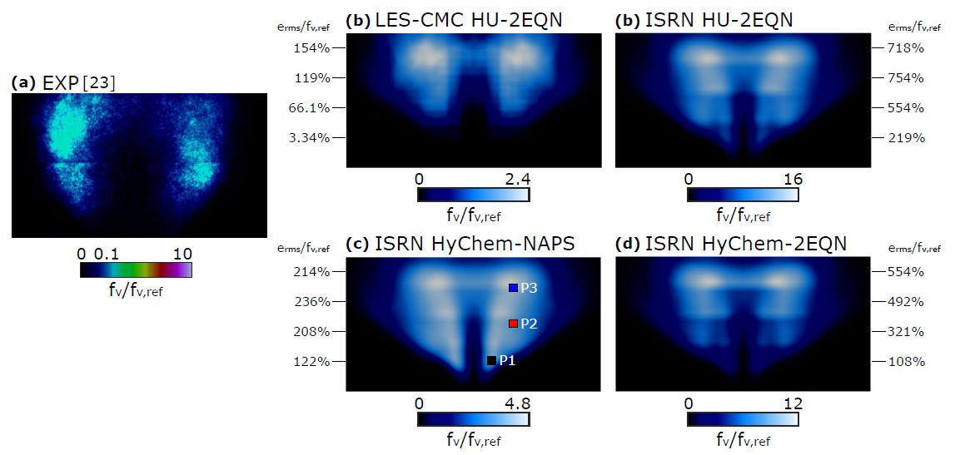
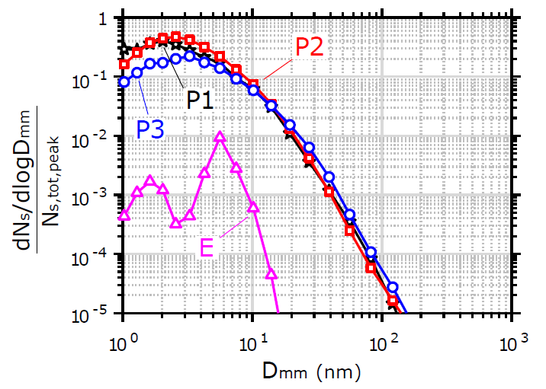
Application 1: Kerosene combustor
LES-CMC HU-2EQN
ISRN HU-2EQN
EXP ^{[1]}
ISRN HyChem-NAPS
ISRN HyChem-2EQN
ISR spacing
Polyhedral, 154 ISRs
gas
HU: Heidelberg Uni. dodecane scheme
HyChem: Jet-A1 Hybrid Chemistry
2EQN: Leung et al. two-equation model
NAPS: Napoli sectional model for C₂H₄
soot

Slide 10
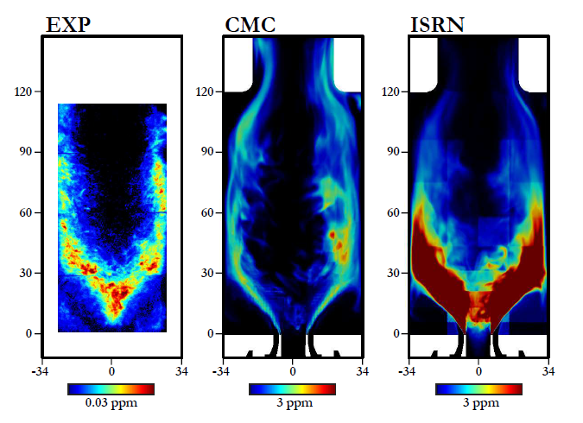
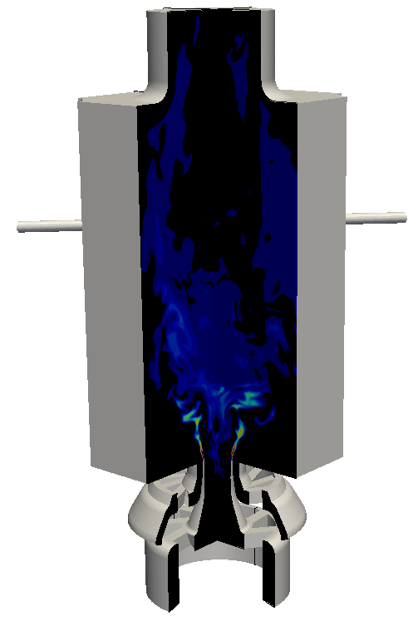
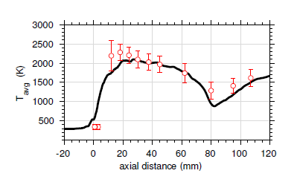
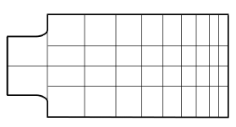
Application 2: DLR burner
EXP
LES-CMC
ISRN
0.03 ppm
3 ppm
3 ppm
C2: Aramco mechanism (ethylene)
2EQN: two-equation soot model
ISR spacing
Polyhedral, 152 ISRs

Slide 11
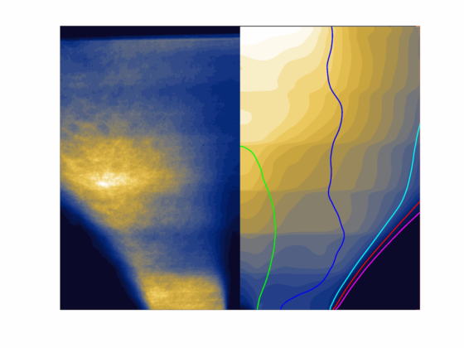
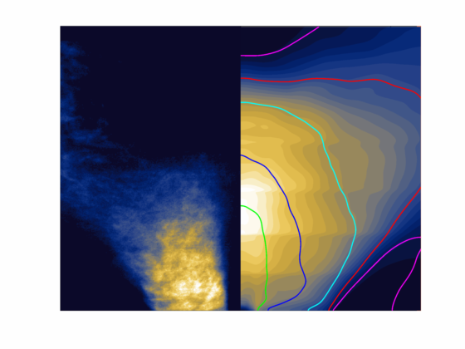
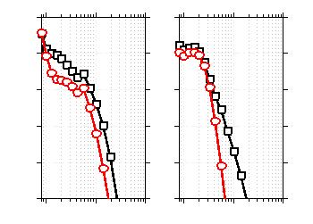
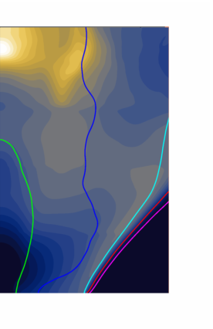
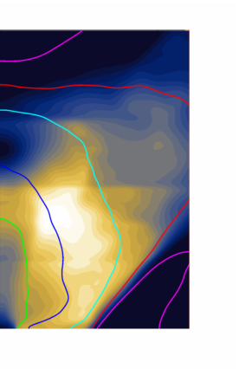
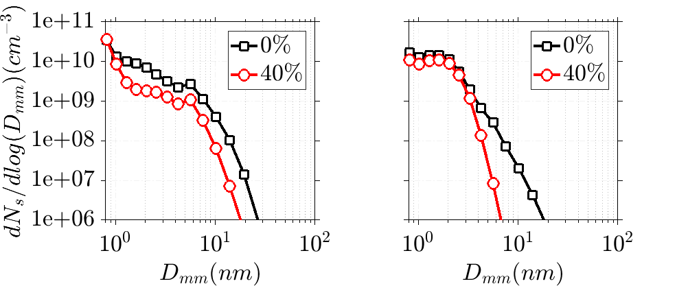










































Application 3: Cambridge RQL burner
Dilution 0%
Dilution 40%
EXP
EXP
$$\overline{LII}$$
$$50$$
$$1$$
Burner-out
LES-CMC
ISRN
$$h(mm)$$
$$25$$
$${10}^{12}$$
$${10}^{11}$$
$$0$$
$$IRZ$$
$$IRZ$$
$$0$$
$${10}^{10}$$
$${dN}_{s }/dlog(D)(cm^{−3})$$
$$\overline{f_{v}} (ppb)$$
LES-CMC
ISRN
LES-CMC
ISRN
$$IRZ$$
$${10}^{9}$$
$$\overline{f_{v}} (ppb)$$
$$100$$
$$50$$
$$ORZ$$
$$ORZ$$
$$40$$
$${10}^{8}$$
$$0\%$$
$$40\%$$
$$h(mm)$$
$${10}^{7}$$
$$1$$
$$10$$
$$1$$
$$10$$
$$100$$
$$25$$
$$100$$
$$D (nm)$$
$$D (nm)$$
$$0$$
$$0$$
$$0$$
$$−30$$
$$0$$
$$30$$
$$−30$$
$$0$$
$$30$$
$$w(mm)$$
$$w(mm)$$
ISR spacing
NAPS: - Napoli sectional model
Polyhedral, 32 ISRs
- C₂H₄ oxidation chemistry

Slide 12
Closure
Summary
Novel post-process approach for CFD
Simple, inexpensive and easily coupled with comprehensive soot models
Assessed and validated with detailed CFD of various combustors
Future steps
Parametric analyses and optimum solution strategy
More chemical mechanisms, soot models, more burners
Transient phenomena and multi-mode combustion

Slide 13
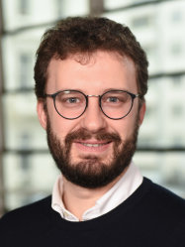




Contributors
Thank you!
Dr Andrea Giusti
Prof. Epaminondas Mastorakos
Acknowledgements
Dr Mariano Sirignano & Prof. Andrea D’Anna
(University of Naples)
Miss Jenna M. Foale (Cambridge)
Prof. Hai Wang (Stanford), Prof. Fokion Egolfopoulos (USC)

