Slide 1

Large eddy simulation of acoustic-hydrodynamic interaction for a bluff body burner under iso-thermal conditions
Jialin Su, Dong Yang, Aimee S. Morgans
Department of Mechanical Engineering
Email: j.su@lboro.ac.uk
J. Su et al
Imperial College London
16/09/2020

Slide 2
Objectives
Validate theoretical model (overall acoustic properties of bluff-body burners)
Examine acoustic-hydrodynamic interactions in terms of large scale structures
Examine turbulence variation under acoustic perturbations
Examine transport of passive scalar under periodic perturbations
J. Su et al
Imperial College London
16/09/2020
2

Slide 3
Numerical setup
local 1D characteristic boundary condition
5 m/s
Ø 8mm
Ø 25mm
characteristic boundary condition including transverse derivatives
Ø 35mm
Ø 70mm
5 m/s
160mm
passive scalar introduced close to burner exit
360mm
Modified OpenFOAM compressible rhoPimpleFOAM solver
Acoustic boundary conditions: Inviscid characteristic boundary condition including transverse derivatives
Yoo and Im, in Combustion Theory and Modelling, 2007
Su et al., in Proceedings of ASME Turbo Expo, 2015
LES with WALE model on ~36 million cell grid (>85% of turbulence resolved)
Additional transport equation for passive scalar with laminar and turbulent Schmidt number equal to 0.7
J. Su et al
Imperial College London
16/09/2020
3

Slide 4
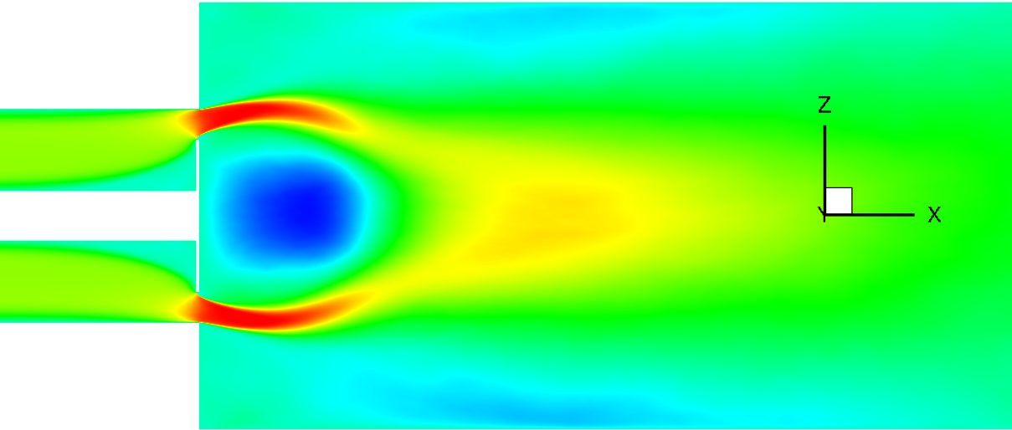
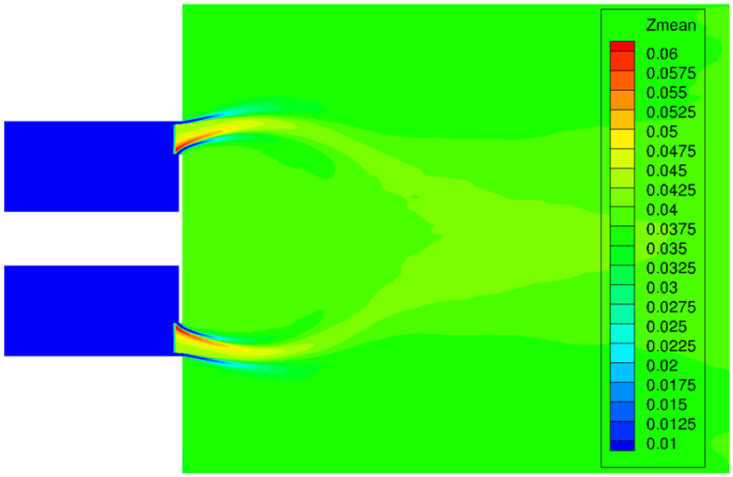
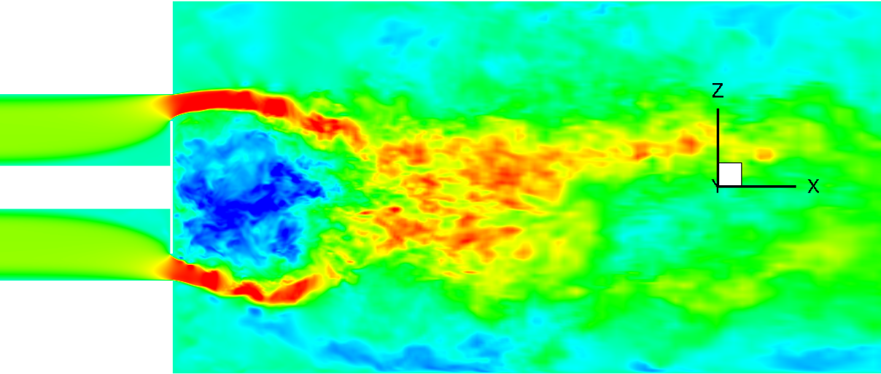
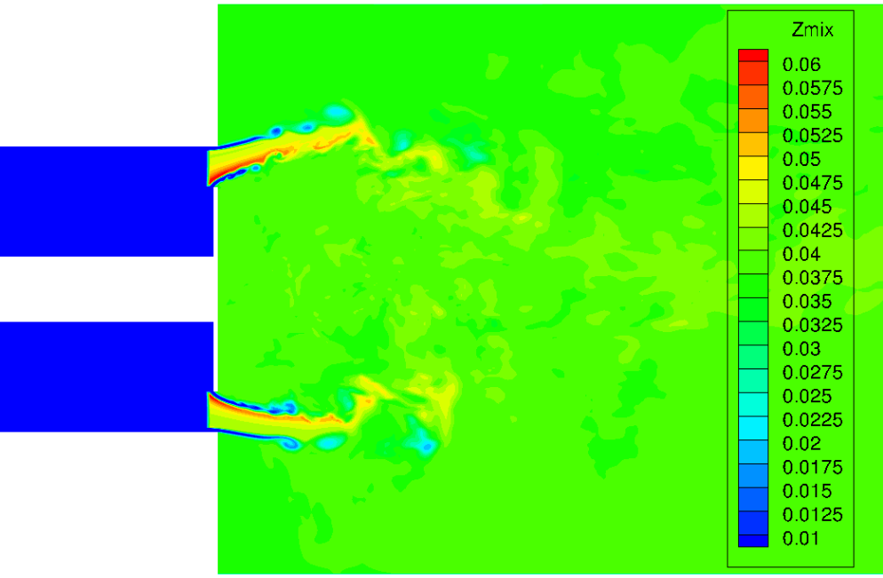
Unperturbed flow
time-averaged
passive scalar
instantaneous
J. Su et al
Imperial College London
16/09/2020
4

Slide 5
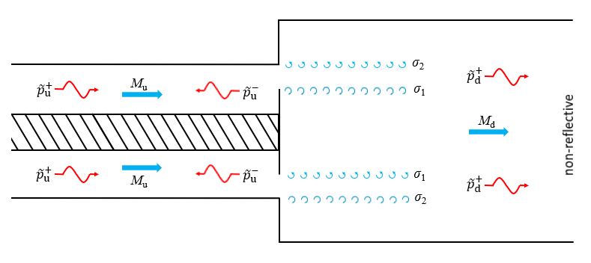

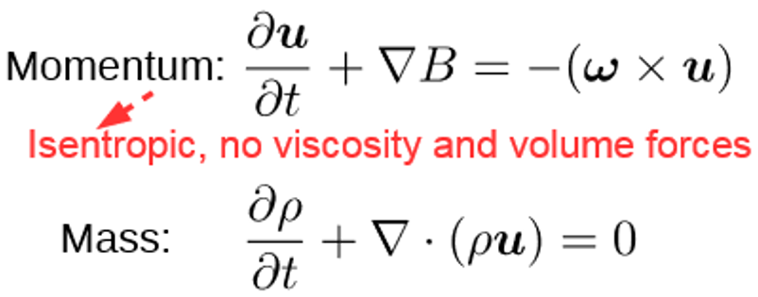
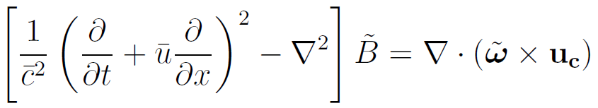
Theoretical model for acoustic-hydrodynamic interaction
J. Su, D. Yang and A. S. Morgans, submitted to Journal of Sound and Vibration, 2020
D. Yang and A. S. Morgans, in Journal of Sound and Vibration, Vol. 384, 2016
J. Su et al
Imperial College London
16/09/2020
5

Slide 6
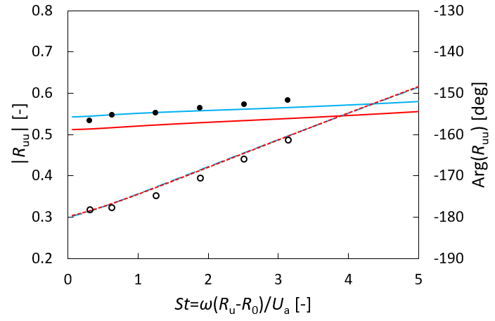
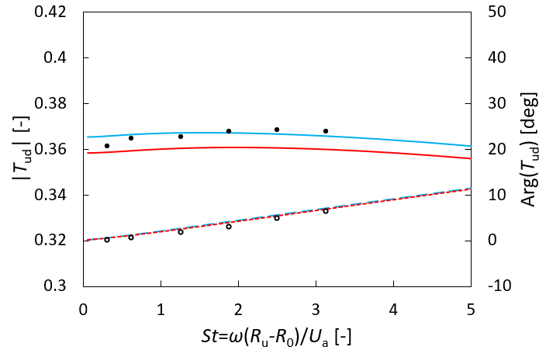


Reflection and transmission coefficients
(with respect to upstream incident wave)
$R_{uu}={\hat{p}}_{u}^{−}/$ ${\hat{p}}_{u}^{+}$
$T_{ud}={\hat{p}}_{d}^{+}/$ ${\hat{p}}_{u}^{+}$
Amplitude
Present model: u_{c} = 6.7m/s
Present model: u_{c} = 10m/s
CFD
Phase
Present model: u_{c} = 6.7m/s
Present model: u_{c} = 10m/s
CFD
J. Su et al
Imperial College London
16/09/2020
6

Slide 7
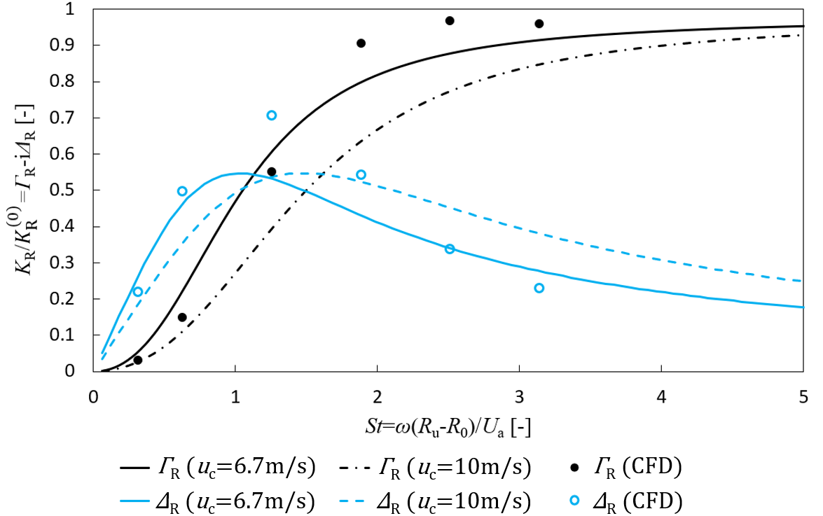
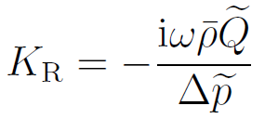
Rayleigh conductivity
J. Su et al
Imperial College London
16/09/2020
7

Slide 8
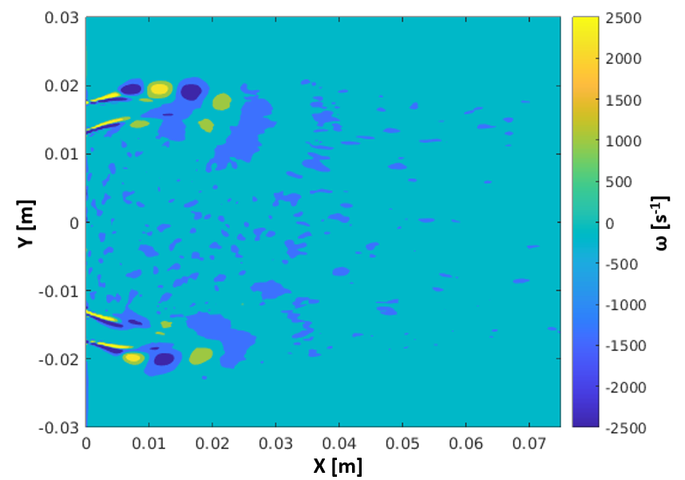
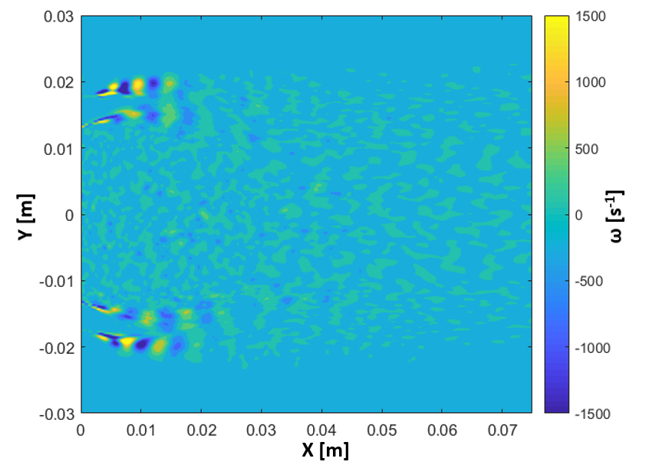
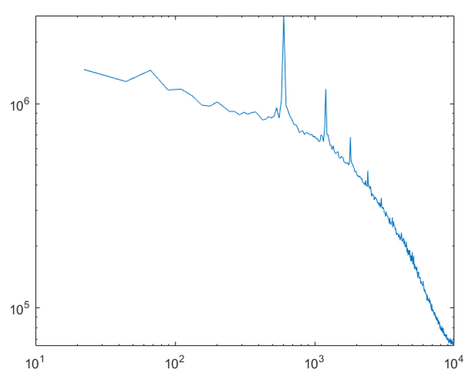
Forced simulation at 600Hz
(DMD of azimuthal vorticity)
Fundamental mode
Second harmonic
Frequency [Hz]
Real part of DMD mode of 600Hz
Real part of DMD mode of 1200Hz
Spectrum of L2-norm
J. Su et al
Imperial College London
16/09/2020
8

Slide 9
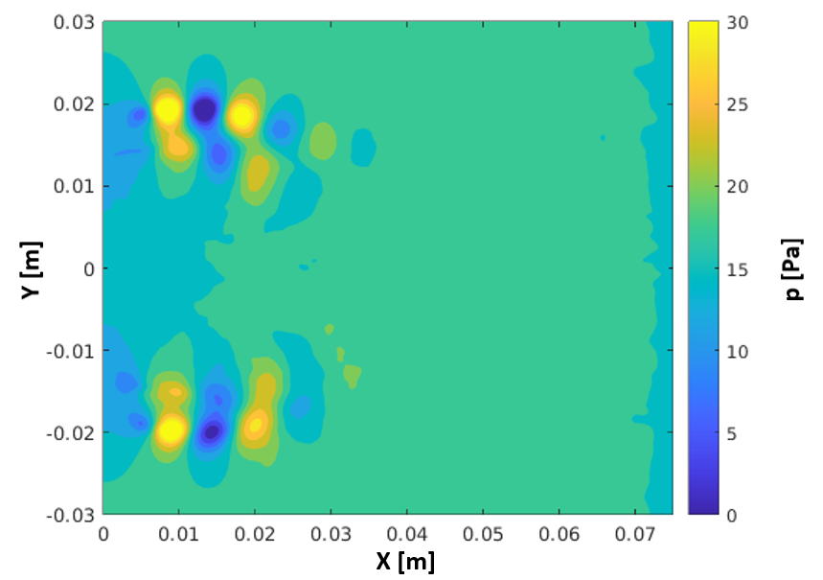
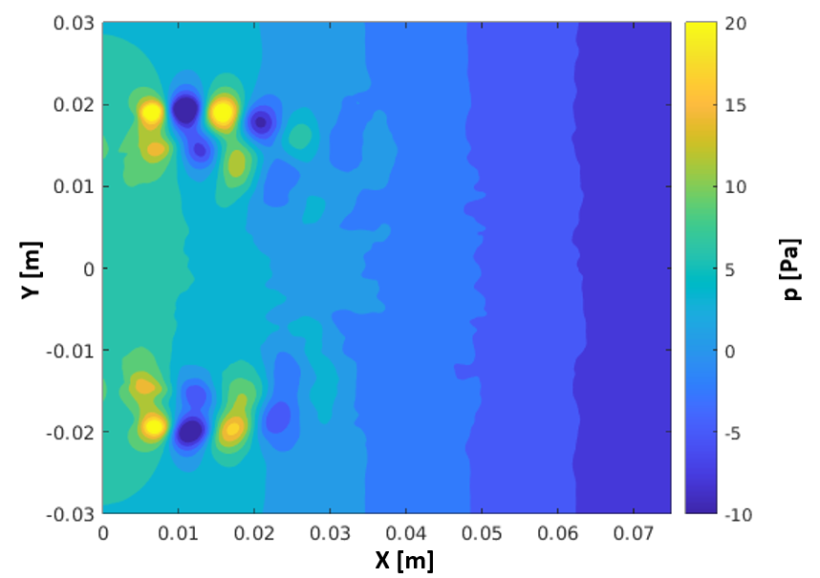
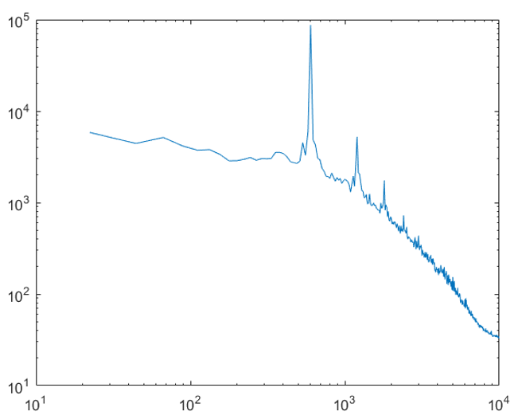
Forced simulation at 600Hz
(DMD of pressure)
Real part
Imaginary part
Frequency [Hz]
DMD mode of 600Hz
Spectrum of L2-norm
J. Su et al
Imperial College London
16/09/2020
9

Slide 10
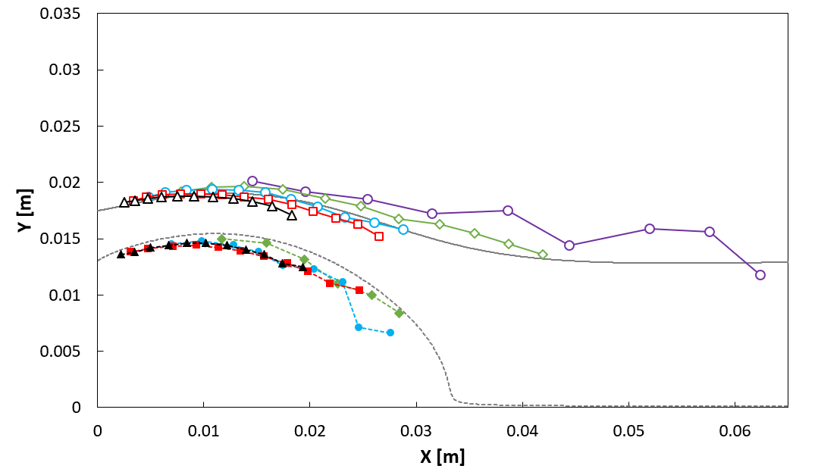
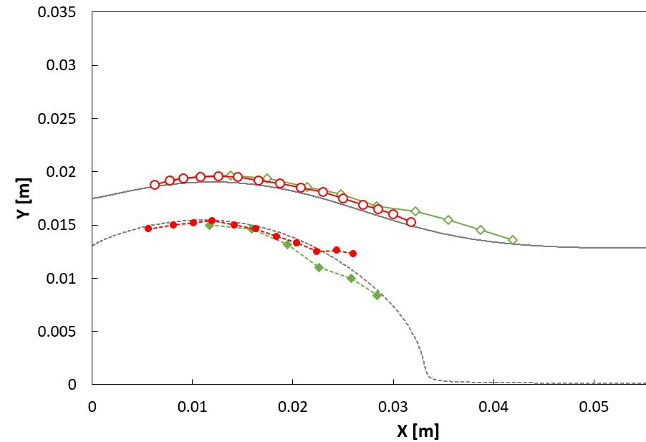


Path of unsteady vortex convection derived from pressure DMD mode
Forced simulation at 400Hz
J. Su et al
Imperial College London
16/09/2020
10

Slide 11
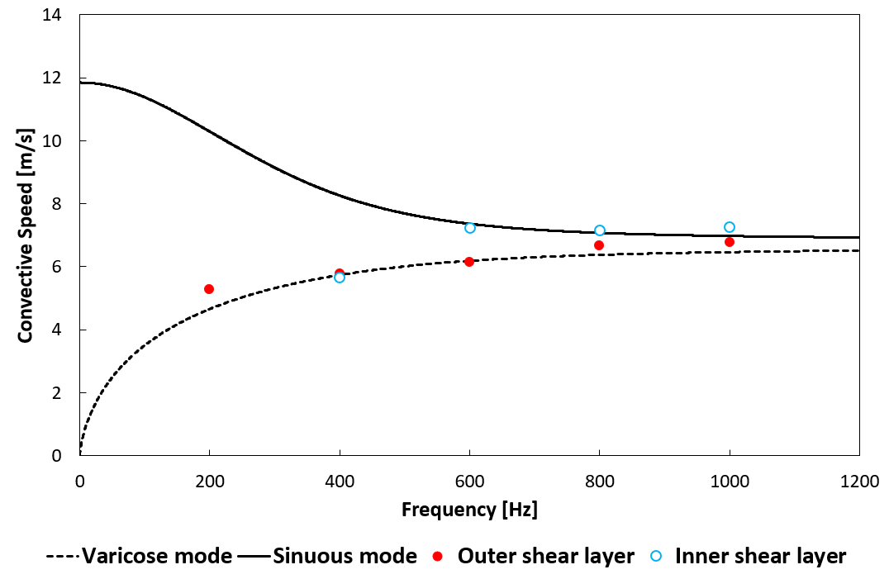
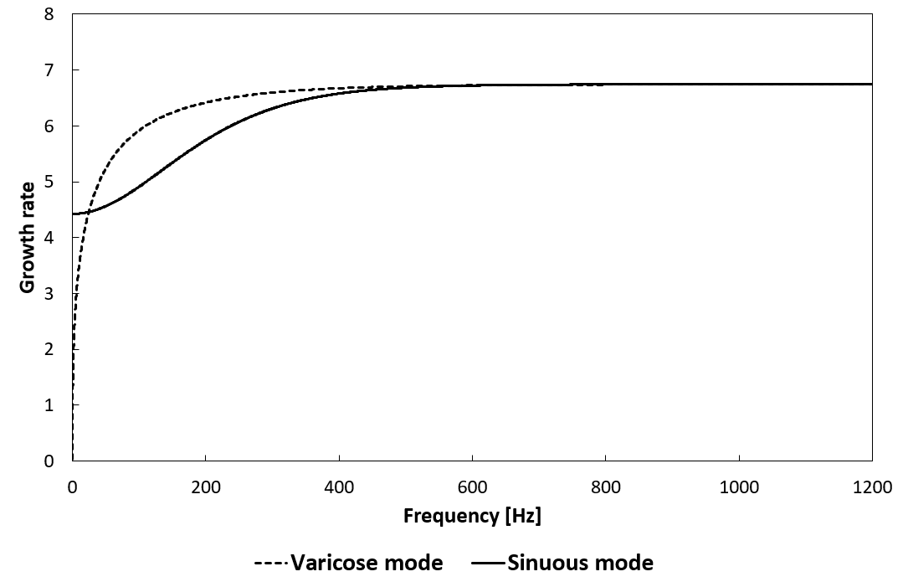
Linear stability analysis of an infinitely long confined annular sheet
sinuous mode
varicose mode
ω_{r}/k
ω_{i}/k
J. Su et al
Imperial College London
16/09/2020
11

Slide 12
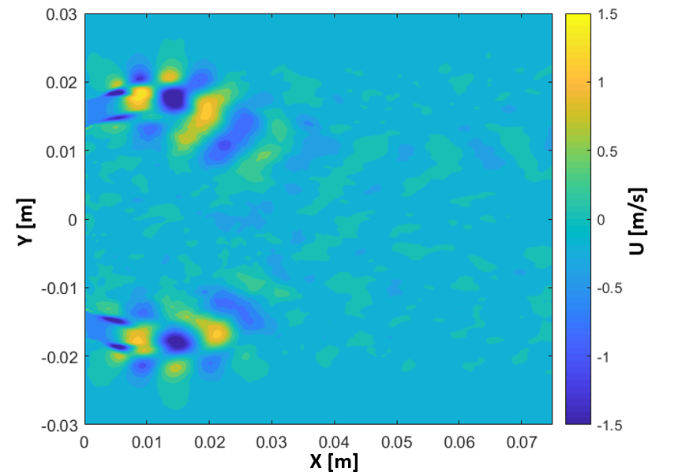
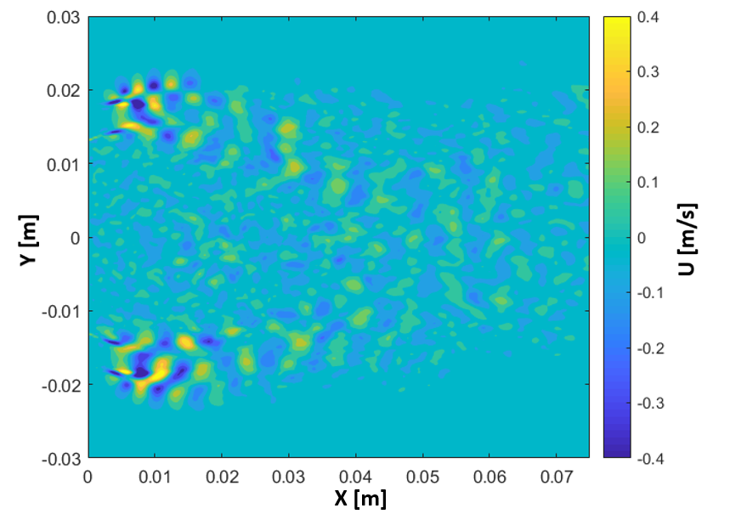
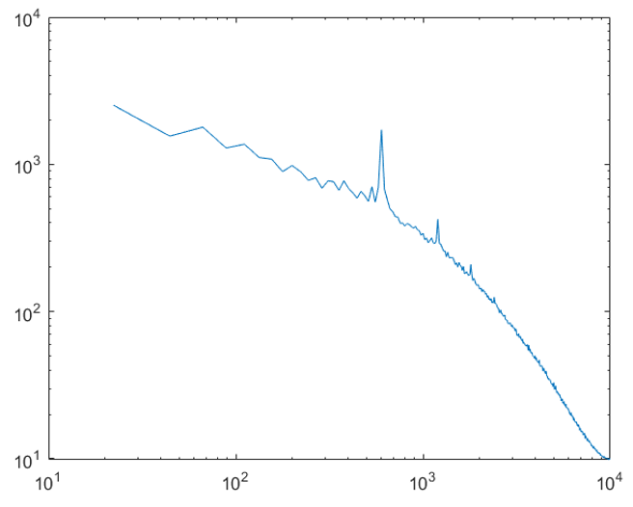
Forced simulation at 600Hz
(DMD of axial velocity)
Fundamental mode
Second harmonic
Frequency [Hz]
Real part of DMD mode of 600Hz
Real part of DMD mode of 1200Hz
Spectrum of L2-norm
J. Su et al
Imperial College London
16/09/2020
12

Slide 13
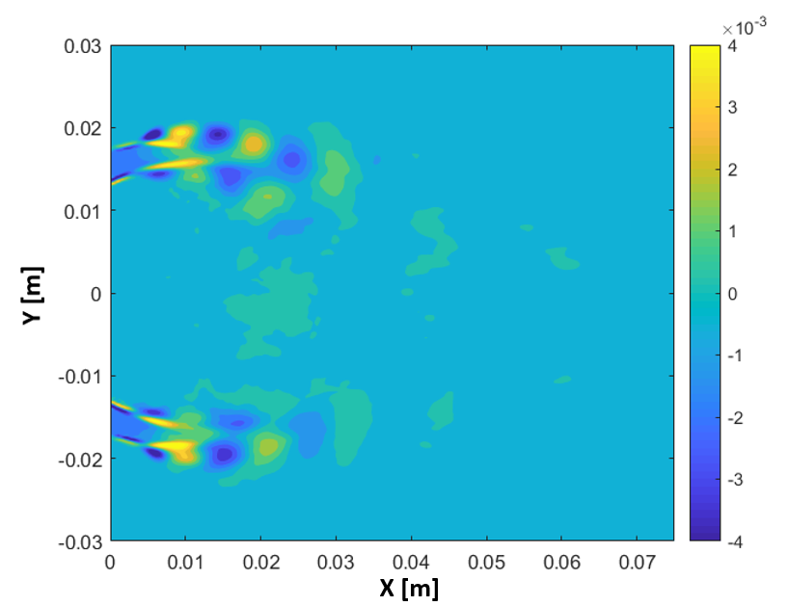
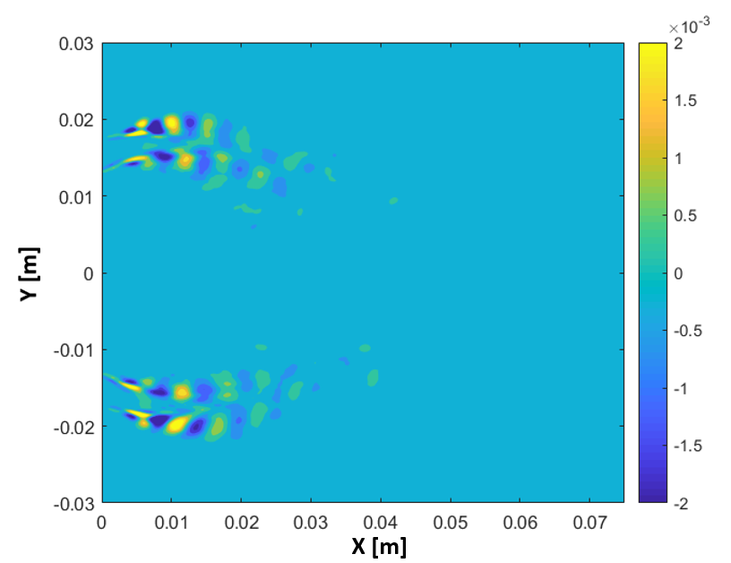
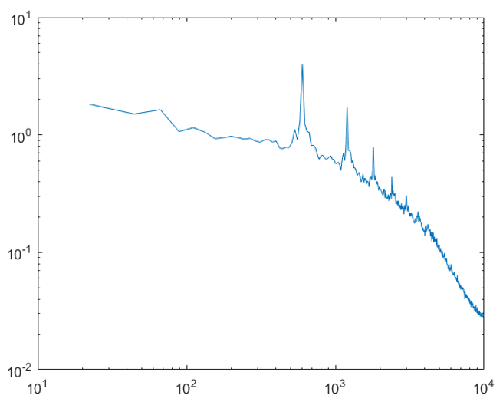
Forced simulation at 600Hz
(DMD of passive scalar)
Fundamental mode
Second harmonic
Frequency [Hz]
Real part of DMD mode of 600Hz
Real part of DMD mode of 1200Hz
Spectrum of L2-norm
J. Su et al
Imperial College London
16/09/2020
13

Slide 14
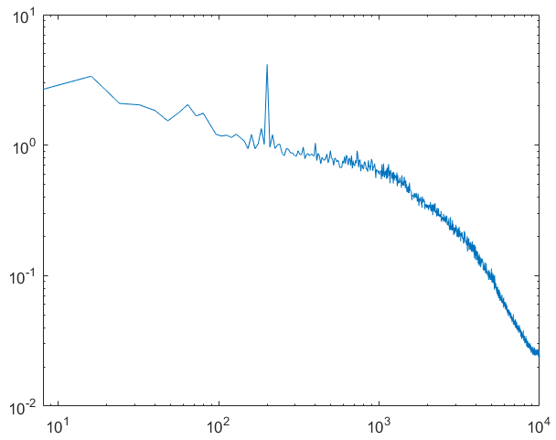
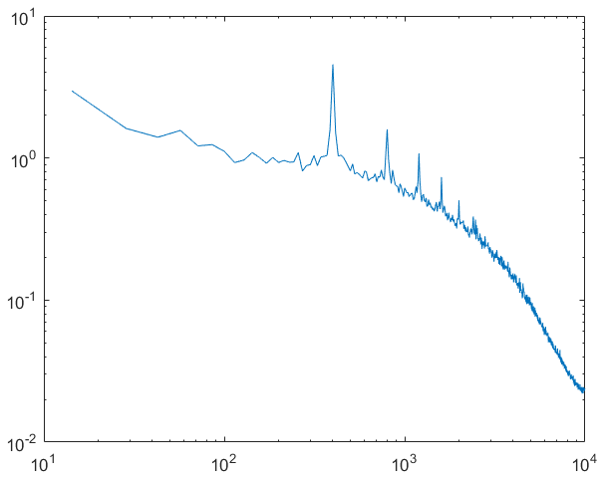
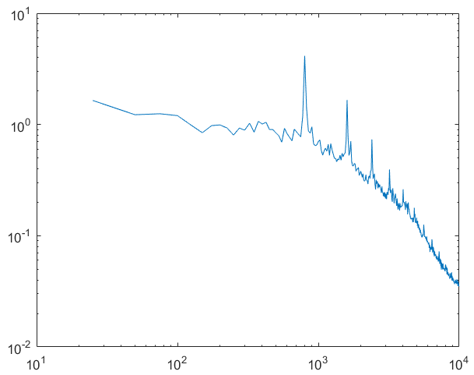
Spectrum of passive scalar DMD mode at different forcing frequencies
200Hz
400Hz
800Hz
Frequency [Hz]
Frequency [Hz]
Frequency [Hz]
Nonlinear term in transport of passive scalar: $u^{′}∙∇Z^{′}$
J. Su et al
Imperial College London
16/09/2020
14

Slide 15
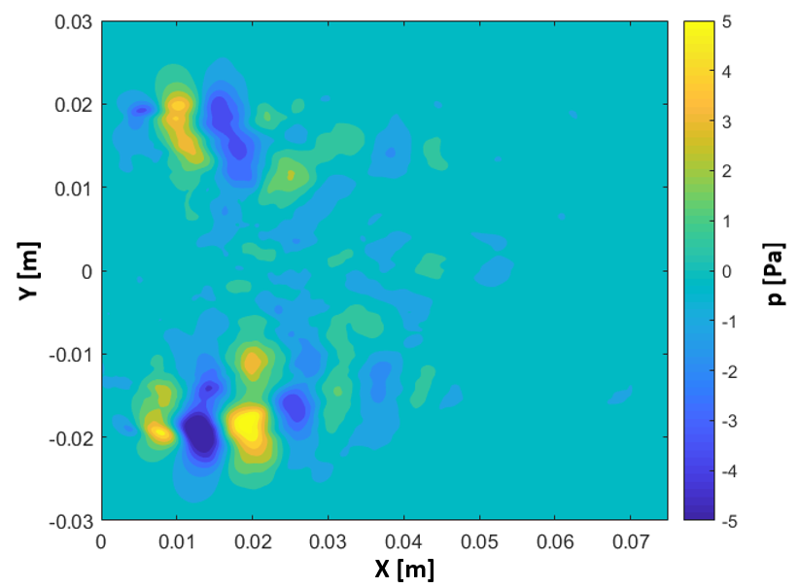
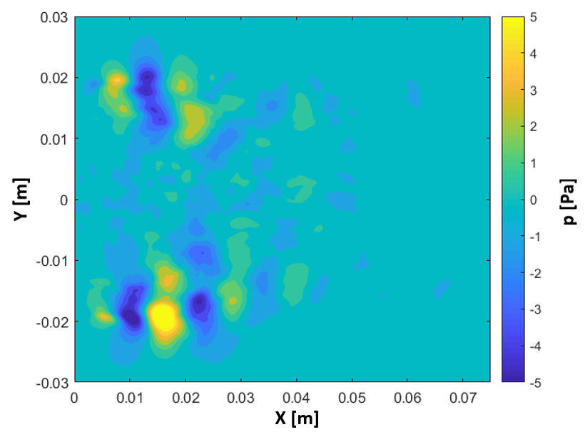
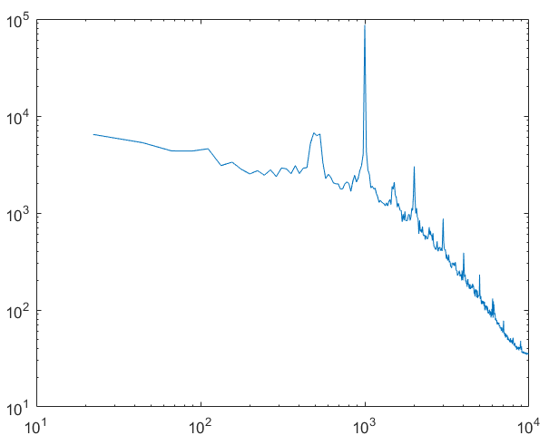
Forced simulation at 1000Hz
(DMD of pressure)
Real part
Imaginary part
Y [m]
Frequency [Hz]
DMD mode of 511Hz
Spectrum of L2-norm
J. Su et al
Imperial College London
16/09/2020
15

Slide 16
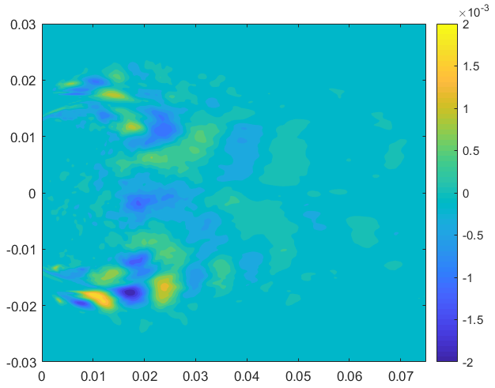
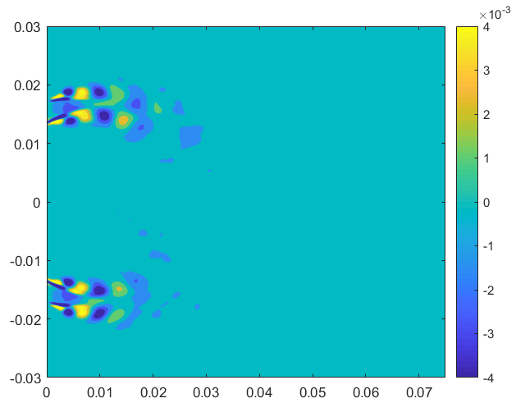
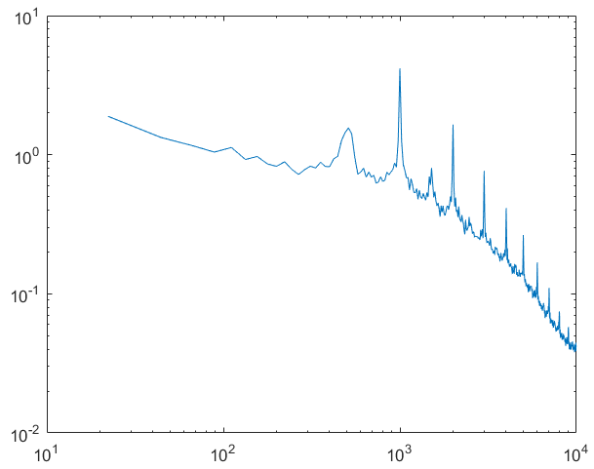
Forced simulation at 1000Hz
(DMD of passive scalar)
‘Sub-harmonic’ mode
Fundamental mode
Y [m]
Y [m]
Frequency [Hz]
X [m]
X [m]
Real part of DMD mode of 511Hz
Real part of DMD mode of 1000Hz
Spectrum of L2-norm
J. Su et al
Imperial College London
16/09/2020
16

Slide 17
Further analysis
Solution of linearised Navier-Stokes equation augmented with frozen eddy viscosity
Triadic interaction between fluctuations in velocity and passive scalar
Variation of PDFs of the velocity and passive scalar
Relation between the variation of turbulent quantities (e.g. eddy viscosity and passive scalar variance) with the variation of the invariants of velocity strain tensor
J. Su et al
Imperial College London
16/09/2020
17

Slide 18
Simulating the acoustic response of the flame in a swirl combustor
D. Yang et al
Imperial College London
16/09/2020

Slide 19
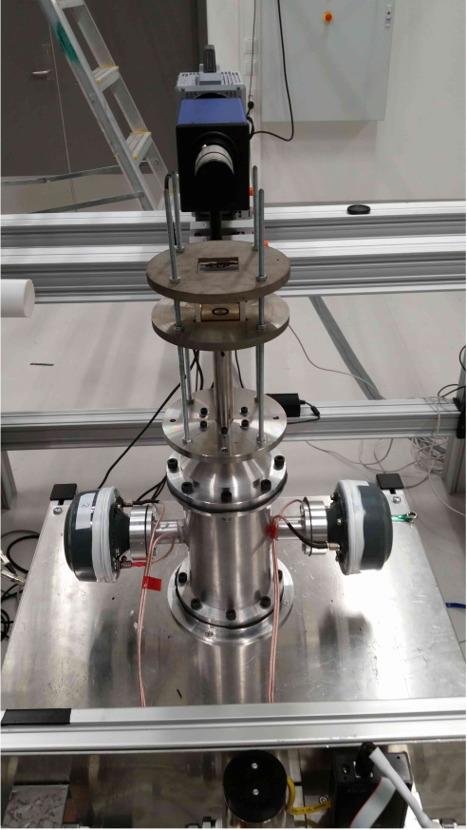
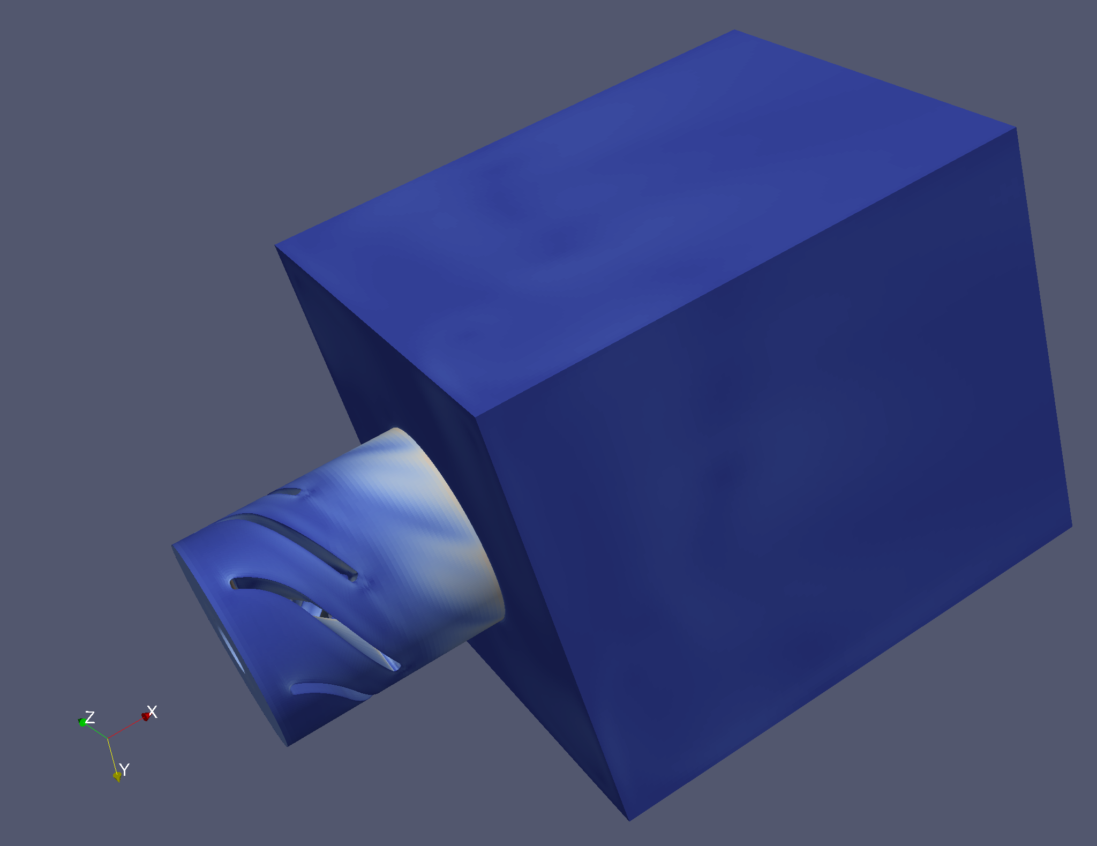

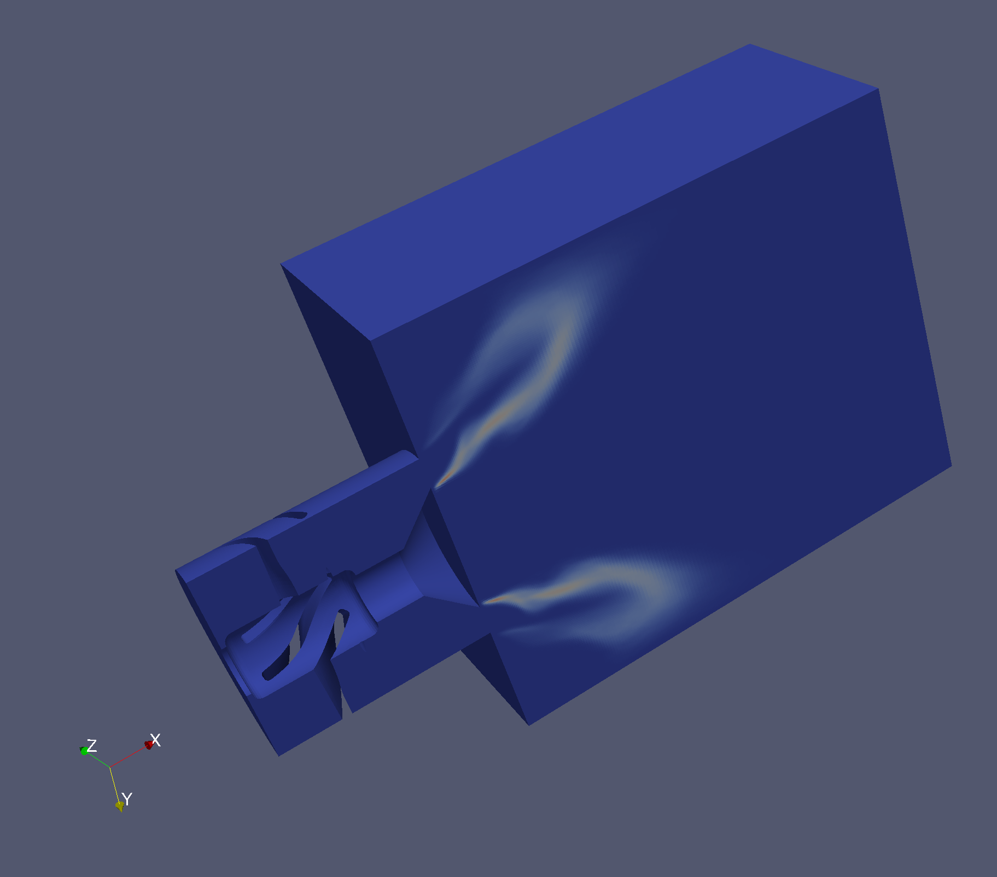
Experiment from NTNU
CFD from Imperial
Solver: Incompressible OpenFOAM-LES
Chemistry: 2-step C₂H₄/air reaction scheme
Combustion model: Partially-Stirred Reactor (PaSR)
Turbulence model: Constant Smagorinsky
~9M mesh cells
Adiabatic, or wall temperature (can be measured only outside)
T1 increases linearly to T2
Td
Bluff body
Swirler
6-blade
D=19mm
C₂H₄/air premixed (𝜙=1)
u=12 m/s, Re~15,000, Ti=300K
J. Su et al
Imperial College London
19
D. Yang et al
Imperial College London
16/09/2020
16/09/2020
19

Slide 20
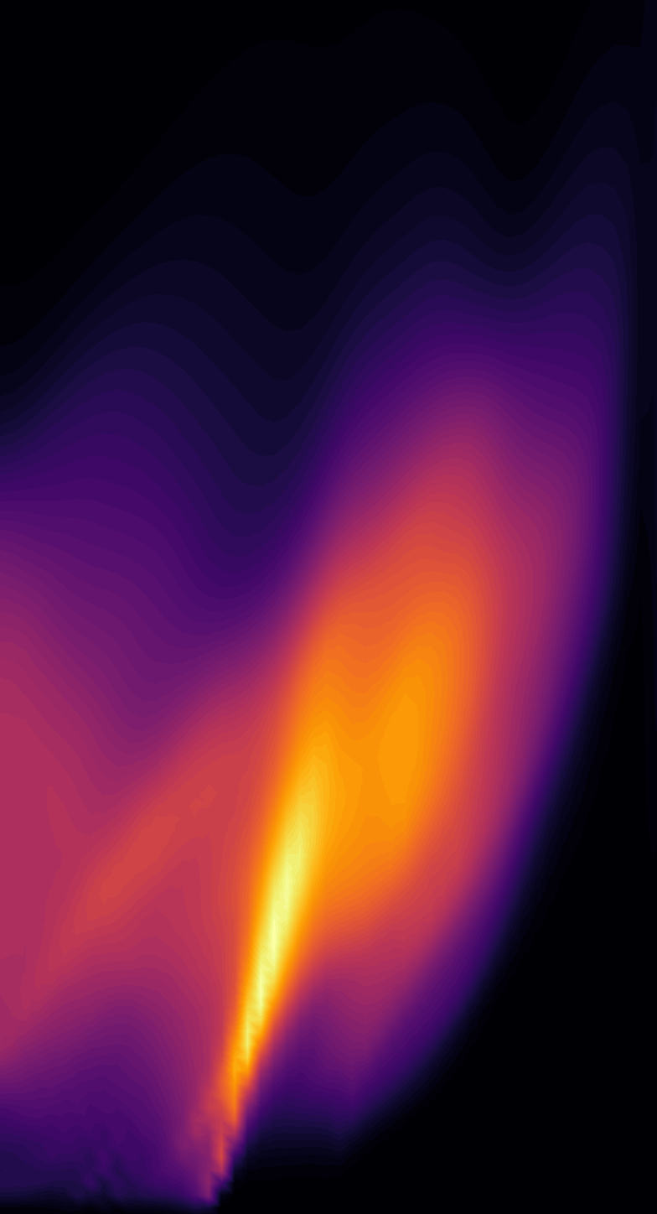
 | Ti (K) | Td (K) | T1 (K) | T2 (K)
Case A | 300 | 500 | 500 | 1500
A thermal boundary condition based on experimental observations
The mean flame shape
(from a line-of-sight integration)
Exp
CFD
T1 increases linearly to T2
Td
Bluff body
Swirler
6-blade
D=19mm
Inlet: Ti=300K
J. Su et al
Imperial College London
20
D. Yang et al
Imperial College London
16/09/2020
16/09/2020
20

Slide 21
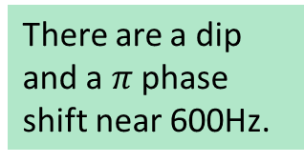
 | Ti (K) | Td (K) | T1 (K) | T2 (K)
Case A | 300 | 500 | 500 | 1500
Flame Transfer Function
The mean flame shape
(from a line-of-sight integration)
Exp
CFD
There are a dip and a $π$ phase shift near 600Hz.
Inlet: Ti
Inlet: Ti
D. Yang et al
Imperial College London
16/09/2020
21

Slide 22
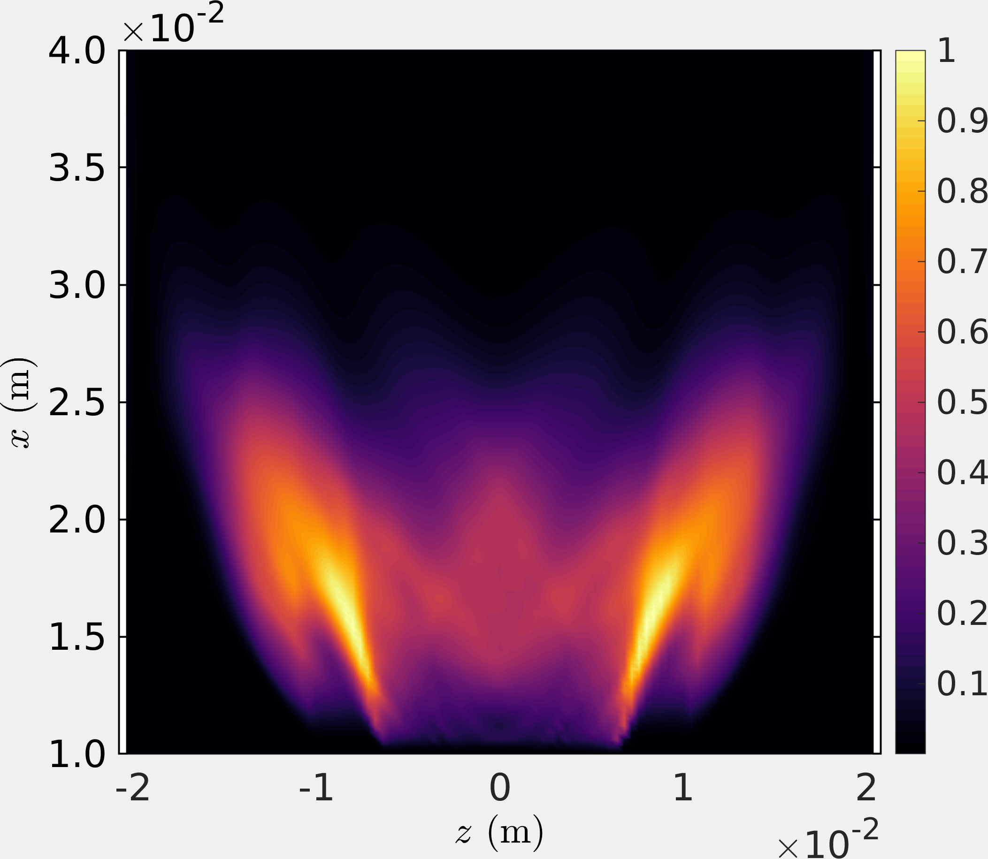
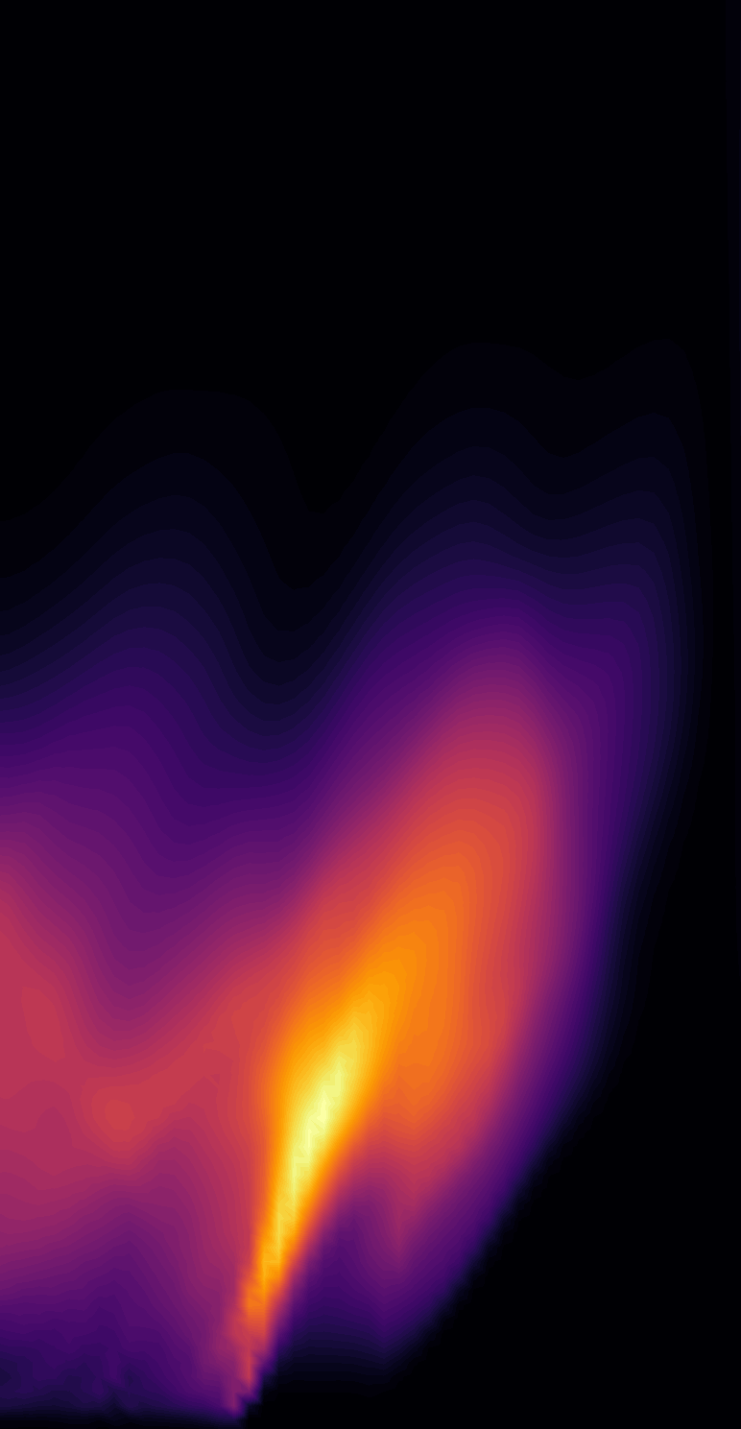
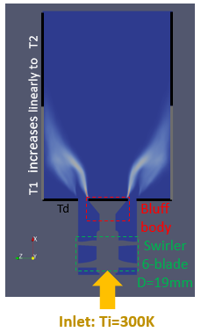
 | Ti (K) | Td (K) | T1 (K) | T2 (K)
Case A | 300 | 500 | 500 | 1500
Case B | 450 | 600 | 600 | 1500
Case C | 400 | 400 | 700 | 1700
Case D | 400 | 400 | 500 | 1500
More test simulations about the thermal boundary condition
The Mean flame shape
Exp
CFD-A
CFD-B
CFD-C
CFD-D
D. Yang et al
Imperial College London
16/09/2020
22

Slide 23
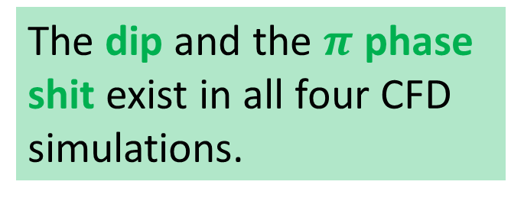
The dip and the $π$ phase shit exist in all four CFD simulations.
D. Yang et al
Imperial College London
16/09/2020
23

Slide 24
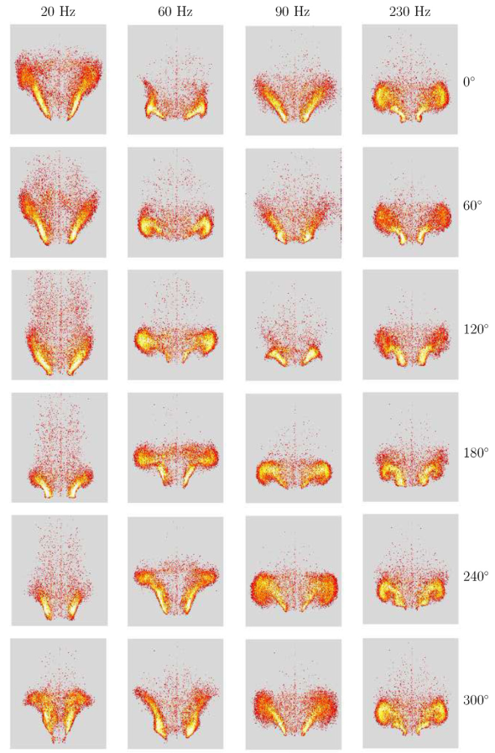
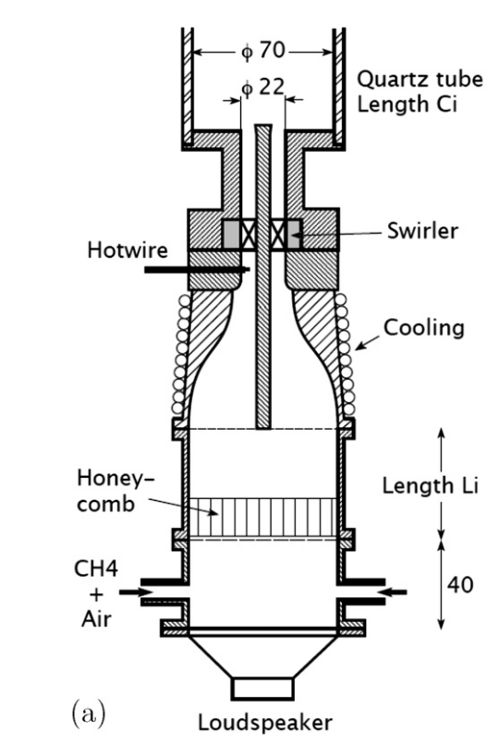
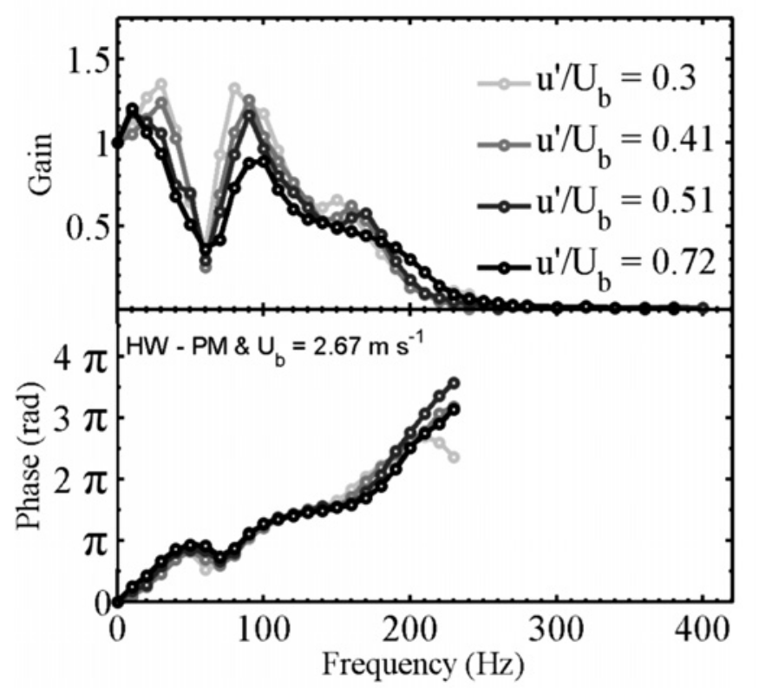
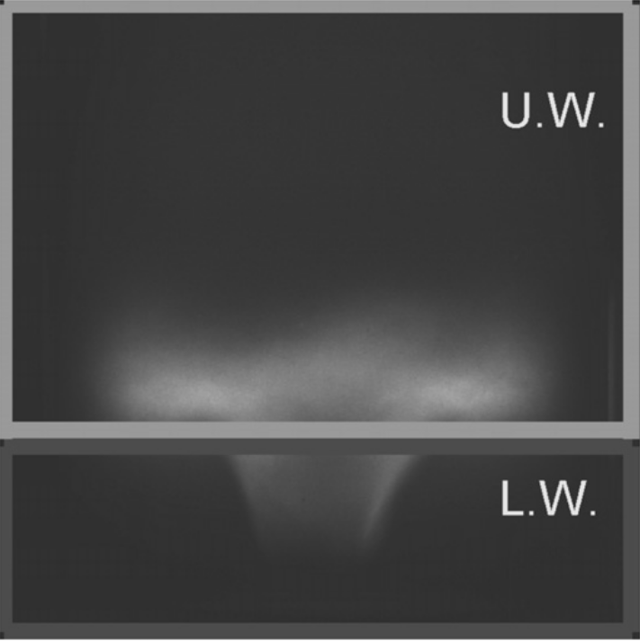
The EM2C Rig
Flame Transfer Function
60Hz
Palies et al., CNF, 2010.
Phase-averaged flame dynamics:
Cancelling effect between the lower and upper parts of the flame
D. Yang et al
Imperial College London
16/09/2020
24

Slide 25
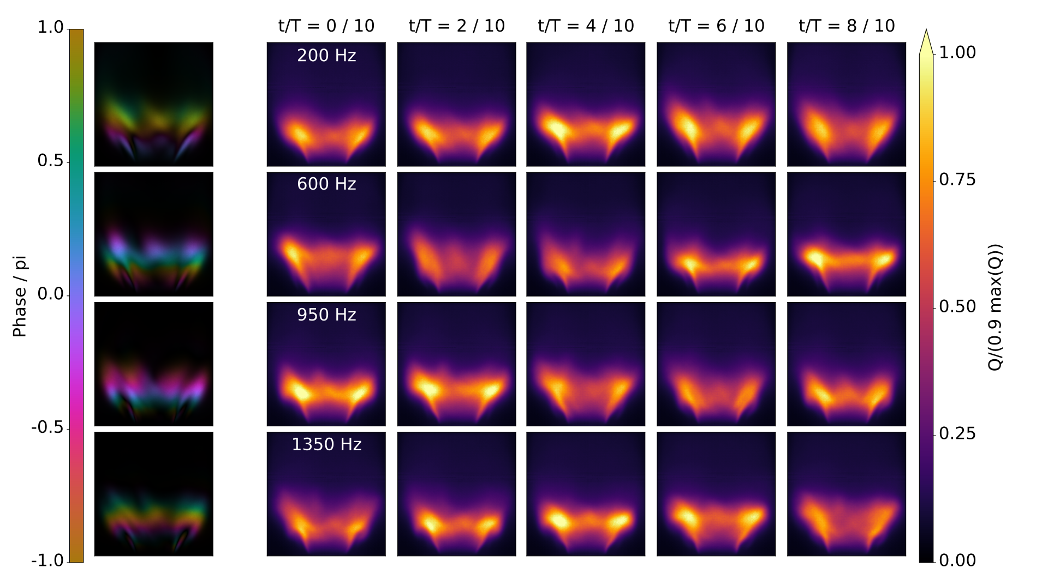
Phase-averaged flame dynamics for the present rig:
The cancelling effect is inhibited in experiment.
Further numerical exploration is needed.
D. Yang et al
Imperial College London
16/09/2020
25

Slide 26
Thank you
We would like to gratefully acknowledge the Engineering and Physical Sciences Research Council (ERSRC) grant (code EP/P003036/1) CHAMBER (2017-2019) and the ERC Consolidator Grant AFIRMATIVE (2018-2023) for supporting the current research.
Time usage on ARCHER: 14,000 kAUs
J. Su et al
Imperial College London
16/09/2020

