Slide 1
Coupling direct numerical simulation with population balance modelling for predicting turbulent particle precipitation in a T-mixer
Hin Yan TANG¹, George PAPADAKIS², Stelios RIGOPOULOS¹
¹ Department of Mechanical Engineering, Imperial College London, UK
² Department of Aeronautics, Imperial College London, UK

Slide 2
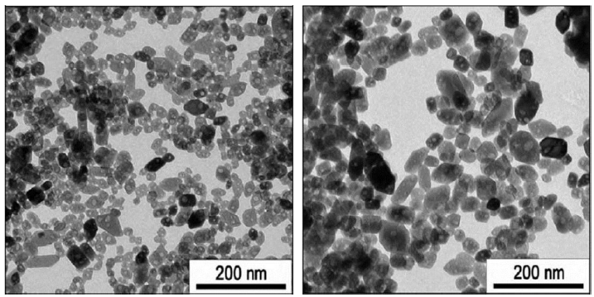
What is particle precipitation?
-A process that forms particulate product
Growth
Breakage
Mixing reactants
Supersaturated Solution
Reaction between chemical species
Phase change
Nucleation
Aggregation
The product quality usually correlates with the particle size distribution (PSD)
L.Metzger, et.al (2016)

Slide 3
Challenges
Motivation
Precipitation is highly sensitive to the local composition
Fast changing kinetics
Fast reaction-precipitation
Small precipitation time scale
PSD is changing rapidly in space and in time
Local information can hardly be captured by experiments
Numerical simulations open a door to understand the physics in turbulent precipitation
Develop a coupled DNS-PBE approach for simulating particulate process in turbulent flow

Slide 4
Coupling between DNS and Population Balance Modelling

Slide 5
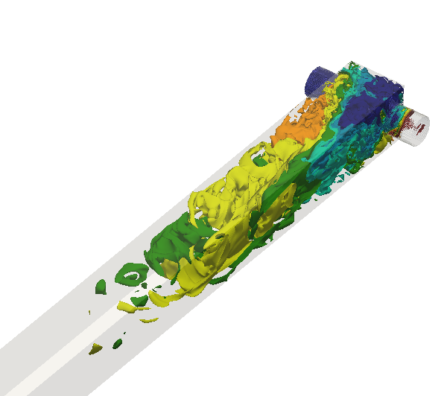
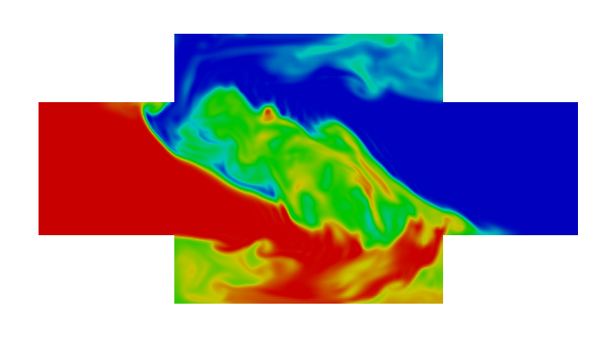
Direct numerical simulation (DNS)
$$\frac{∂u}{∂t}+u∙∇u=−∇P+υ∇^{2}u$$
N-S equations:
Transport for ions:
Fraction step
BDF3 for time advancement
Implicit diffusion and explicit convection
$$\frac{∂C_{i}}{∂t}+u∙∇C_{i}={\frac{υ}{Sc}∇}^{2}C_{i}+r_{i}$$

Slide 6
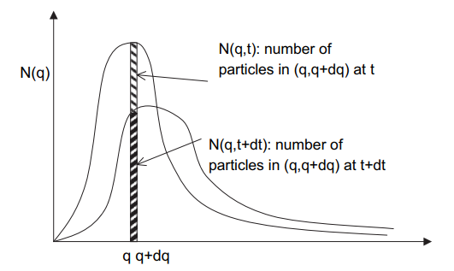
Population Balance Modelling
Evolution of Number density distribution in time
$$n_{L}\left(L\right)$$
$$n_{L}\left(L,t\right)dL$$
$(L,L+dL)$ at t
$n_{L}\left(L,t+dt\right)dL$:number of
Particle number
Discretised into intervals
Number density
General form of Population Balance Equation (PBE) for particulate processes
$(L,L+dL)$ at t+dt
$$n_{L}\left(L\right)=\frac{dN(L)}{VdL}$$
L L+dL
S. Rigopoulos (2010)
$$\frac{∂n_{L}}{∂t}+\frac{∂G∙n_{L}}{∂L}=B_{0}+B_{aggl}+B_{disr}−D_{aggl}−D_{disr}$$
N Total number of particles
$n_{L}$ Number density
L Size interval (Class)
B₀ Nucleation term
B Generation term
D Destruction term
G Growth rate
Transient term
Growth term
Nucleation term
Generation term due to aggregation
Generation term due to breakage
Destruction term due to aggregation
Destruction term due to breakage

Slide 7
Number transport
Source term
Assume particles as tracer
PBE is solved locally in each cell together with the DNS
The PBE source terms are used also in the computation of ion consumption to achieve coupling with ion transport
The flow field is captured by DNS, which can be considered as fully resolved
The only modelling terms are the growth and nucleation rates
These kinetics depends on the supersaturation (driving force) and are non-linear
$$\frac{∂n_{j}}{∂t}+u∙∇n_{j}={{\frac{υ}{Sc}∇}^{2}n_{j}+B}_{0}−\frac{∂G∙n_{j}}{∂L}$$
Convection term
Diffusion term
Nucleation
Growth
Semi-empirical relations

Slide 8
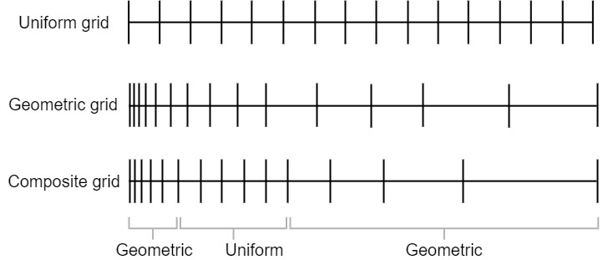
Discretisation on the Particle Size Distribution (PSD)
$$\frac{∂n(j)}{∂t}+u∙∇n(j)={{\frac{υ}{Sc}∇}^{2}n\left(j\right)+B}_{0}δ(V_{j}−V_{nuc})−\frac{∂G_{j}∙n(j)}{∂V}$$
Particle size range is discretised into 45 intervals ( j = 1 - 45 ) with a composite grid

Slide 9
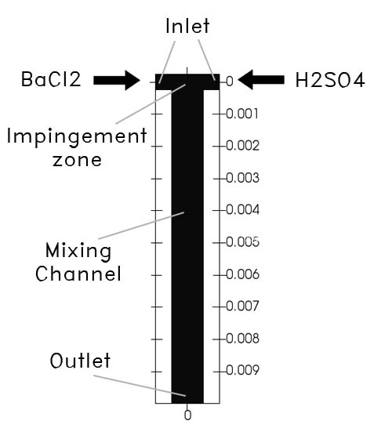
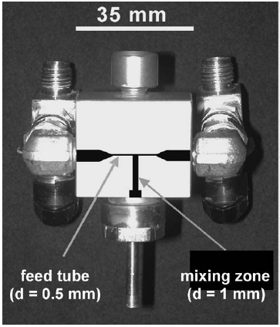
Nanoparticle precipitation in a T-mixer
Apply the coupled DNS-PBE approach to the nano-particle precipitation of BaSO₄ in a T-mixer (H.-C. Schwarzer, 2004)
What are the effects of mixing on the precipitation process ?
How the PSD is influenced by local effects ?
3D Cartesian mesh
21 million cells
Flow field is fully resolved to Kolmogorov scale
0.5M BaCl₂
0.33M H₂SO₄
H.-C. Schwarzer, et. Al (2004)

Slide 10
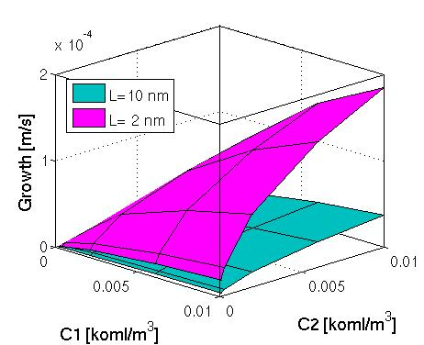
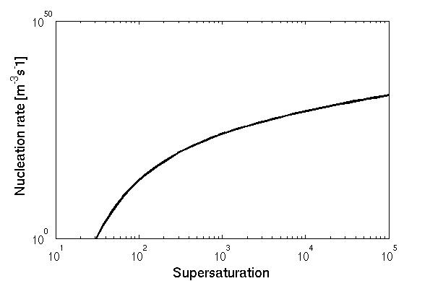
The kinetics
Homogeneous nucleation and transport-controlled growth is employed as suggested by Gradl & Peukert (2009) and is taken from the classical theory. (Mersmann, 2000)
Supersaturation
$$S=γ_{±}\sqrt{\frac{C_{Ba^{2+} }C_{SO4^{2−}}}{K_{sp}}}$$
Nucleation rate
Growth rate
$$B_{0}=1.5D{\left(\sqrt{K_{sp}}SN_{A}\right)}^{\frac{7}{3}}\sqrt{\frac{γ}{k_{B}T}}V_{m}exp\left(−\frac{16π}{3}{\left(\frac{γ}{k_{B}T}\right)}^{3}\frac{V_{m}^{2}}{{\left(υ\ln{S}\right)}^{2}}\right)$$
$$G=2\frac{Sh D_{α} \sqrt{K_{SP}}M_{w}}{ρ_{BaSO4}}\frac{S−1}{L}$$
Precipitation timescales
$$τ_{nuc}=\frac{\int{n\left(L\right)dL}}{B_{0}}$$
$$τ_{G}=\frac{k_{v}\int{L^{3}n\left(L\right)dL}}{k_{a}\int{G\left(L\right)L^{2}n\left(L\right)dL}}$$

Slide 11
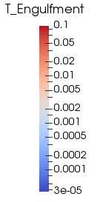
Flow field & Mixing
Re = 1135
,Turbulent at Re>400 (Telib et al., 2004)
Helical Pattern
Intense mixing at impingement zone
Fastest mixing time scale in the order of 10⁻⁵
Streamline
Micro-mixing (Engulfment) time scale
(characterizes the timescale of the most energetic vortex)
$$τ_{E}=17{\left(\frac{υ}{ε}\right)}^{\frac{1}{2}}$$

Slide 12
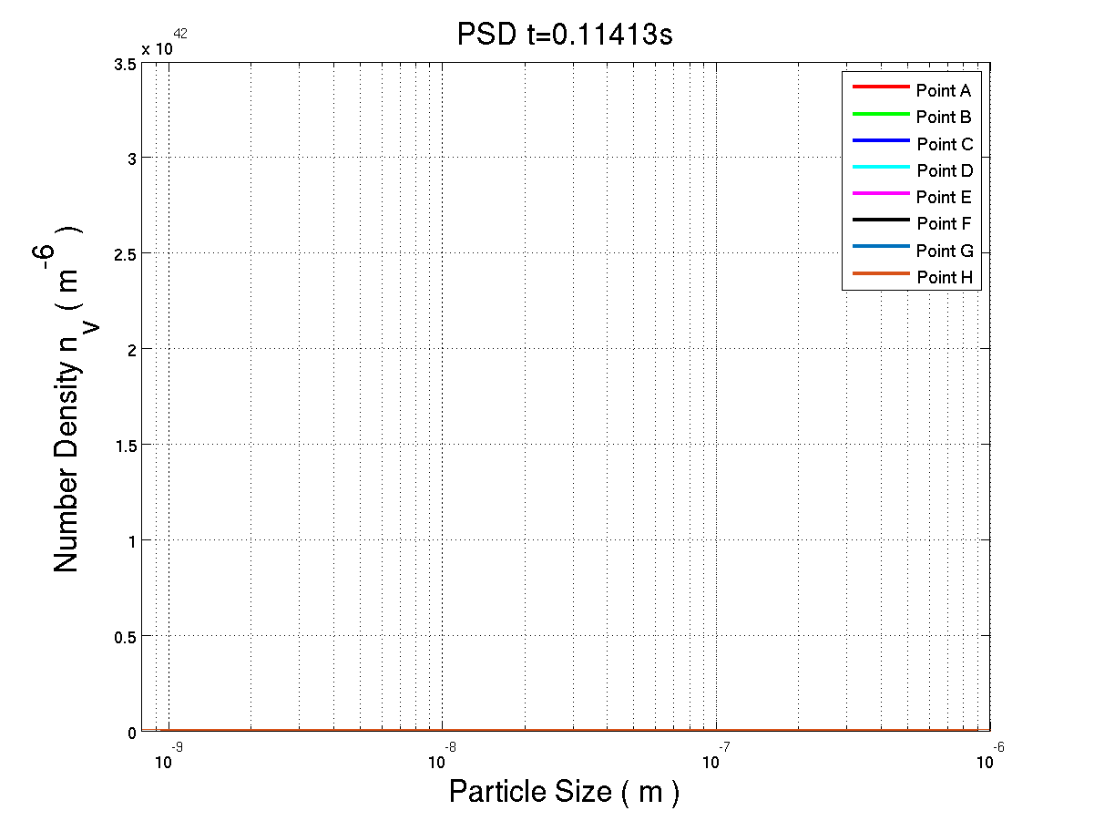
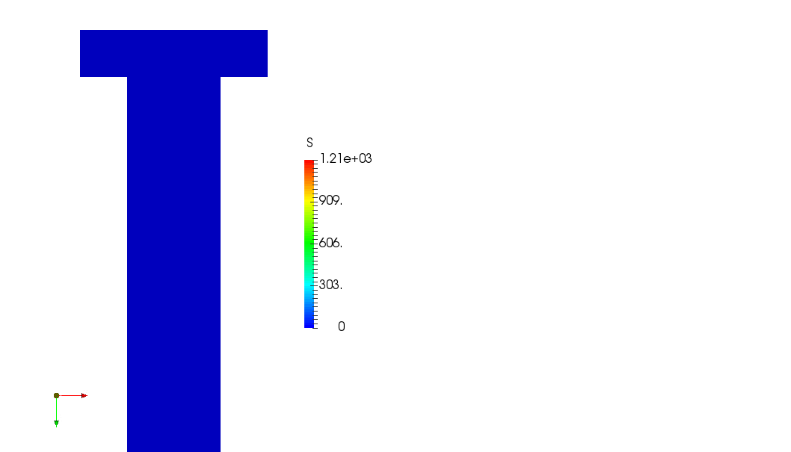
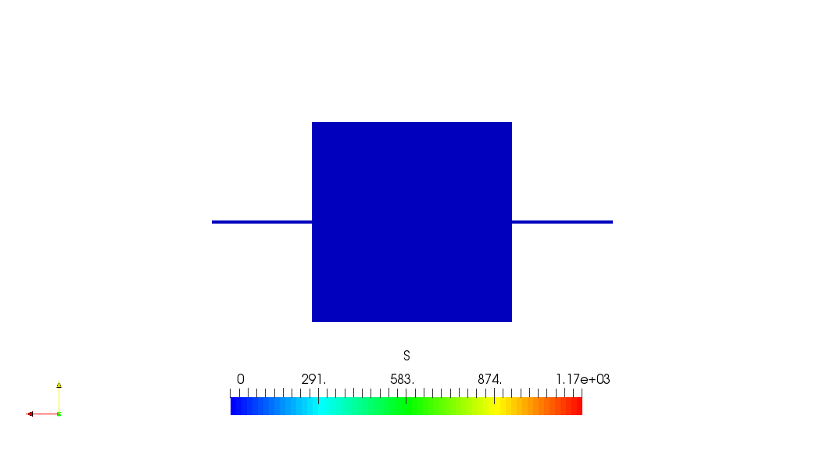
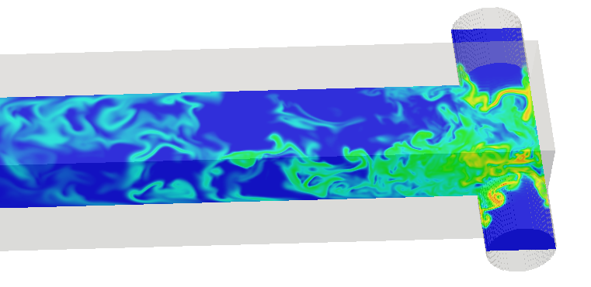
The PSD
0.5M BaCl₂
0.33M H₂SO₄
B
A
A
D
C
E
G
H
F

Slide 13
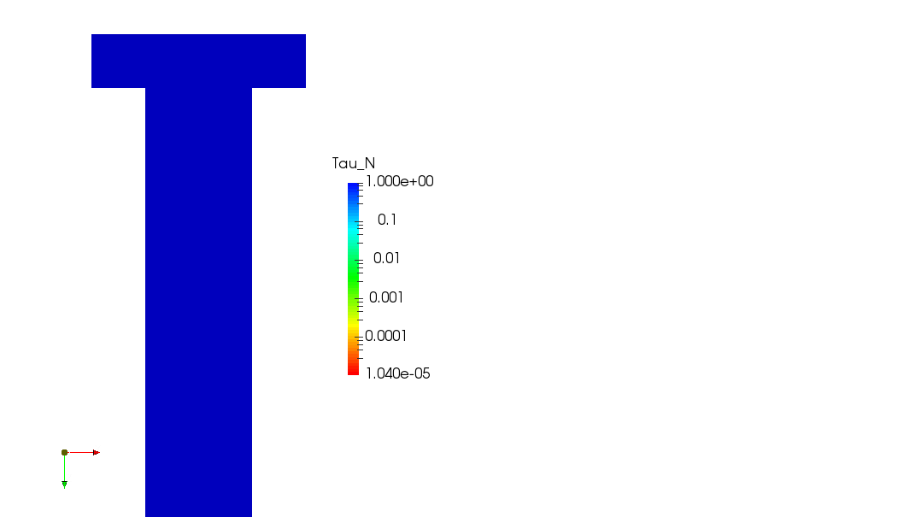
The local kinetics
Supersaturation
Nucleation timescale
Growth timescale
0.5M BaCl₂
0.33M H₂SO₄

Slide 14
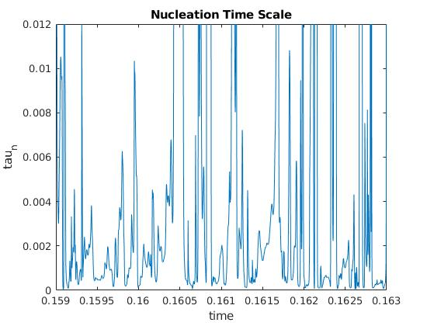
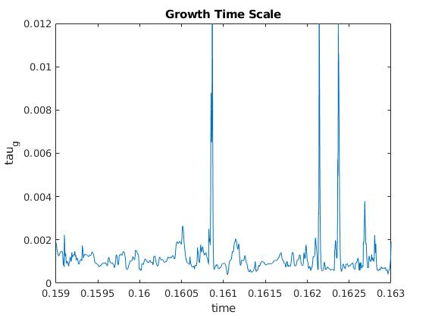
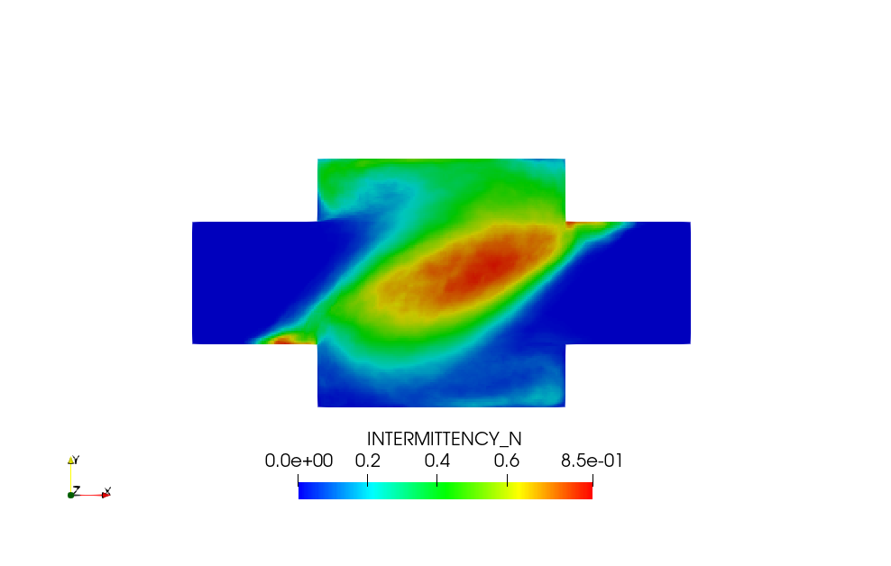
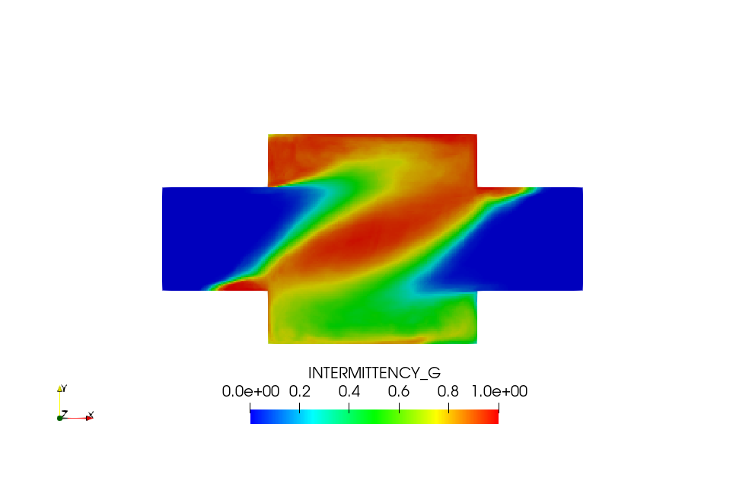
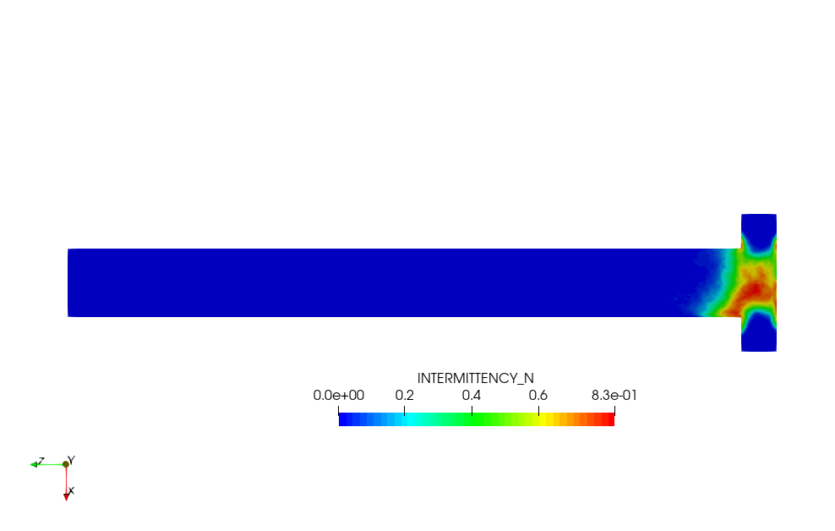
Intermittency
Non-linear kinetics and turbulent mixing leads to highly intermittent formation.

Slide 15
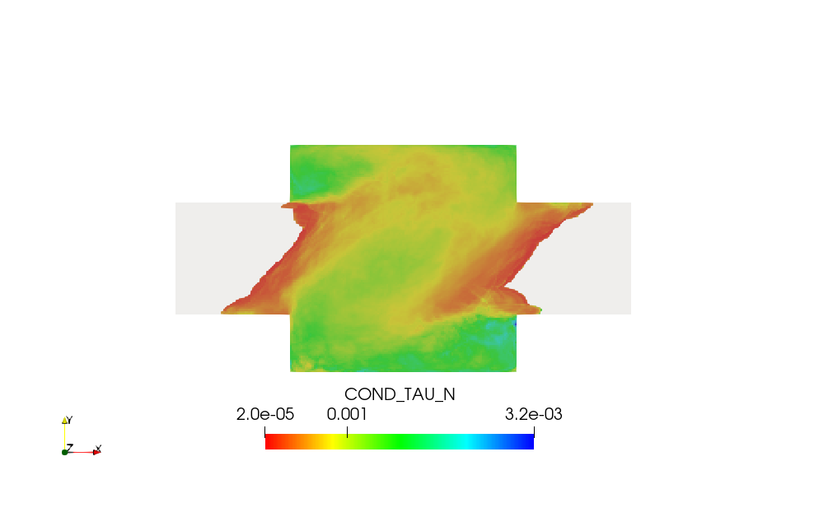
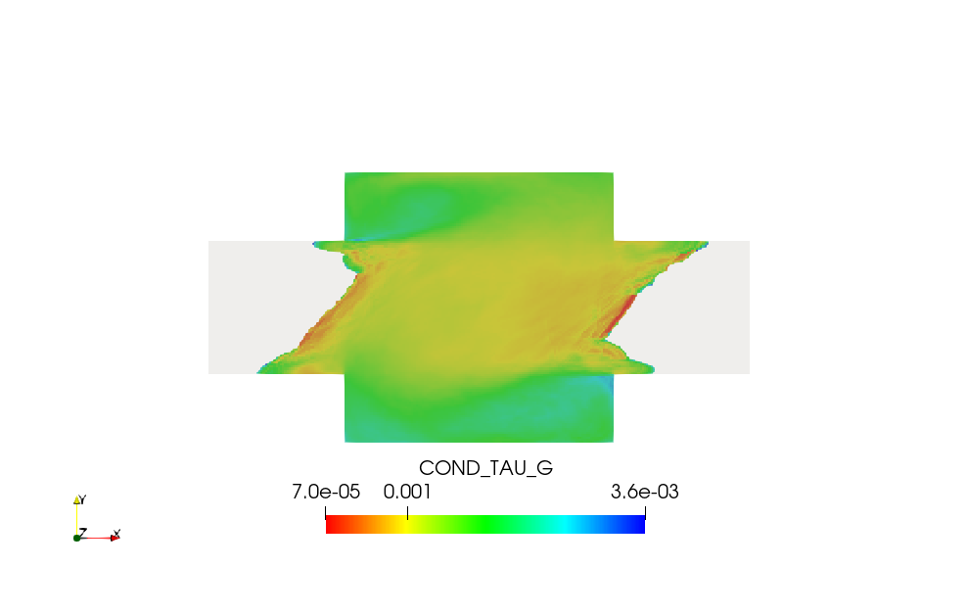
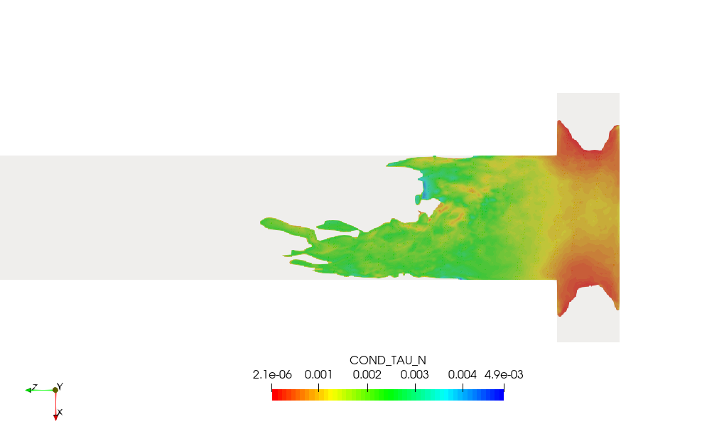
Conditional timescales

Slide 16
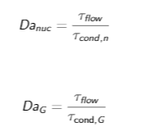
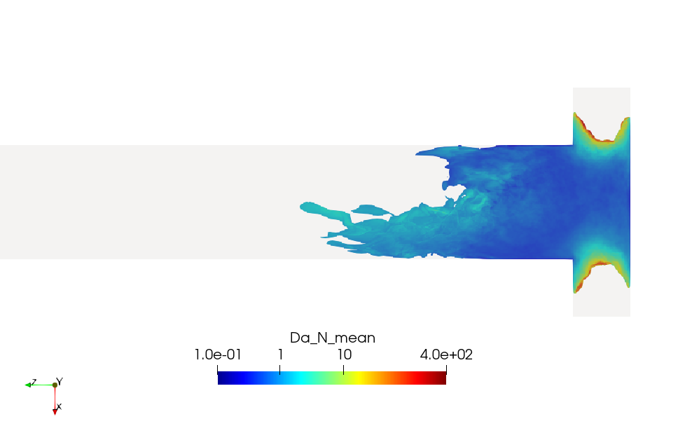
Damköhler numbers
Nucleation and growth have their own timescales.
Two Damköhler numbers can be defined:

Slide 17
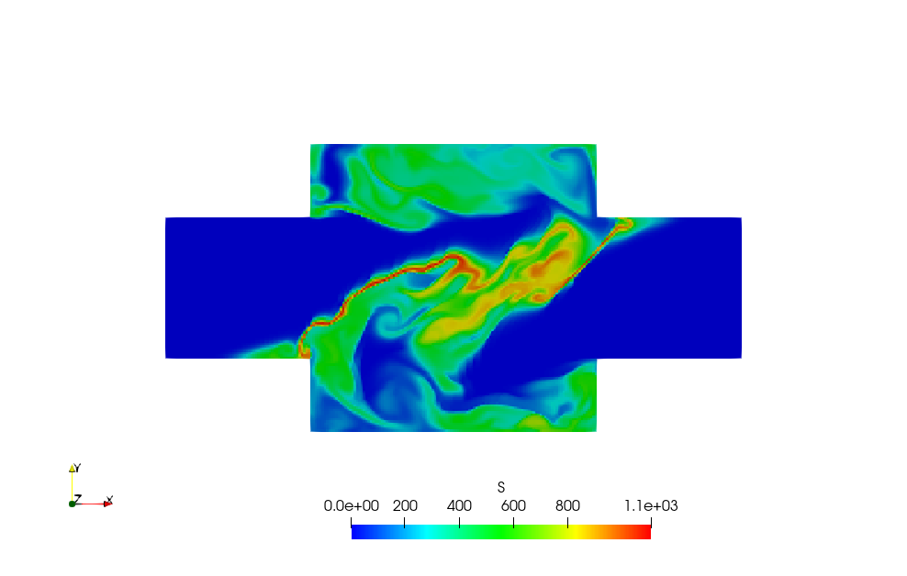
Local dominance zone and its mapping with supersaturation
High correspondence to the supersaturation map
Growth
dominance
zone
Competing
zone
Nucleation
dominance
zone
Nucleation dominance: S > 700
Competing: 400 < S < 800
Growth dominance: S < 550

Slide 18
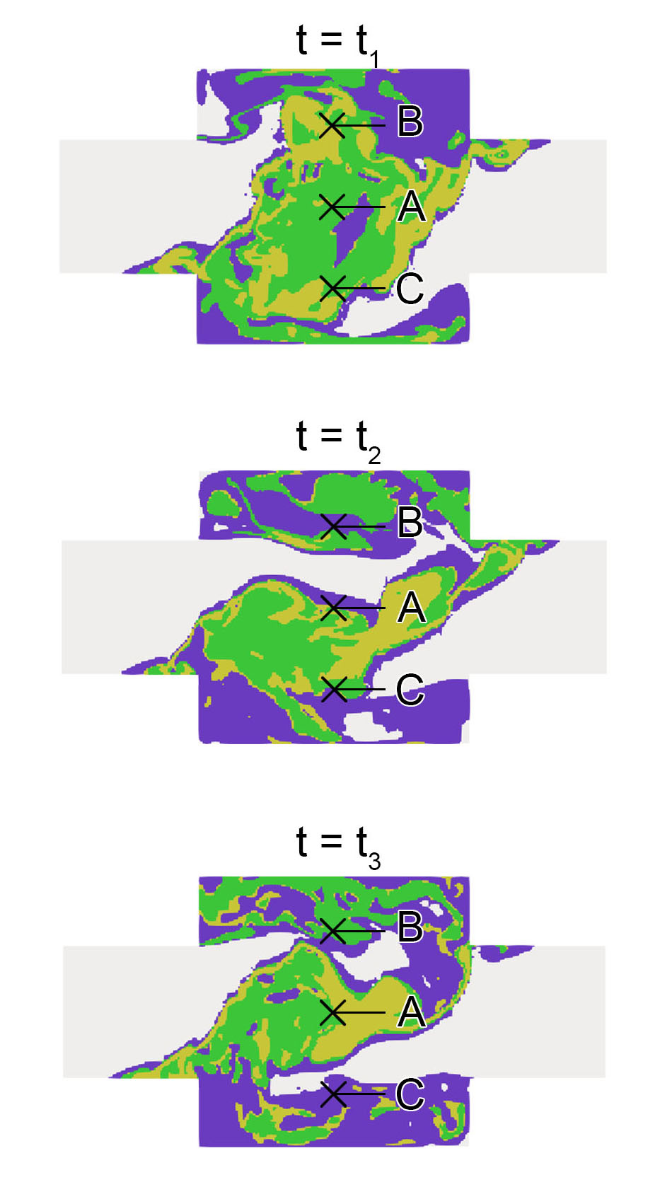
Characteristics of each dominance zone
The PSD in each zone exhibits different characteristics.
The area / volume distribution of each zone has determining effects on the final PSD.
How area / volume of these zone changes with Reynolds number is currently under investigation.
Growth
dominance
zone
Competing
zone
Nucleation
dominance
zone

Slide 19
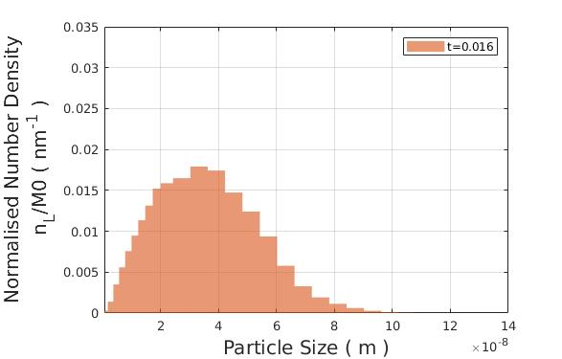
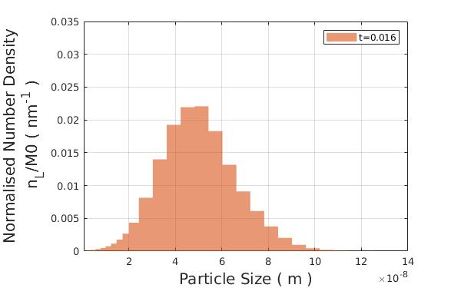
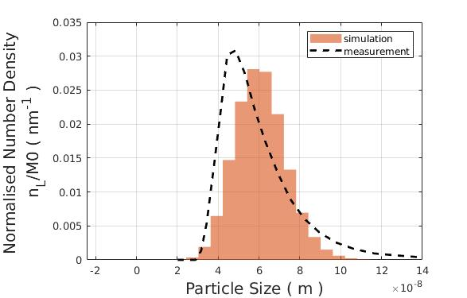
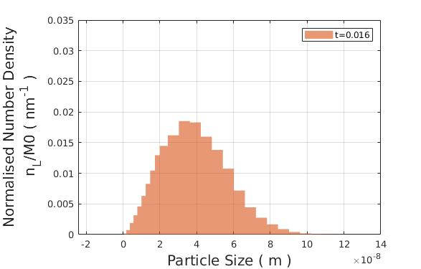
Mean plane averaged PSD

Slide 20
Conclusions
DNS – PBE coupled approach is developed an is applied on BaSO₄ precipitation
Excellent agreement with measurement
Different dominance zone and their contribution can be identified

Slide 21
Thank you

Slide 22
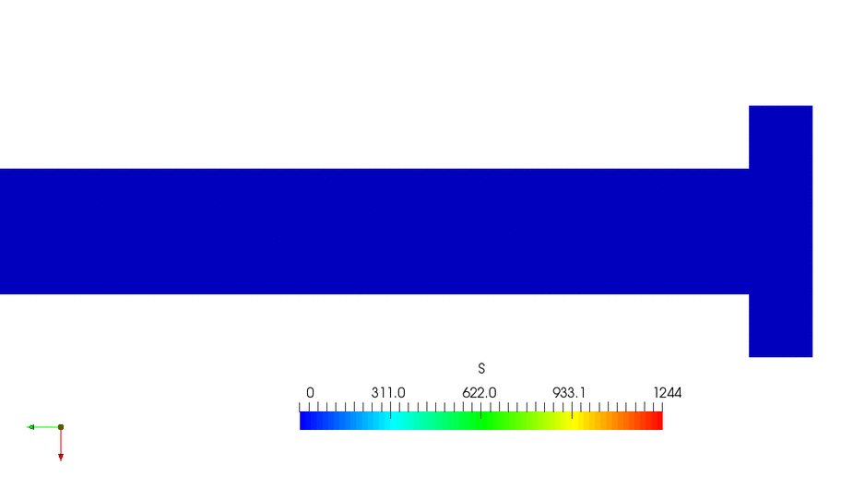
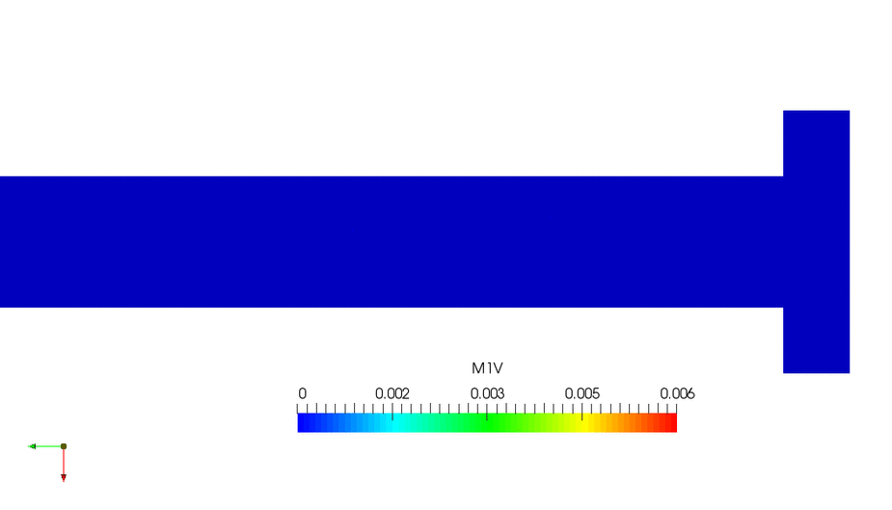
Moment of distribution
Supersaturation
1st Moment
(Crystal volume per unit volume)
0th Moment
(No. of particle per unit volume)

Slide 23
Intensity of Segregation
(a measure of evenness)

Slide 24
Intensity of segregation
A measure of evenness
1 - Fully segregated
0 – Homogeneously mixed

Slide 25
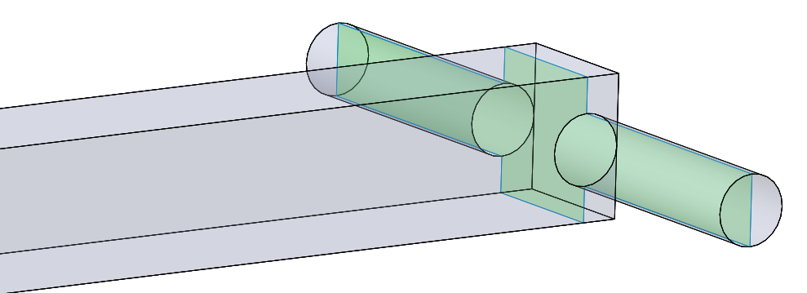
Flow field obtained from DNS
t=10 s
t=140 s
t=150 s
t=180 s

Slide 26
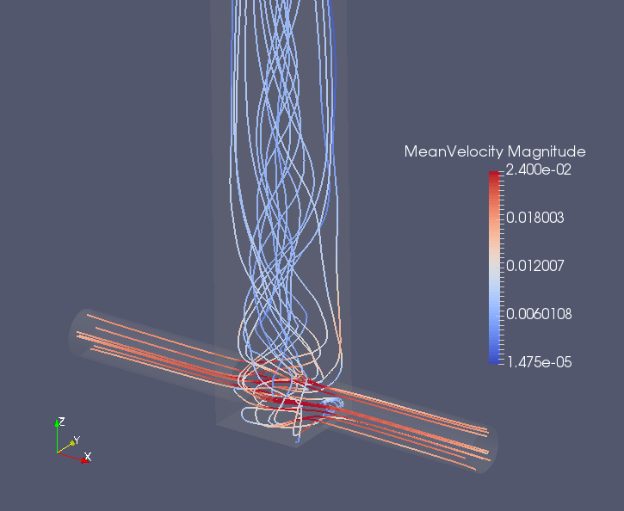
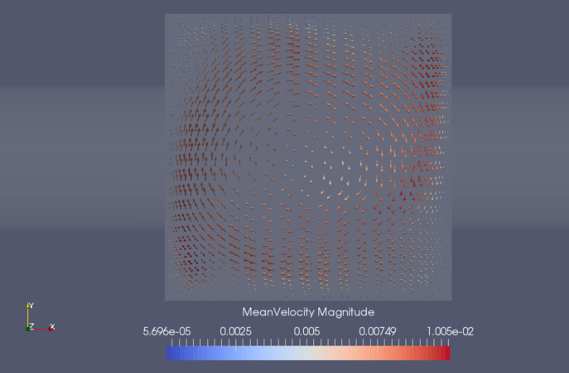
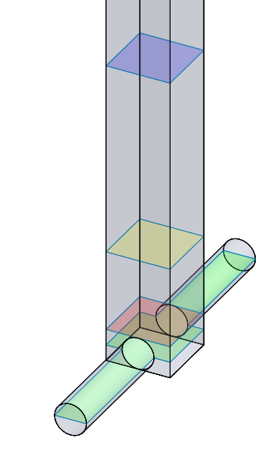
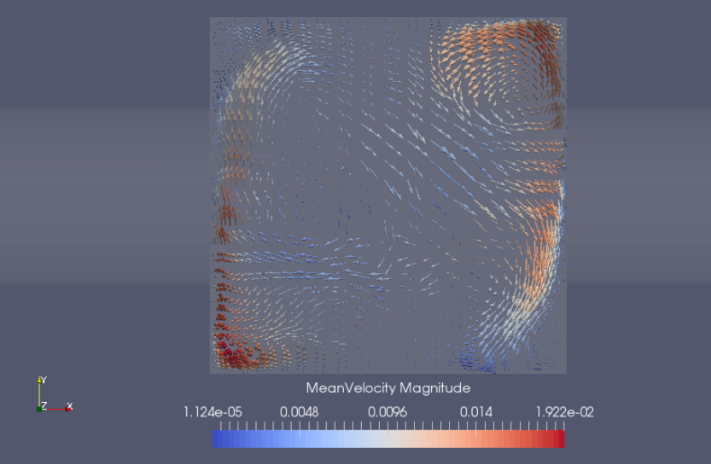
Flow field obtained from DNS (cont’d)
x/H=2.75
x/H=0.75
x
x/H=0.25
y
z
x/H=0
H

Slide 27
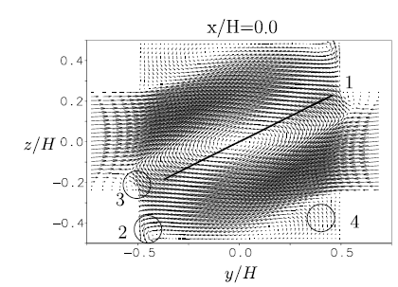
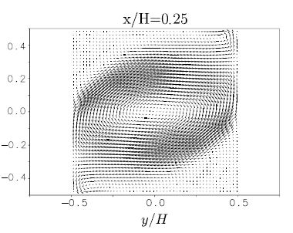
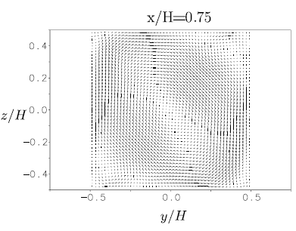
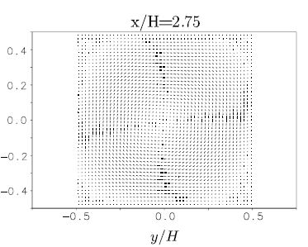
Compare with experimental PIV results^{[4]}
x/H = 0
x/H = 0.25
x/H = 0.75
x/H = 2.75
[4] F. Schwertfirm, J. Gradl, H. Schwarzer, W. Peukert and M. Manhart, “The low Reynolds number turbulent flow and mixing in a confined impinging jet reactor,” International Journal of Heat and Fluid Flow, vol. 28, pp. 1429-1442, 2007.

Slide 28
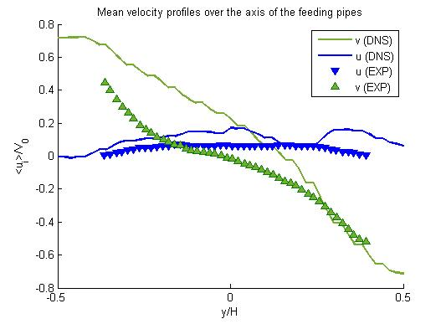
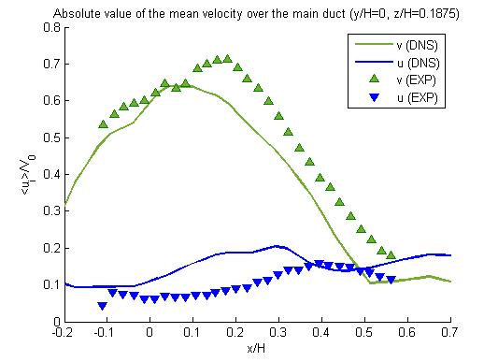
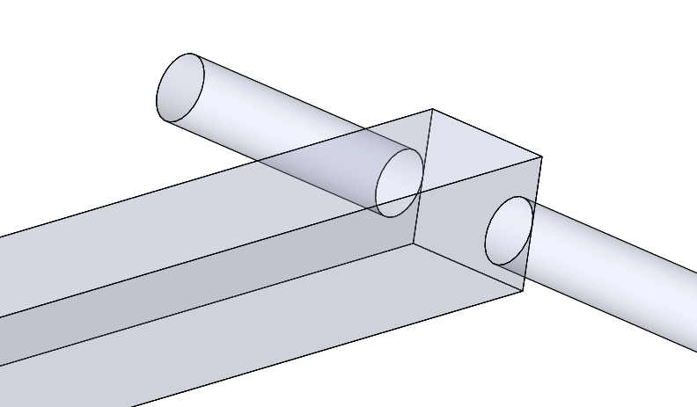
Velocity Profile (preliminary comparison with experimental results^{[4]} )
[4] F. Schwertfirm, J. Gradl, H. Schwarzer, W. Peukert and M. Manhart, “The low Reynolds number turbulent flow and mixing in a confined impinging jet reactor,” International Journal of Heat and Fluid Flow, vol. 28, pp. 1429-1442, 2007.

