Slide 1
The role of strain and mixture fraction variance in the prediction of local extinctions in LES of partially premixed combustion
Alessandro Soli^{a,}*, Ivan Langella^{a,b}, Zhi X. Chen^{c}
ª Loughborough University – Aeronautical and Automotive Engineering
^{b} Technical University of Delft – Faculty of Aerospace Engineering
^{c} University of Cambridge – Department of Engineering
* corresponding e-mail: a.soli@lboro.ac.uk
Notes:
*
***
Good afternoon and thank you everyone for inviting me to speak.
My name is Alessandro Soli and I am a PhD student at Loughborough University.
This afternoon I will discuss a mechanism based on strain and mixture fraction variance which is relevant for the prediction of local extinctions in partially premixed jet flames using large eddy simulation and flamelets.
The work was carried out together with Dr Langella, who is now at TU Delft, and Dr Chen from the University of Cambridge, using the ARCHER supercomputing service under the UKCTRF, both of which we would like to thank.

Slide 2
Introduction | Motivation
Mechanisms behind local extinctions yet to be fully understood
Non-premixed flames: diffusion losses > local heat release
Premixed flames: flame strained by high-vorticity regions
Partially-premixed flames: less understood
Sydney/Sandia jet flame with inhomogenous inlets ^{[1,2]}
Local extinctions increasing as bulk velocity rises
Unstrained premixed flamelets able to predict experimental data ^{[3]}
Extinctions underestimated closer to blow-off ^{[3]}
Why can we predict extinctions with an unstrained flamelets formulation?
How does the mechanism change closer to blow-off?
¹ Barlow et al., Combust. Flame 162 (10) (2015) 3516--3540
² Cutcher et al., Combust. Flame 194 (2018) 439--451
³ Chen et al., Combust. Flame 212 (2020) 415--432
Notes:
The reason for the investigation is that, despite the huge leaps made during the last decades, we still don’t know the full story about local extinction mechanisms.
We know that in diffusion flames they seem to occur when diffusion losses outweigh the local heat release, while in premixed flames they are somehow caused by flame strain from high vorticity regions. How this happens in partially premixed configurations is instead more complicated and less understood.
This has been targeted with the Sydney/Sandia jet flame with inhomogeous inlets , which has been studied experimentally by the group of Barlow and Cutcher over the past few years. They show increasing levels of local extinctions as the bulk velocity of the jet increased.
This geometry has been addressed in a previous numerical study by Chen et al., which was recently published on Combustion and Flame. In this study LES and tabulated chemistry with unstrained (and I stress unstrained) premixed flamelets were able to predict first and second order statistics of a number of fields with great accuracy and also the levels of extinctions. However they pointed out that these were underpredicted at bulk speeds of the order of 90% of the blow-off speed.
The present investigations ADDS to the study conducted in that paper, and tries to answer two main questions:
WHY can we predict extinctions (something which is in supposedly controlled by strain) using unstrained flamelets
And why does this method only work up to a certain blow-off ratio? what changes in the extinction mechanism?

Slide 3
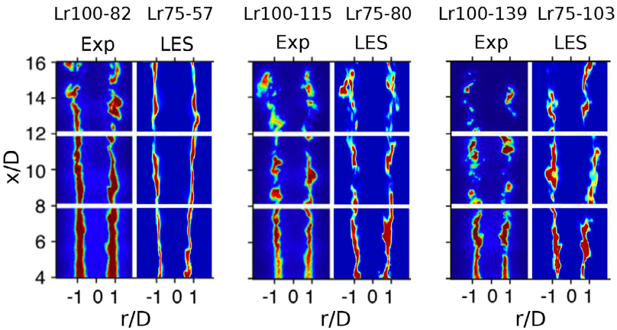
Introduction | Test case
Sydney/Sandia jet flame with inhomogenous inlets ^{[1,2]}
Flame | $L_{r}$ [mm] | $$U_{b}$$ [m/s] | $$U_{f}$$ [m/s] | $$U_{a}$$ [m/s] | $U_{b}/U_{bo}$ [%]
Lr75-80 | 75 | 80 | 93.8 | 83.4 | 70
Lr75-103 | 75 | 103 | 120.6 | 107.2 | 90
$$L_{r}$$
$$U_{a}$$
$$U_{f}$$
$U_{b}$: bulk flow velocity
$U_{bo}$: flame blow-off velocity
^{[3]}
OpenFOAM
12 flow-through times per flame
24h on 240 ARCHER cores
Total kAUs: 3456
¹ Barlow et al., Combust. Flame 162 (10) (2015) 3516--3540
² Cutcher et al., Combust. Flame 194 (2018) 439--451
³ Chen et al., Combust. Flame 212 (2020) 415--432
Notes:
As I said the test case investigated is the Sydney/Sandia flame with inhomogeneous inlets. Methane is injected from a central pipe within a second pipe where air is injected. The distance Lr between the two exits can be changed to have different levels of mixing, before ignition through a pilot, which is the most external pipe.
The CNF paper mentioned before addresses three cases, which are 50, 70 and 90% of the blow-off speed. The picture of the bottom left shows the comparison of the OH fields with the experiment, showing increasing level of local extinctions. The match is remarkable up until 70% blow off speed, while there is a slight underestimations in the fastest case. For this reason we now address only 70 and 90% blow-off rates.
The calculations in this study were carried out over 12 flow-through times, in about 24h per flame using 240 ARCHER cores. At this point we would like to thank ARCHER and UKCTRF once again for their support.
###In case someone asks, remember that part of the simulation were performed in Cambridge (the ones published already in the CnF paper) and other were re-run in Lboro, all under the UKCTRF consortium.

Slide 4
Turbulence and Combustion Modelling
Favre-filtered LES equations for mass, momentum and total enthalpy
$μ_{t}=C_{k}\overline{ρ}Δ\sqrt{k_{sgs}}$, from $k_{sgs}$ transport equation
Turbulence-chemistry interactions via presumed PDF (beta functions)
Database of unstrained premixed flamelets (GRI 3.0)
Transport equations for combustion variables $φ=\{\tilde{c},\tilde{c^{′′}},\tilde{Z},\tilde{Z^{′′}}\}$:
^{[3]}
premixed non-premixed
³ Chen et al., Combust. Flame 212 (2020) 415--432
Notes:
We solve the Favre-filtered LES equations for mass, momentum and total enthalpy, as well as subgrid kinetic energy which is used to calculated the subgrid viscosity.
Chemistry is tabulated using unstrained premixed flamelets. Turbulence-chemistry interaction is dealt with a presumed PDF approach using beta functions, solving transport equations of progress variable, mixture fraction and their respective variances.
The source term of progress variable is split into a stratified premixed and a non-premixed contribution and the details can be found in the CNF paper.
### Omega_fp is the precomputed reaction rate of a laminar freely-propagating unstrained flamelet, P is the PDF, chi_z is the sum of subgrid and resolved scalar dissipation rate and psi_b is the unscaled progress variable at burnt conditions.

Slide 5
Turbulence and Combustion Modelling
Favre-filtered LES equations for mass, momentum and total enthalpy
$μ_{t}=C_{k}\overline{ρ}Δ\sqrt{k_{sgs}}$, with $k_{sgs}$ transport equation
Turbulence-chemistry interactions via presumed PDF (beta functions)
Database of unstrained premixed flamelets (GRI 3.0)
Transport equations for combustion variables $φ=\{\tilde{c},\tilde{c^{′′}},\tilde{Z},\tilde{Z^{′′}}\}$:
^{[4,5,6,…]}
⁴ Dunstan et al., Proc. Combust. Inst. 34 (2013) 1193—1201
⁵ Langella et al., Combust. Theory Model. 19 (5) (2015) 628--656
⁶ Langella et al., Combust. Flame 173 (2015) 161---178
Notes:
Turbulent production of variance is represented by the source terms with the squared gradient, while the term in omega_c is a reaction source term which appears in the progress variable variance equation only.
The scalar dissipation rate, chi, is computed using a linear relaxation model for mixture fraction (in blue) and an algebraic equation for progress variable based on the assumption that the scalar dissipation rate of progress variable must balance both reaction term and turbulent production. The model here in red has been proposed by Swaminathan and coworkers and has plenty of validation, some papers are listed here.

Slide 6
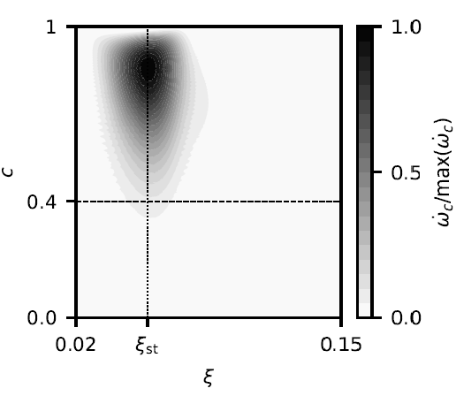
Lagrangian tracking
Massless Lagrangian particles injected periodically from burner mouth
Classified by:
origin (main vs pilot)
amount of fuel (reactants mixing vs co-flow mixing)
mixture fraction (in vs out of flammability limits)
burning status through reaction rate and threshold $c^{∗}=0.4$ ^{[7]}
extinction threshold
⁷ Mitarai et al., Phys. Fluids 15 (12) (2013) 3856--3866
Notes:
For the first part of the analysis, about 5000 Lagrangian particles are injected periodically from the burner mouth and tracked over a time window of 2.8ms.
At a second stage they are classified in different groups based on the location of injection, which is: is the particle coming from the main or from the pilot? on the amount of fuel, to identify particles that mix with the reactants from those that just mix with coflowing air. We then check what is the mixture fraction to distinguish those particles that lie within flammability limits, and we finally define the burning status of each particle.
We all agree that extinction occurs when reaction rate drops to – or close to – zero but given the model, and the turbulent nature of our flow, we would not be able to distinguish quenching from a particle that is simply fully burnt.
In this study we detected as an extinction an event where a particle, right after burning, experiences a sudden drop in progress variable below a threshold, in our case 0.4. This also corresponds to negligible reaction rate. This method is not new, but has also been used in other studies, like the one of Mitarai to analyse DNS data.

Slide 7
Results | Lagrangian tracking | Lr75-80
injection from pilot
+
ignition
67%
injection from main jet
+
ignition
41%
injection from main jet
+
ignition
+
quenching
7%, 1.5% stoich.
Notes:
This analysis allowed us to identify some characteristic behaviour.
On the first and second row you can see particles that are injected from the pilot (on the top) and from the main jet (in the middle) that start burning. These represent the majority of the particles injected from these locations and are 67% and 41% respectively. I am not going to go through them in detail, but essentially these diagrams of temperature, reaction rate, diffusion term and location show us that most of the particles start burning due to diffusive effects happening at the interface between main and pilot stream, and then the reaction propagates.
The number of particles that experience quenching at some point in time, which is again a progress variable going below our threshold, is much lower, for example 7% for the particles injected from the main jet. If we remove the particles that quench because they end up outside the flammability limits, only less than 2% quenches close to the stoichiometric line, and potentially represent local extinctions.

Slide 8
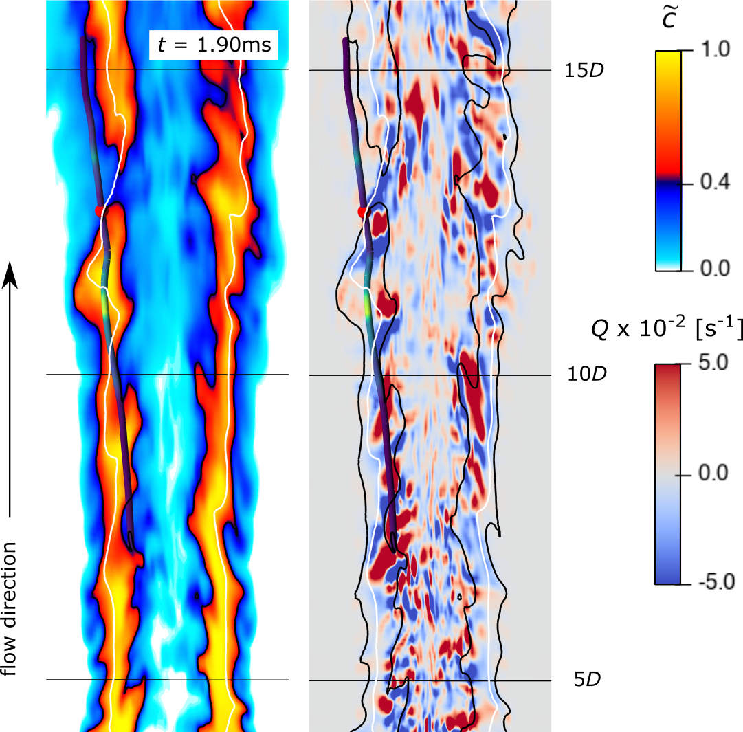
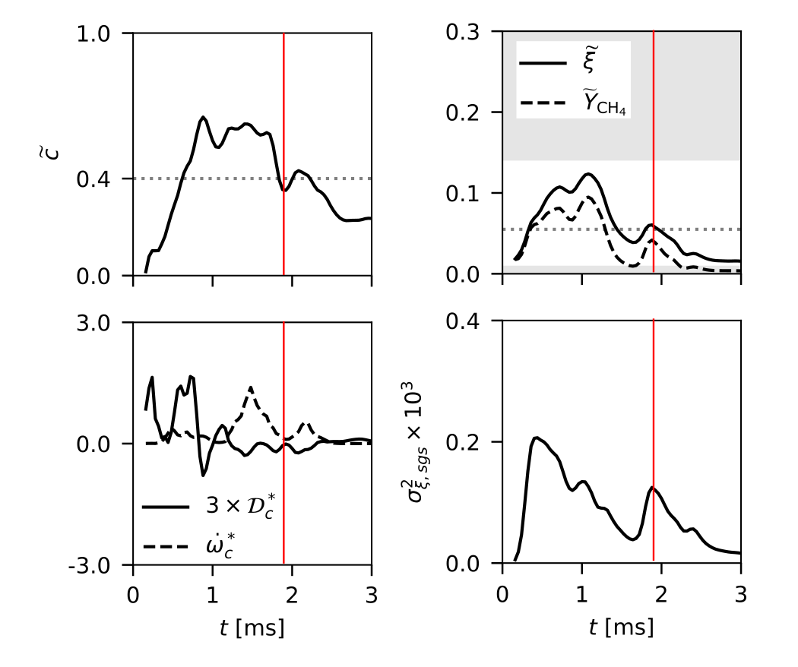
Results | Lagrangian tracking | Lr75-80
local extinction
injection from main jet
Notes:
When we isolate these particles quenching near the stoichiometric line, we observe that these particles (indicated in red) correspond to extinction holes, here indicated for a progress variable contour plot.
The time history on the right shows that this particles coming from the main jet is first heated up (as we can see from the progress variable plot), mixed with more fuel (as I can see from the mixture fraction plot), then reacts (as we can see from the dashed line here representing reaction rate) and then experiences a sudden drop of both progress variable and reaction rate, indicated by the red line, which corresponds to the time step of the contours.

Slide 9
Results | Lagrangian tracking | Lr75-80
high resolved strain
local extinction
injection from main jet
interaction with cold reactants
Notes:
We also observed two things:
The first is the presence of high strain through the Q-criterion plot in correspondence of these discontinuities of the flame front.
The second is that the extinction corresponds to a sudden increase in both fuel and subgrid mixture fraction variance. This in particular suggests that the particle might be interacting with cold and non-uniform reactants.

Slide 10
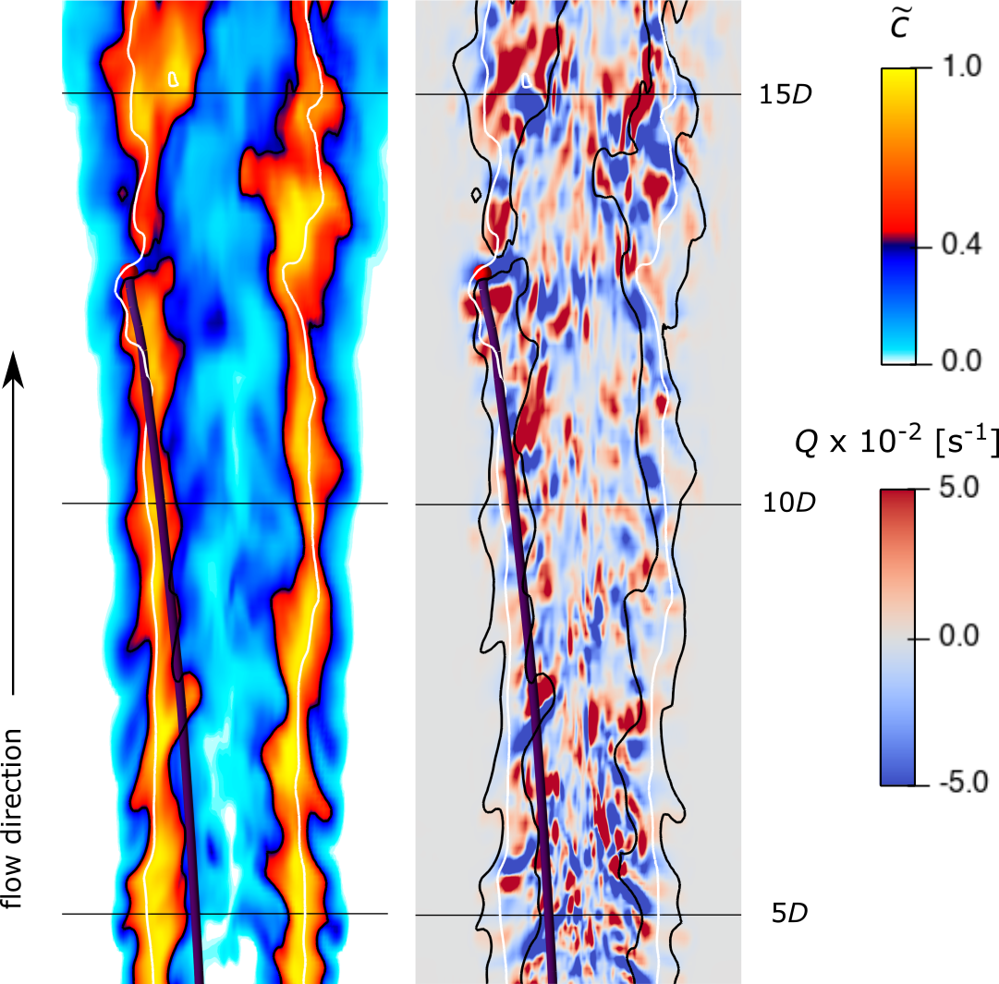
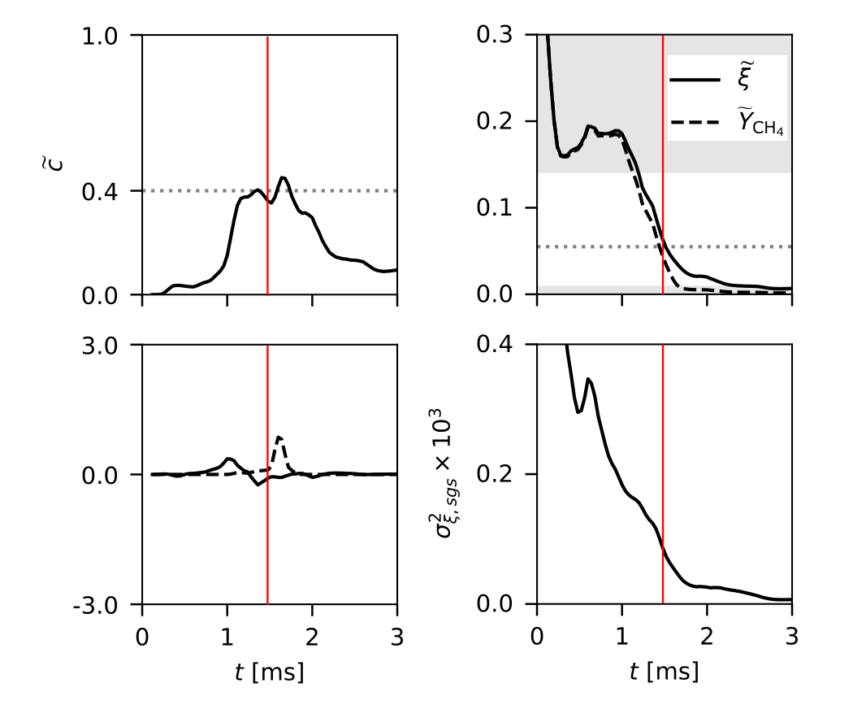
Results | Lagrangian tracking | Lr75-80
“cold”
local extinction
t = 1.38 ms
moderate/high SGS mixing
injection from main jet
Notes:
In fact, following a similar approach we were able to isolate some cold particles with high mixture fraction variance impinging on the extinction hole.

Slide 11
Results | Lagrangian tracking | Lr75-80
“cold”
local extinction
t = 1.38 ms
$Δt≈0.5$ ms
$t_{c}≈1−1.5$ms
not enough time
to start burning!
moderate/high SGS mixing
injection from main jet
Notes:
From a time scale analysis it is clear that these particles are heated or cross the flame front in 0.5ms only.
If we compare this with the characteristic time scale of the flamelet, we observe that these particles essentially don’t have enough time to heat up and start burning.
In other words it is as if the flame front is bombarded with packets of cold flow from the central jet that eventually generate the extinction holes.

Slide 12
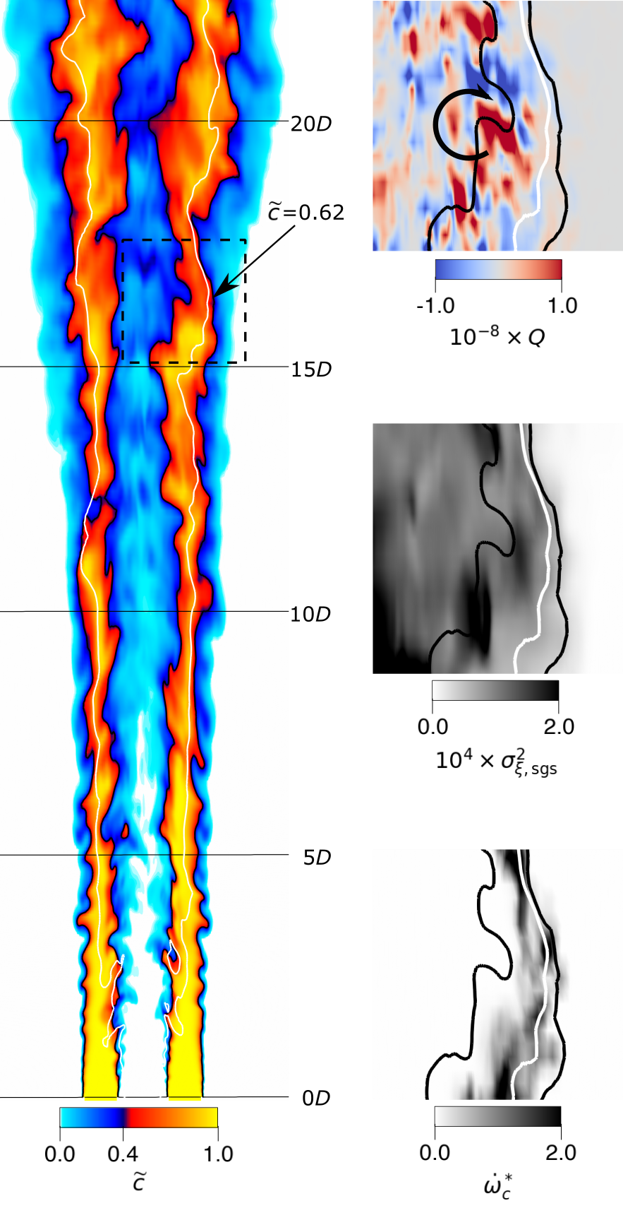
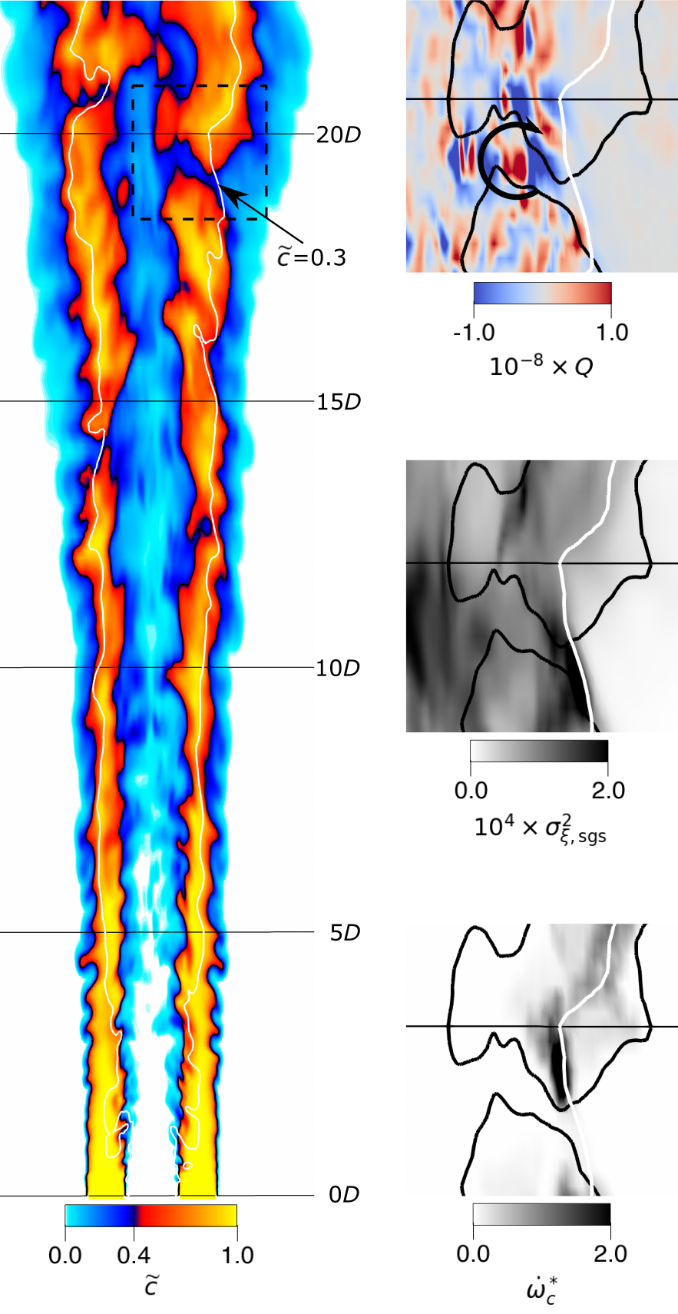
Results | Eulerian analysis | Lr75-80
t =1.72 ms
t =2.21 ms
vortex
strain
high $\tilde{Z^{′′}}$
Notes:
To understand how these particles ended up onto the flame front we analysed the problem from an Eulerian point of view right before (on the left) and after (on the right) the formation of an extinction.
The contour of reaction rate on the bottom shows how the burning region is rather continuous first and discontinuous later.
The big plot is again progress variable and shows that the flame front is strained and looks thinner before the extinction. We explained this by looking at the Q-criterions plot, which shows how this is caused by a vortex aligning with the flame front which in turn causes high local flow strain
You can see the high strain as a blue zone.
Correspondingly, the vortex seems to carry a packet of mixture fraction variance from the cold centre of the flame which impinges on the stoichiometric line contributing to the onset of the extinction.

Slide 13
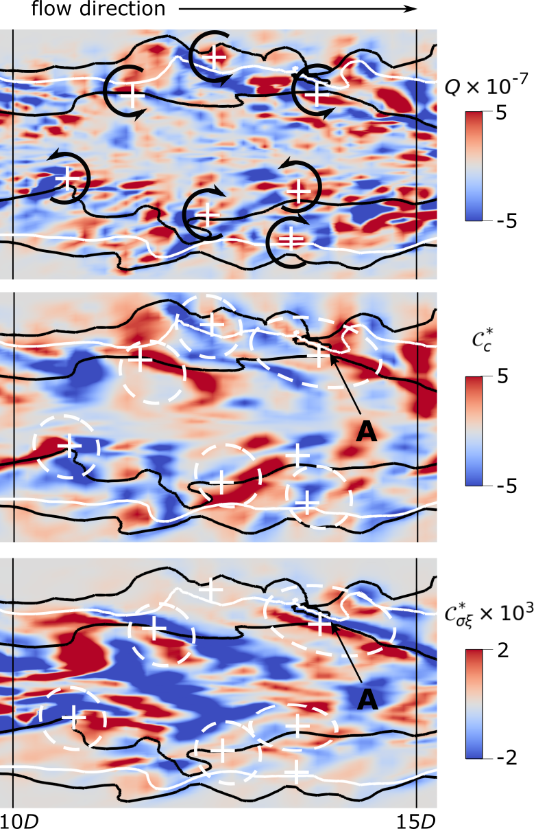
Results | Eulerian analysis | Lr75-80
How is this connected to the Lagrangian argument?
Vortex-induced convective fluxes of $\tilde{c}$ and $\tilde{Z^{′′}}$
Incoming $\tilde{Z^{′′}}$ and outgoing $\tilde{c}$ destabilizing for the flame
Indicates incoming cold reactants
Resolved strain aligns flame front to destabilising flux (A)
Maximises incoming cold reactants
Notes:
Now, how can we connect this to the Lagrangian argument? Well we can observe as each vortex, here indicated with the black arrows, generates a pair of positive and negative convective fluxes of mixture fraction and subgrid mixture fraction variance, which are the areas in the white circles below.
In particular an incoming flux of subgrid variance corresponds to an outgoing flux of c, which in turn indicates incoming fresh reactants. Both and increase in mixture fraction variance and a decrease in progress variable reduce the reaction rate, destabilizing the flame front. In this way we have linked the large to the behaviour of the Lagrangian particles seen before. In addition to this, we observed that resolved strain could occasionally align the stoichiometric line to a region of high destabilizing flux, as shown with the letter A here, and this maximises the amount of incoming cold reactants. This means that also resolved strain has a fundamental role in the onset of these extinctions.
Or LES can predict resolved strain and the effect of unmixedness through mixture fraction variance and this is why we believe the model works.

Slide 14
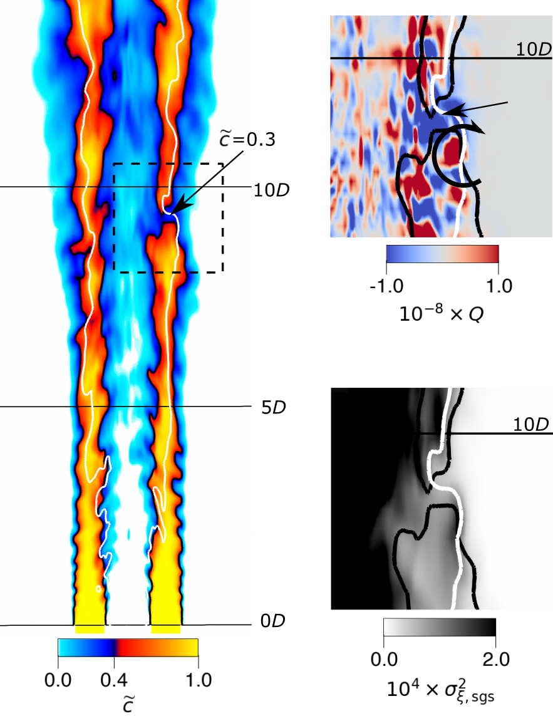
Results | Lr75-103
Same general behaviour of particles
Extinction now strain controlled
No SGS mixing mechanism
Limitation of unstrained flamelets
No SGS strain
Vorticity might be over-suppressed
+30% vorticity
no $\tilde{Z^{′′}}$ peak
higher SDR
Notes:
Now, on the other hand, when we go at 90% of the blow-off speed, we observe a strong increase in vorticity and therefore strain, whereas the higher scalar dissipation rate means that there is no more peak of mixture fraction variance impinging on the flame front.
We can say that this case is more strain controlled, and highlights the pitfalls of unstrained flamelets. We have some considerations here, which I don’t have time to go into. The first one is that subgrid strain might become important at this point, and we are not taking it into account. The second considerations is that we have reasons to believe unstrained flamelets overestimate the decay of vorticity and for this reason the eddies are unable to drag variance onto the stoichiometric line.

Slide 15
Summary
LES data of partially-premixed flame ^{[3]} analysed with combined Lagrangian/Eulerian approach
Combined effect of strain and SGS mixing (through $\tilde{Z^{′′}}$) key mechanism
Linked to large eddies casting fast packets of cold reactants on flame front
Lagrangian extinction of burning particles consequence – and not cause – of extinction holes
Flamelets can predict extinctions if strain is moderate and mostly at resolved level
Limitations are scope for further modelling
³ Chen et al., Combust. Flame 212 (2020) 415--432
Notes:
To summarise.
We have analysed LES data of partially premixed flames following a combined Lagrangian/Eulerian approach.
We have shown that there seems to be a combined effect of resolved strain and subgrid mixing behing extinction onset, and how this is related to the large eddies casing packets of cold reactants onto the flame front.
It is these packets that generate the extinction pockets and not the Lagrangian extinction of burning particle.
Finally we have seen how flamelets can predict the mechanism, but only as long as the strain is mostly at resolved level.
These limitations represent a scope for further modelling.

Slide 16
Acknowledgements
Notes:
I would like to conclude thanking once again UKCTRF, ARCHER and EPSRC for allowing us to carry on our simulations and to Rolls-Royce who is the co-sponsor of my PhD.
And, of course, thank you all for your attention.
I am happy to take any question.

