Slide 1

UK Consortium on Turbulent Reacting Flows (UKCTRF): EP/R029369/1:
Virtual student user conference
Nilanjan Chakraborty
School of Engineering
Newcastle University, Claremont Road, Newcastle-Upon-Tyne, NE1 7RU
16th September 2020
This virtual meeting is not the 2nd annual progress meeting. We still hope to hold it at Daresbury Laboratory in March/April 2021.

Slide 2
Outline
Demands and availability of computational time
Updates
Travel funding by consortium
Annual progress report
Current financial status
Success stories
Final comments

Slide 3
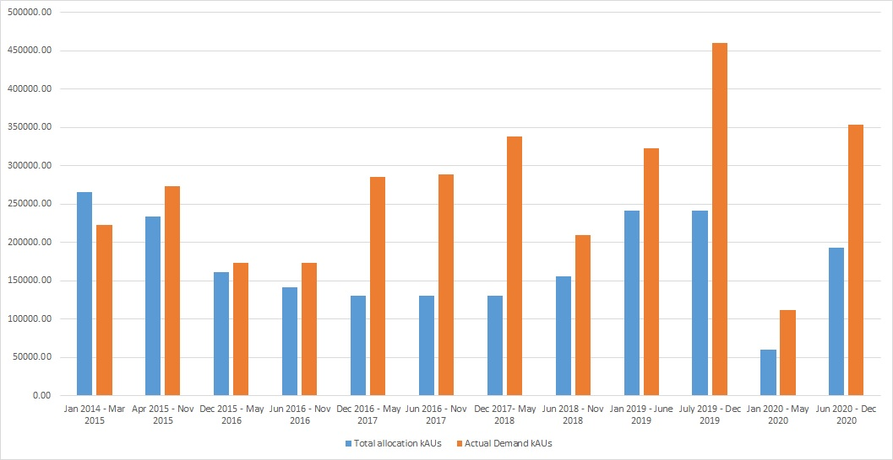
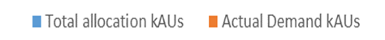
Demand and availability of computational time
kAUs

Slide 4
Update on computational time
ARCHER was supposed to be unavailable from the beginning of 2020 and our users were allocated to Tier-2 machines (e.g. CSD-3 and Cirrus)
EPSRC scrapped that plan in March and gave us access to ARCHER
Management team of the UKCTRF argued to EPSRC that the full allocation for 6 months (Jan.-Jun.2020) cannot be expected to be consumed in 3 months (Mar. -Jun. 2020). Travel funding by consortium.
EPSRC allowed rolling over of the remaining amount to the current allocation period (July –Dec. 2020).
So far, the usage is not satisfactory and there will be reallocation without any warning in the near future if the situation does not change.
It is very important that disk space is properly managed. Please delete the old files which are not used.
Our new EPCC contact is: Dr. William Lucas (w.lucas@epcc.ed.ac.uk)

Slide 5
Current usage of computational time allocation
All the available computational time for the current allocation period has been allocated.
All the applications deal with Work Package 1: Fundamental investigation using DNS and Work Package 2: Combustion applications dealing with LES simulations
It is important to use all the time allocation. If there is no substantial use of computational time over a period of 1.5 months, the computational time will be reallocated. No reminder will be sent.
Serial offenders will not receive computational time allocations in the future.

Slide 6
Computational time allocation: Current status
Group | Allocation | Remaining | Percentage Change
A | 576 | 366.4 | 36.39%
B | 12,331.30 | 7,818.00 | 36.60%
C | 2,252.70 | 1,733.30 | 23.06%
D | 5,075.00 | 3,364.80 | 33.70%
E | 6,108.30 | 4,257.80 | 30.29%
F | 12,317.20 | 9,464.20 | 3.16%
G | 10,578.60 | 6,084.30 | 42.48%
H | 13,414.70 | 10,119.90 | 4.56%
I | 74,139.70 | 65,882.20 | 11.14%
J | 4,652.50 | 4,652.50 | 0.00%
K | 2,395.50 | 2,395.50 | 0.00%
L | 15,437.40 | 13,894.20 | 10.00%
M | 10,227.70 | 7,154.30 | 30.05%
N | 719.7 | 684.3 | 4.92%

Slide 7
Travel funding by consortium
At the beginning of lockdown the management team of the UKCTRF decided to allocate £1500 per PI’s group who will orally present a paper in the 38th International Combustion Symposium. Another £2000 was allocated for each PI’s group for orally presenting a paper at other conferences other than combustion symposium. This will be revisited later today in the management team meeting.
We have received applications for symposium from 8 PIs and so far, we know of 17 papers which arose from the UKCTRF activities. The application form is open until the 30th of September (https://forms.ncl.ac.uk/view.php?id=7731550)
The papers for which travel funding will be provided will need to meet the following requirements:
It needs to deal with reacting flows. If the paper is on laminar flows, it must have some relevance to turbulent reacting flow modelling
It needs to explicitly acknowledge ARCHER and consortium grant (EP/R029369/1)

Slide 8
Consortium website (www.ukctrf.com)
Please be familiar with the consortium website:
Application forms for reimbursement, travel funding and computational time application are available
(http://www.ukctrf.com/index.php/reimbursement/,http://www.ukctrf.com/index.php/travel-funding/ , http://www.ukctrf.com/index.php/computer-time-allocation/ )
List of sample publications by the consortium members
(http://www.ukctrf.com/wp-content/uploads/2018/12/Sample-Publications-for-Website_24.08.2017.pdf )
List of the travel grants for PhD students and RAs
(http://www.ukctrf.com/index.php/conference-funding/ )
List of presentations given in earlier meetings, annual reports and case studies are available on the website (http://www.ukctrf.com/index.php/events/ )
Materials for the website and annual report will be requested soon.

Slide 9
Annual progress report
EPSRC needs an extensive report and a minimum of 3 case studies based on our year 2 activities
We will need list of publications, list of grants and prizes and case studies from the consortium members for the next annual progress report and future Researchfish submissions.
Please respond to the request for the impact summary survey. No response in that survey will mean that the usage of computational time did not lead to any meaningful outcome. Thus, those members can expect no computational time from the consortium in the future.

Slide 10
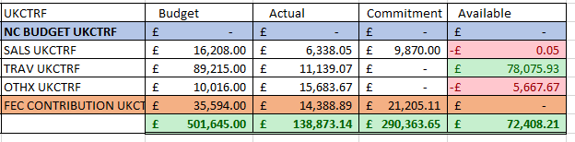
Current financial status
Total Available: £72,408.21
No expenditure has been made since March 23rd 2020 due to COVID-19.

Slide 11
Success stories
Prof. W. P. Jones has been awarded the Alfred C. Egerton Gold Medal, which recognizes distinguished, continuing, and encouraging contributions to the field of combustion. It is one of the highest awards of the Combustion Institute, presented biennially during the International Symposium on Combustion.
Profs. R. Stewart Cant, M. Delichatos and M. Kraft have been elected as Fellows of the Combustion Institute.
Prof. E. Mastorakos is one of the recipients of the Sugden Award 2020, for best Combustion paper by a section member in 2020.
Prof. N. Chakraborty was the editor of the Engineering and Materials chapter of Exascale Computing Science case commissioned by EPSRC. This science case will be presented to the HM Treasury. The combustion section of this science case was authored by Profs. N. Chakraborty and D. Emerson, which was commended by international experts who served as reviewers. One reviewer notes:
1. Combustion simulations: Highest priority – internationally leading
2. Materials chemistry: High priority – internationally competitive
3. High powered lasers and quantum electrodynamics: High priority – internationally competitive
4. Plasma accelerators and light sources: High priority – internationally competitive
5. Magnetic confinement fusion: High priority – internationally competitive
6. Mesoscopic simulations of multiphase flows: High priority – internationally competitive
7. Computational aerodynamics: High priority – internationally competitive
8. Quantum mechanics-based materials modelling: High priority – internationally competitive
9. Simulations of turbulent flow: High priority – internationally competitive
10. Atomic, molecular and optical R-matrix calculations: High priority – internationally competitive

Slide 12
Final comments
The named investigators of the UKCTRF to request their users to clean the disk space on ARCHER as it is stopping people to use the resources. After 30th of September 2020, any data which is more than 3 months old will be deleted. No more reminders will be sent.
8 nominated users will have access to ARCHER2 to run cases and test the system. Their experience will inform EPCC about the machine before it is released to all the users.
The RDF facility may not be continued in its current form so please start planning about moving data.
We still plan to hold the postponed meeting in March-April 2021 in person at Daresbury Laboratory. The next year’s annual meeting will take place at Brunel University.
Thanks for attending this meeting. I would like to thank Ms. Jennifer Richmond for her administrative help.

