Slide 1
Investigation of the effects of body forces on flame-turbulence interactions in turbulent premixed combustion
Arun Ravi Varma, Umair Ahmed, Nilanjan Chakraborty
School of Engineering, Newcastle University, Newcastle-Upon-Tyne, NE17RU, UK
UKCTRF Annual Meeting
16th September 2020

Slide 2
Introduction: Motivation
Turbulent premixed flames are “ducted” → subjected to external pressure gradients
Considerable difference in density between unburned reactants and burned products → Buoyancy is expected influence flame characteristics
Last well-known study → Veynante and Poinsot¹ → Emphasis on scalar flux
Effects of body forces on statistical behaviour of flame surface density (FSD) and its evolution has not been analysed in existing literature
¹ D. Veynante and T. Poinsot, J. Fluid Mech., vol. 353, pp. 83-114, 1997

Slide 3
Introduction: Objectives
Investigate the effects of body force on:
Flame wrinkling and flame brush thickness
FSD statistics
Terms of the FSD transport equation
Assess the performance of the existing closure models
Propose suitable modifications, wherever necessary, to capture the effects of the body force

Slide 4
Mathematical Background
Momentum equation under the action of a body force:
$$\frac{∂\left(ρu_{i}\right)}{∂t}+\frac{∂\left(ρu_{i}u_{j}\right)}{∂x_{j}}=−\frac{∂p}{∂x_{i}}+S_{i}+\frac{∂τ_{ij}}{∂x_{j}}$$
$S_{i}=ρΓ_{i}$ is the source/sink term in the $i^{th}$ direction
$$S_{1}=ρΓ_{1}=\frac{ρg^{∗}δ_{Z}}{S_{L}^{2}}$$
$g^{∗}$ stands for the inverse of Froude number-squared ($g^{∗}=Fr^{−2}$)
$δ_{Z}$ is the Zel’dovich flame thickness
Positive $g^{∗}$ → Unstable stratification
Negative $g^{∗}$ → Stable stratification
Flame
+g*
-g*
Reactants
Products
x₁

Slide 5
Mathematical Background
Progress variable $c$
$$c=\left(Y_{P}−Y_{P0}\right)/\left(Y_{P∞}−Y_{P0}\right)$$
$Y_{P}$ - suitable product mass fraction
Transport equation of Favre averaged progress variable $\tilde{c}$:
$$\frac{∂(\overline{ρ}\tilde{c})}{∂t}+\frac{∂\left(\overline{ρ}\tilde{c}\tilde{u_{j}}\right)}{∂x_{j}}=\overline{\frac{∂}{∂x_{j}}\left(ρD\frac{∂c}{∂x_{j}}\right)}+\overline{\dot{w}}−\frac{∂(\overline{ρu_{j}^{′′}c^{′′}})}{∂x_{j}}$$
Beyond scope of present work
Negligible in statistically planar flames in the context of RANS
Usually expressed in terms of the generalized FSD¹
$\overline{\dot{w}}=\overline{{\left(ρS_{d}\right)}_{s}} Σ_{gen}$
¹ M. Boger, D. Veynante, H. Boughanem, A. Trouvé, Proc. Combust. Inst. 27, pp. 917-925, 1998.

Slide 6
Mathematical Background
Generalized FSD $Σ_{gen}=\overline{\left|∇c\right|}$
Transport equation of generalized FSD:
$$\frac{∂Σ_{gen}}{∂t}+\frac{∂\left({\tilde{u}}_{j}Σ_{gen}\right)}{∂x_{j}}\underset{T_{1}−turbulent transport}{=\underbrace{−∂\{\left[\overline{{\left(u_{k}\right)}_{s}}−{\tilde{u}}_{k}\right]Σ_{gen}\}/∂x_{k}}}+\underset{T_{2}−strain rate}{\underbrace{\overline{{\left(\left(δ_{ij}−N_{i}N_{j}\right){∂u_{i}}/{∂x_{j}}\right)}_{s}}Σ_{gen}}}\underset{T_{3}−propagation}{\underbrace{−∂\left[\overline{{\left(S_{d}N_{k}\right)}_{s}}Σ_{gen}\right]/∂x_{k}}} + \underset{T_{4}−curvature}{\underbrace{\overline{{\left(S_{d}{∂N_{i}}/{∂x_{i}}\right)}_{s}}Σ_{gen}}}$$
The terms $T_{1}$, $T_{2}$, $T_{3}$, and $T_{4}$ are unclosed terms and need to be modelled

Slide 7
Numerical Implementation
3D compressible DNS code SENGA+
Boundary conditions – NSCBC technique¹
Turbulence field – pseudo spectral method of Rogallo², Batchelor-Townsend energy spectrum³
$u^{′}/S_{L}$ values: 3.0, 5.0, 7.5, 10.0 → Decaying turbulence
$g^{∗}$ values: -3.12, -1.56, 0.0, 1.56, 3.12
Total of 20 simulation cases
Periodic
Partially
non-reflecting
boundaries
Flame
Periodic
y
x
z
$$u^{′}/S_{L}$$ | $$l_{T}/δ_{th}$$ | $$Da$$ | $$Ka$$ | $$Domain size$$ | $$Grid size$$
$$3.0$$ | $$3.0$$ | $$1.0$$ | $$3.0$$ | $$70.2δ_{Z}×{\left(35.1δ_{Z}\right)}^{2}$$ | $$400×{\left(200\right)}^{2}$$
$$5.0$$ | $$3.0$$ | $$0.6$$ | $$6.45$$ | $$70.2δ_{Z}×{\left(35.1δ_{Z}\right)}^{2}$$ | $$400×{\left(200\right)}^{2}$$
$$7.5$$ | $$3.0$$ | $$0.4$$ | $$11.86$$ | $$70.2δ_{Z}×{\left(35.1δ_{Z}\right)}^{2}$$ | $$400×{\left(200\right)}^{2}$$
$$10.0$$ | $$3.0$$ | $$0.3$$ | $$18.26$$ | $$70.2δ_{Z}×{\left(35.1δ_{Z}\right)}^{2}$$ | $$400×{\left(200\right)}^{2}$$

Slide 8
Numerical Implementation
Single-step Arrhenius type irreversible chemical reaction is considered
Standard value of parameters:
Unity Lewis number
Prandtl number $Pr$= 0.7
Zel’dovich number $β$ = 6.0
Heat release parameter $τ=(T_{ad}−T_{0})/T_{0}$ = 4.5 (methane flames preheated to 415K)
Simulation time $t_{s}$ > 3.0$t_{e}$, where $t_{e}$ is the initial eddy turnover time (comparable to several previous studies)

Slide 9
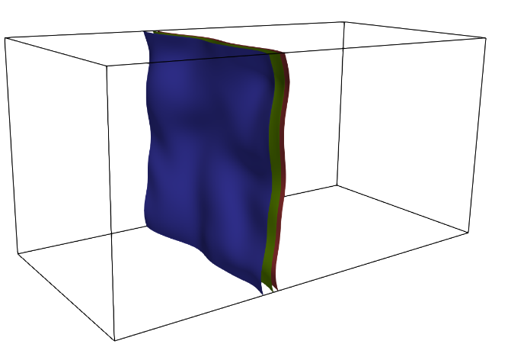
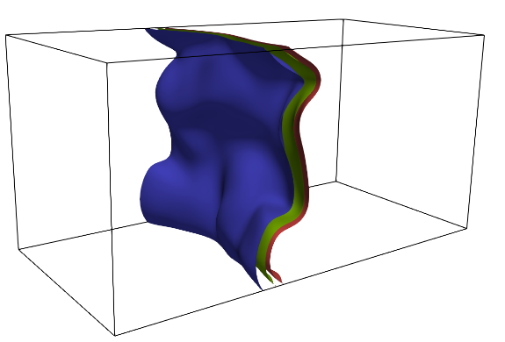
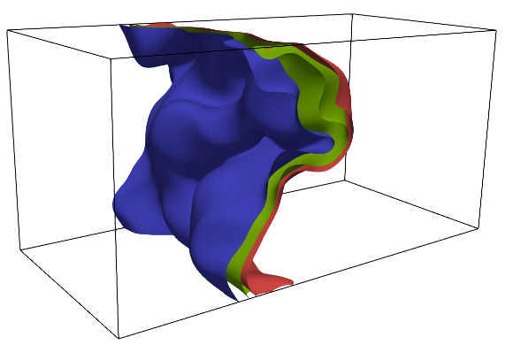
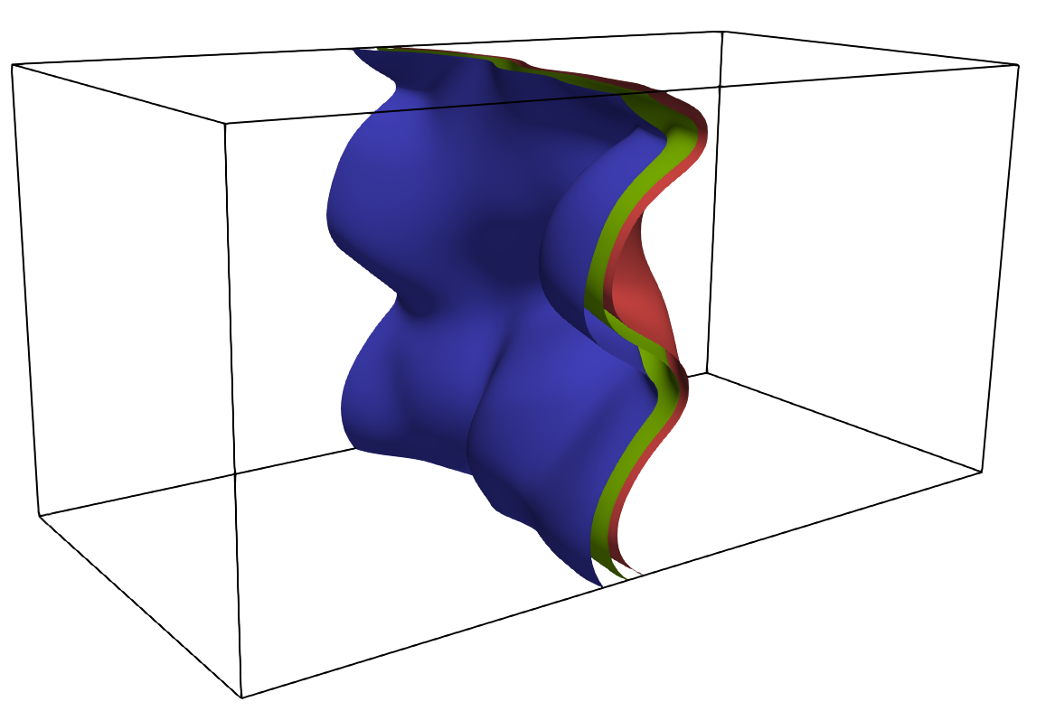
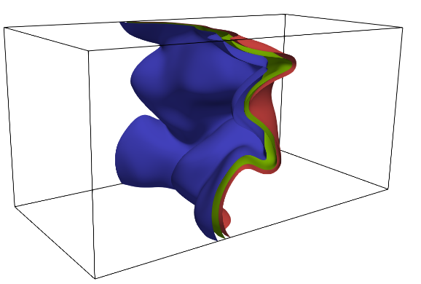
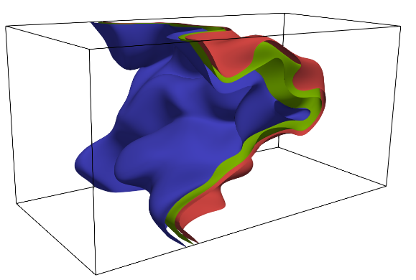
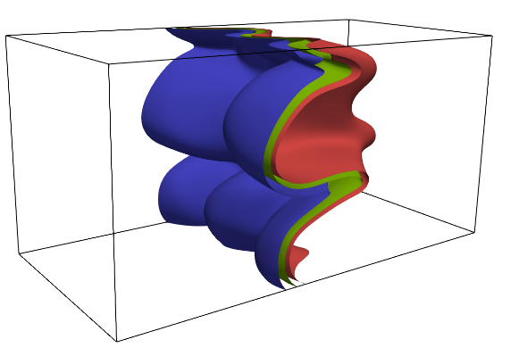
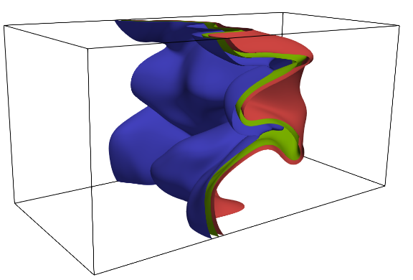
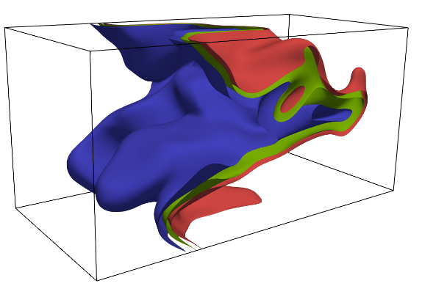
Results: Isosurfaces of $c$
$u^{′}/S_{L}$ increases
Flame wrinkling Flame brush thickness
Flame wrinkling Flame brush thickness
Consistent with previous findings of Veynante and Poinsot
 | $u^{′}/S_{L}$= 3.0 | $u^{′}/S_{L}$= 5.0 | $u^{′}/S_{L}$=10.0
$$g^{∗}=−3.12$$
$$g^{∗}=0.0$$
$$g^{∗}=3.12$$
$$g^{∗}$$
$$u^{′}/S_{L}$$
$g^{∗}$ increases
$$c=0.1$$
$$c=0.5$$
$$c=0.9$$
Instantaneous isosurfaces of $c$

Slide 10
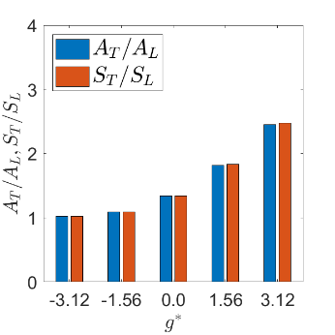
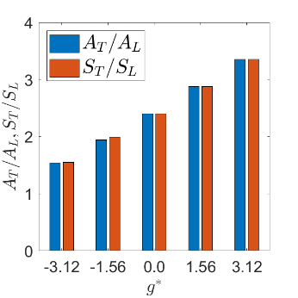
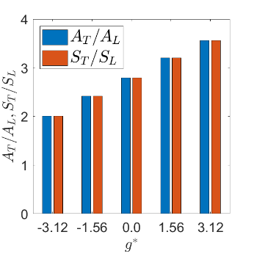
Results: Normalized flame surface area and turbulent flame speed
$u^{′}/S_{L}$ = 3.0
$u^{′}/S_{L}$ = 5.0
$u^{′}/S_{L}$ = 7.5
$u^{′}/S_{L}$ = 10.0
$A_{T}/A_{L}$ $S_{T}/S_{L}$ → $g^{∗}$
$A_{T}/A_{L}$ $S_{T}/S_{L}$ → $u^{′}/S_{L}$
$$A_{T}=\int_{V}{|∇c|}dV=\int_{V}{Σ_{gen}}dV$$
$$S_{T}=\int_{V}{\dot{w}}dV/ρ_{0}A_{P}$$
$A_{P}$ is flame area projected in $x_{1}$ direction

Slide 11
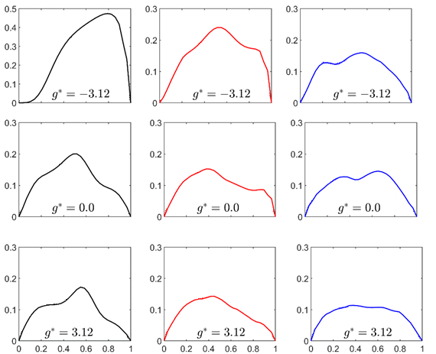
Results: Mean reaction rate closure
Boger et al.¹ → $\overline{\dot{w}}=\overline{{\left(ρS_{d}\right)}_{s}} Σ_{gen}$
For unity Lewis number, according to several previous studies^{2,3}
$$\overline{{\left(ρS_{d}\right)}_{s}}≈ρ_{0}S_{L}$$
$ρ_{0}$ is the density of the unburned gas
 | $u^{′}/S_{L}$= 3.0 | $u^{′}/S_{L}$= 5.0 | $u^{′}/S_{L}$=10.0
$$\overline{\dot{w}}×δ_{Z}/ρ_{0}S_{L}$$
 | $$\tilde{c}$$ | $$\tilde{c}$$ | $$\tilde{c}$$
¹ M. Boger, D. Veynante, H. Boughanem, A. Trouvé, Proc. Combust. Inst. 27, pp. 917-925, 1998.
² R.S. Cant, S.B. Pope, K.N.C. Bray, Proc. Combust. Inst. 27, 809-815, 1990.
³ S. Candel, V. Venante, F. Lacas, E. Maistret, N. Darabhia, T. Poinsot, Recent Advances in Combustion Modelling, World Scientific, Singapore, 1990, pp. 19-64, 1990.
DNS data (solid line) and predictions of the model (dotted line)

Slide 12
Results: Modelling of the turbulent transport term $T_{1}$
Modelling of $T_{1}$ is dependent on the modelling of the turbulent flux of generalized FSD
Model proposed by Chakraborty and Cant¹
 | $u^{′}/S_{L}$= 3.0 | $u^{′}/S_{L}$= 5.0 | $u^{′}/S_{L}$=10.0
$$\left(\left[\overline{{\left(u_{1}\right)}_{s}}−\tilde{u_{1}}\right]Σ_{gen}\right)×δ_{Z}/S_{L}$$
 | $$\tilde{c}$$ | $$\tilde{c}$$ | $$\tilde{c}$$
$$\left[\overline{{\left(u_{i}\right)}_{s}}−{\tilde{u}}_{i}\right]Σ_{gen}=\frac{\left(1−2\tilde{c}\right)\overline{ρu_{1}^{′′}c^{′′}}Σ_{gen}}{\overline{ρc^{′′2}}+\overline{ρ\tilde{c}}\left(1−\tilde{c}\right)}$$
¹ N. Chakraborty, R.S. Cant, Phys. Fluids 21 (2009) 035110, 1–11.
DNS data (solid line) and predictions of the model (dotted line)

Slide 13
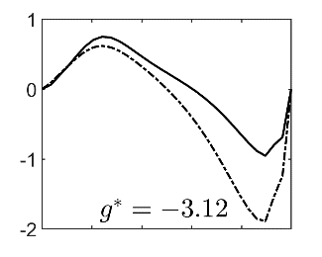
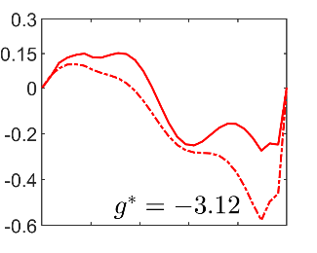
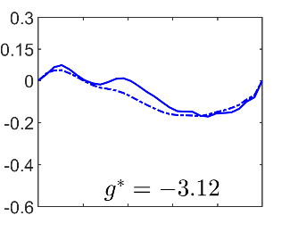
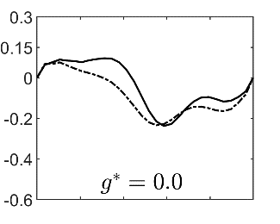
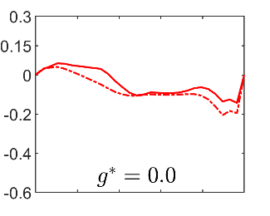
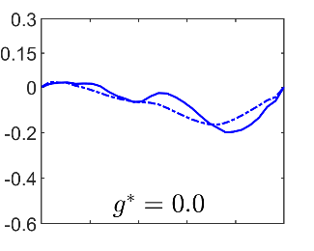
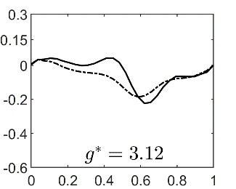
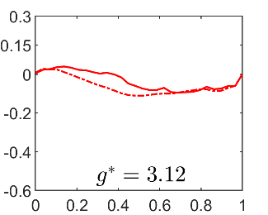
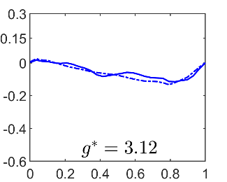
Results: Modelling of the combined $\left(T_{3}+T_{4}\right)$ term
Model^{1,2} for $\left(T_{3}+T_{4}\right)$
${(T}_{3}+T_{4})$= $−\frac{∂}{∂x_{i}}\left[\frac{ρ_{0}S_{L}}{\overline{ρ}}{\overline{\left(N_{i}\right)}}_{s}Σ_{gen}\right] + \frac{ρ_{0}S_{L}}{\overline{ρ}}\frac{∂{\overline{\left(N_{i}\right)}}_{s}}{∂x_{i}}Σ_{gen}−\underset{Unresolved part}{\underbrace{β_{0}α_{N}\frac{\left(\overline{c}−c_{cp}\right)S_{L}Σ_{gen}^{2}}{\overline{c}\left(1−\overline{c}\right)} }}$
Satisfactorily predicts the combined propagation and curvature term
 | $u^{′}/S_{L}$= 3.0 | $u^{′}/S_{L}$= 5.0 | $u^{′}/S_{L}$=10.0
$$\left(T_{3}+T_{4}\right)×δ_{Z}^{2}/S_{L}$$
 | $$\tilde{c}$$ | $$\tilde{c}$$ | $$\tilde{c}$$
¹ I. Hun, K.Y. Huh, Combust. Flame 152, 194-205, 2008.
² N. Chakraborty, R.S. Cant, Combust. Flame 158, 1768-1787, 2011
DNS data (solid line) and predictions of the model (dotted line)

Slide 14
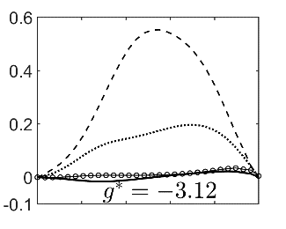
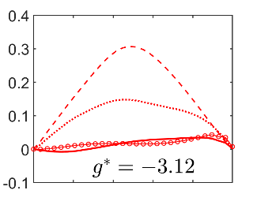
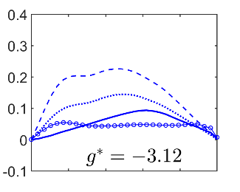
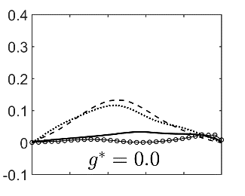
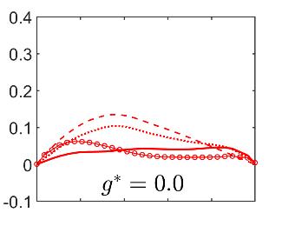
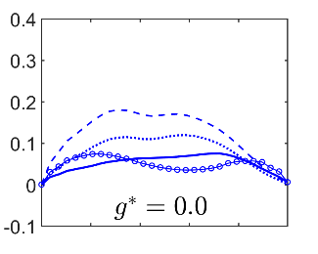
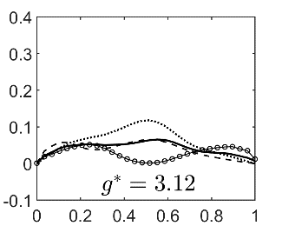
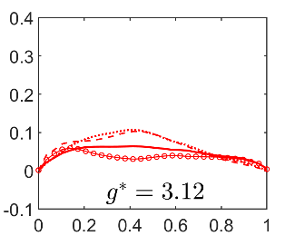
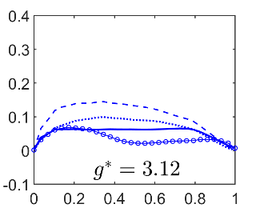
Results: Modelling the strain rate term $T_{2}$
Existing models:
CPB model¹ (dotted lines) – based on the Kolmogorov time scale
CFM model^{2,3} (dashed lines) – based on integral time scale
DNS data (solid lines)
$T_{2}$ not satisfactorily captured by the existing models
Alternative model proposed
Predictions of the alternative model for $T_{2}$ (line with circles)
 | $$u^{′}/S_{L}=3.0$$ | $$u^{′}/S_{L}=5.0$$ | $$u^{′}/S_{L}=10.0$$
$$T_{2}×δ_{Z}^{2}/S_{L}$$
 | $$\tilde{c}$$ | $$\tilde{c}$$ | $$\tilde{c}$$
¹ R.S. Cant, S.B. Pope, K.N.C. Bray, Proc. Combust. Inst. 27, 809-815, 1990.
² D. Veynante, J. Piana, J.M. Duclos, C. Martel, Proc. Combust. Inst. 26 pp. 413–420, 1996.
³ S. Candel, V. Venante, F. Lacas, E. Maistret, N. Darabhia, T. Poinsot, Recent Advances in Combustion Modelling, World Scientific, Singapore, 1990, pp. 19-64, 1990.
DNS data (solid lines)
CPB model (dotted lines)
CFM model (dashed lines)
Proposed model (lines with circles)

Slide 15
Results: Alternative model for $T_{2}$
Based on the alignment of $∇c$ with the local fluctuating strain rates^{1,2}
The proposed model for the $T_{2}$ term is given by:
$$T_{2}=\underset{D1_{FSD}}{\underbrace{\frac{∂{\tilde{u}}_{i}}{∂x_{i}}\left|∇\overline{c}\right|}}+\underset{D2_{FSD}}{\underbrace{\frac{τ.S_{L}}{δ_{th}}\left[A{\left(1−\tilde{c}\right)}^{ζ}\left(Σ_{gen}−\left|∇\overline{c}\right|\right)\right]}}−\underset{N1_{FSD}}{\underbrace{{ \overline{\left(N_{i}\right)}}_{s}{\overline{\left(N_{j}\right)}}_{s}\frac{∂{\tilde{u}}_{i}}{∂x_{j}}Σ_{gen}− \left(δ_{ij}/3\right)\left[1−{\overline{\left(N_{k}\right)}}_{s}{\overline{\left(N_{k}\right)}}_{s}\right]\frac{∂{\tilde{u}}_{i}}{∂x_{j}}Σ_{gen}}}+\underset{N2_{FSD}}{\underbrace{\frac{\tilde{ε}}{\tilde{k}}\left[C_{1}−τC_{2}Da_{L}\right]Σ_{gen}}}$$
$D1_{FSD}$ and $D2_{FSD}$ → contributions of the dilatation rate
$N1_{FSD}$ and $N2_{FSD}$ → normal strain rate contribution
Model parameters → $A, C_{1}$ and $C_{2}$ → functions of $g^{∗}$ (Froude number)
1
2
3

Slide 16
Conclusions
The effects of body force on the statistical behaviours of FSD and its transport have been evaluated using a DNS database of three-dimensional statistically planar turbulent premixed flames using the decaying turbulence approach.
An unstable (stable) density stratification promotes (weakens) flame wrinkling
Existing models satisfactorily capture $T_{1}$ and ($T_{3}+T_{4}$)
Alternative model for $T_{2}$
Effects of body force weakens with increasing turbulence intensity
$\frac{1}{Fr Re_{T}} \sim \frac{\sqrt{g^{∗}}}{Re_{T}}$ where $Re_{T}=\frac{ρ_{0}u^{′}l_{T}}{μ_{0}}\sim \left(\frac{u^{′}}{S_{L}}\right)\left(\frac{l_{T}}{δ_{Z}}\right)$

Slide 17
Future work
Effects of body force → forced turbulence approach.
A bandwidth-filtered forcing strategy^{1,2} → maintain the turbulence level on the unburned gas side.

Slide 18
Acknowledgements
The computational support of Rocket, Cirrus and ARCHER are gratefully acknowledged.
Time usage on ARCHER (approx. kAU): 6,000 kAU

