Slide 1
Anisotropy Invariant Mapping of a Turbulent Boundary Layer by Deep Learning
Quentin Martinez and Dr. Jun Xia

Slide 2
Main Problems
- Turbulence modelling/simulation can be very expensive in real world applications.
- How can deep learning be applied as a low(er) cost alternative to traditional computational techniques?
- What are the limitations of deep learning in fluid mechanics?

Slide 3
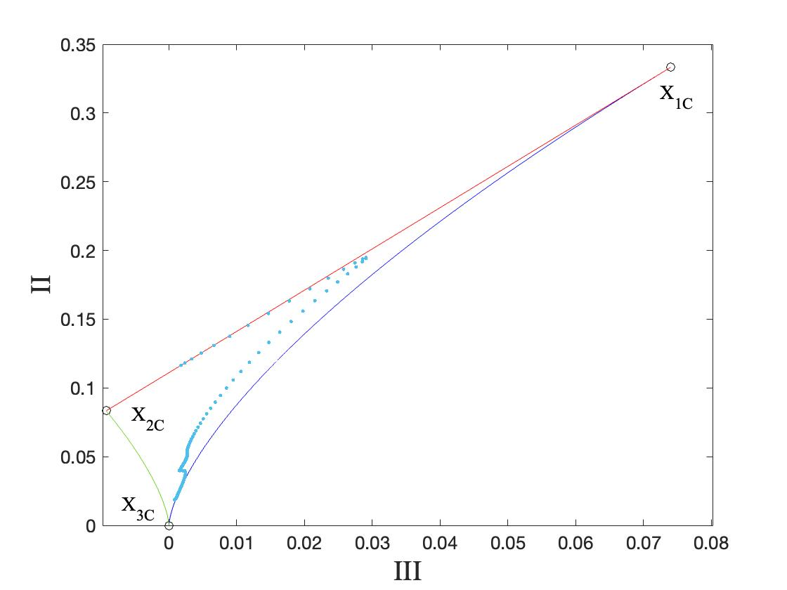
Proposal
- Neural networks can be used to learn and corelate relevant patterns in turbulence data.
- Low dimensional representation of turbulence to help to mitigate the "curse of dimensionality" (Bellman, 1966).
Figure 1. Lumley Triangle for Downstream Flat Plate Turbulent Boundary Layer
Notes:
1) Previous work (Weiwei et al., 2018) (Duraisamy et al., 2015) has shown DL as a viable instrument in turbulence modeling and prediction.
2) In many engineering applications, properly pre- dicting the amount and type of anisotropy is critical for accurate numerical simulation of turbulent flows.
2) eigenvalues, lambda1 and lambda 2, are used to describe the relative strength of the fluctuating eddies, i.e. turbulence componentiality. All points within this map can be categorized as some complex combination of limiting states represented by the red, blue, and green boundaries. Red is one component turbulence, green is 2-component turbulence, and blue is isotropic turbulence.
2) we don’t want to induce a similar computational burden with training as running a turbulence simulation

Slide 4
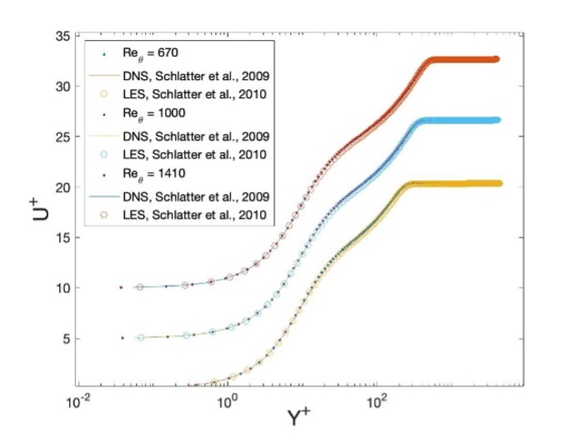
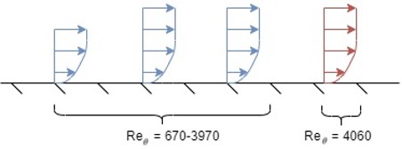
Setup: Training, Validation, and Test Data
- Secondary sourced DNS data for a zero-pressure gradient flat plate turbulent boundary layer (Schlatter & Orlu, 2010)
Figure 3. Data Split Ratio
Figure 4. Wall Normal Profile

Slide 5
Setup: Network Architecture
- NAR learns through an autocorrelation of previously lagged data.
- Very effective for multi-step sequence predictions.
- Used in financial, biological, and system control applications.
Figure 2. Nonlinear Autoregressive Neural Network (NAR)

Slide 6
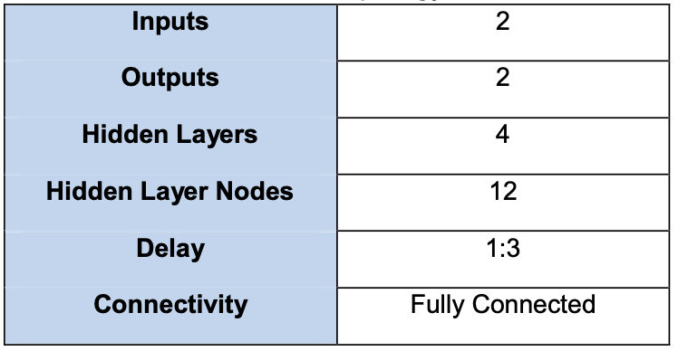
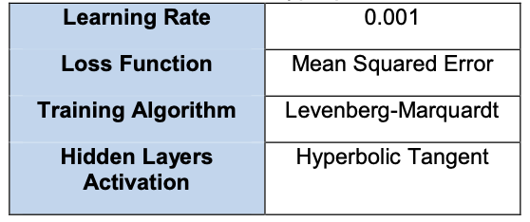
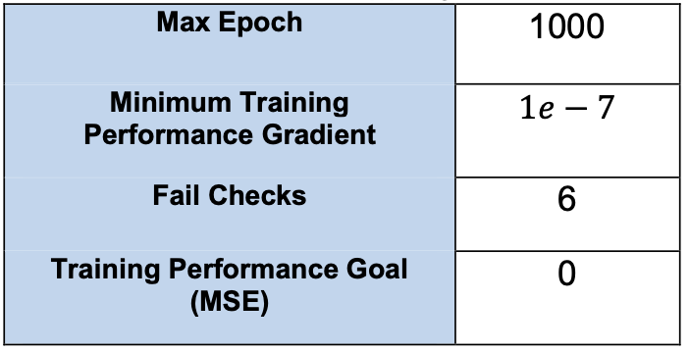
Setup: Parameters and Hyperparameters
- Typically, parameters and hyperparameters are tuned via a trial-and-error process as there are many degrees of freedom that can affect a model's intended performance.
- Common issues: over/underfitting, catastrophic forgetting, stagnating or leaping gradient descent.
Tables 1,2,3. Setup Parameters and Hyperparameters
Notes:
1) there are other methods for tuning networks like bayesian optimisation and topology optimisation via genetic algorithm but for this work we had stuck with trial-and-error due to time constraints.
2) For anyone that has used neural networks, there are plenty of issues that can occur during tuning. Some common macro issues though are over/underfitting, catastrophic forgetting, and stagnation or leaping gradient descent. For example, we can prevent over/underfitting by matching the network topology to the data size. As well, learning rate helps to dictate how fast we perform gradient descent and if we stagnate or converge too early.

Slide 7
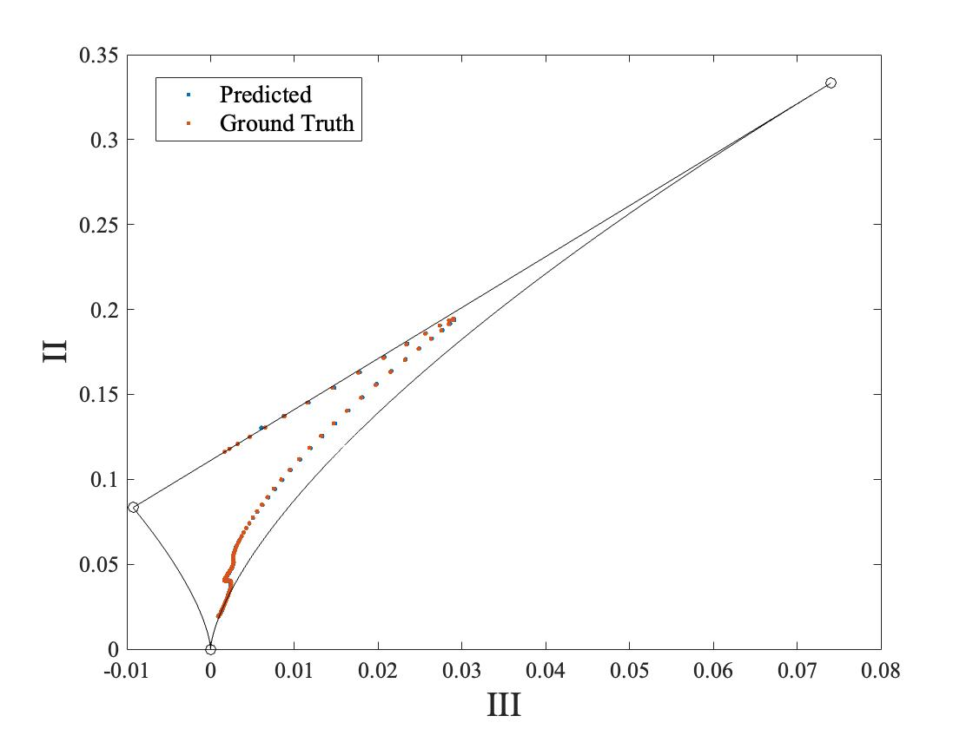
Results: Open Loop
- Model exhibits no long-term forecasting capabilities. Only single-step prediction is available.
- Open loop prediction yields goodness of fit score, MSE = 2.071e-6.
Figure 3. Open Loop Prediction for Reθ = 4060
Notes:
1) Model is able to self correct after each prediction because target data is available.
- cost function is mean squared error.
- represents the error norm between the test data and our predicted data.

Slide 8
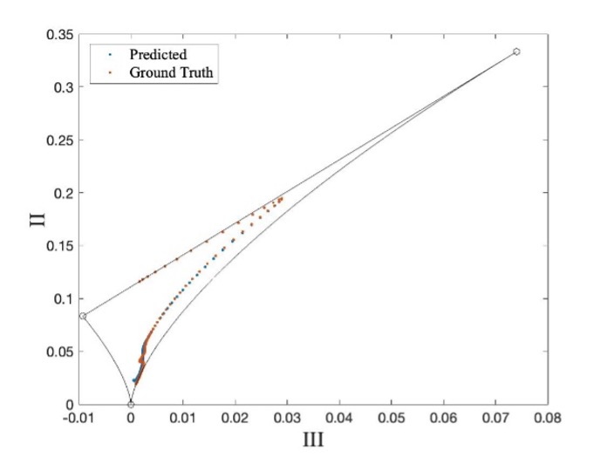
Results: Closed Loop
- Closed loop model recursively predicts upon itself to generate multi-step forecasts up to some specified horizon.
- Degraded goodness of fit score, MSE = 0.035.
Figure 4. 93% Horizon Closed Loop Prediction for Reθ = 4060
Notes:
1) the model operates in open loop form initially up to some user specified time or state. That final open loop state then acts as the initial state for our closed loop network.
2) the model is able to forecast a general trend

Slide 9
Results: Error Accumulation
- Closed loop network is highly sensitive to error accumulation in long horizons.
- Initial errors tend to magnify and propagate throughout recursion process.
- Open loop training metrics can sometimes misrepresent closed-loop performance.
Notes:
h is an initially unknown function that the neural network determines during training.
Eta describes the difference between Yt and the conditional mean up to Yt-1. Conditional mean is the calculated mean after a set of conditions has occurred.

Slide 10
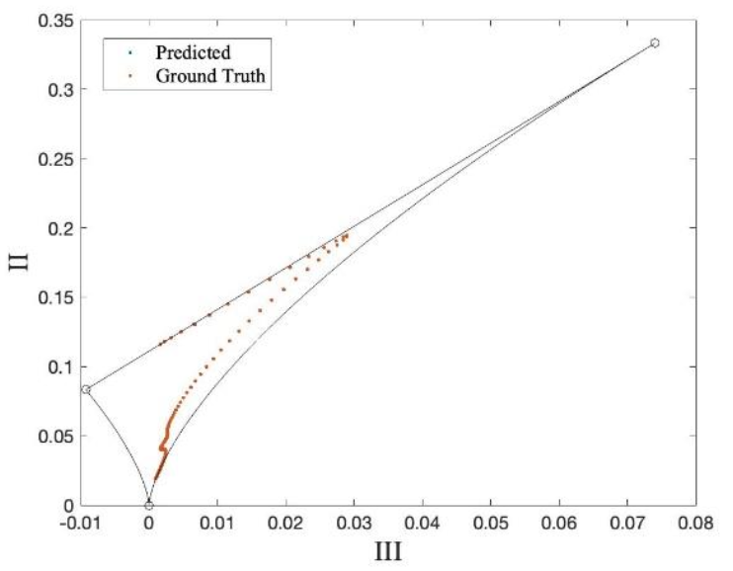
Results: Error Accumulation Continued
Figure 5. Retrained: Open Loop Prediction for Reθ = 4060
Figure 6. Retrained: Closed Loop Prediction for Reθ = 4060

Slide 11
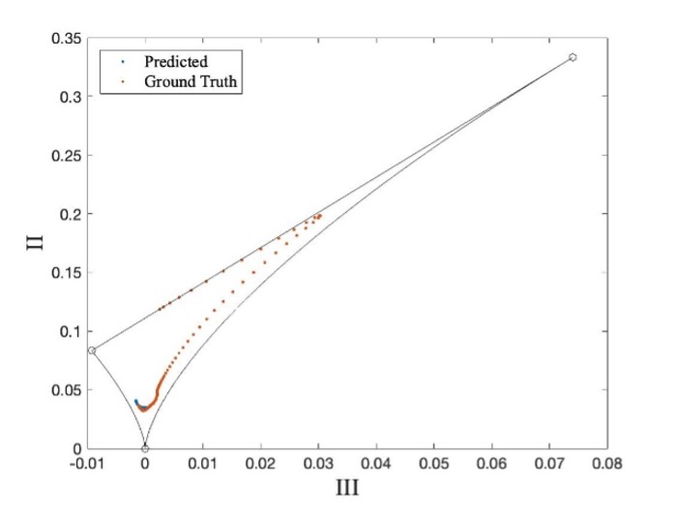
Results: Reducing Prediction Horizon
- Error accumulation is less intrusive.
- Model has a tendency of forecasting an average anisotropy profile.
- Goodness of fit score, MSE = 3.823e-4
Figure 7. Closed Loop Prediction for mean AIM profile, 33% Horizon
Notes:
88% prediction

Slide 12
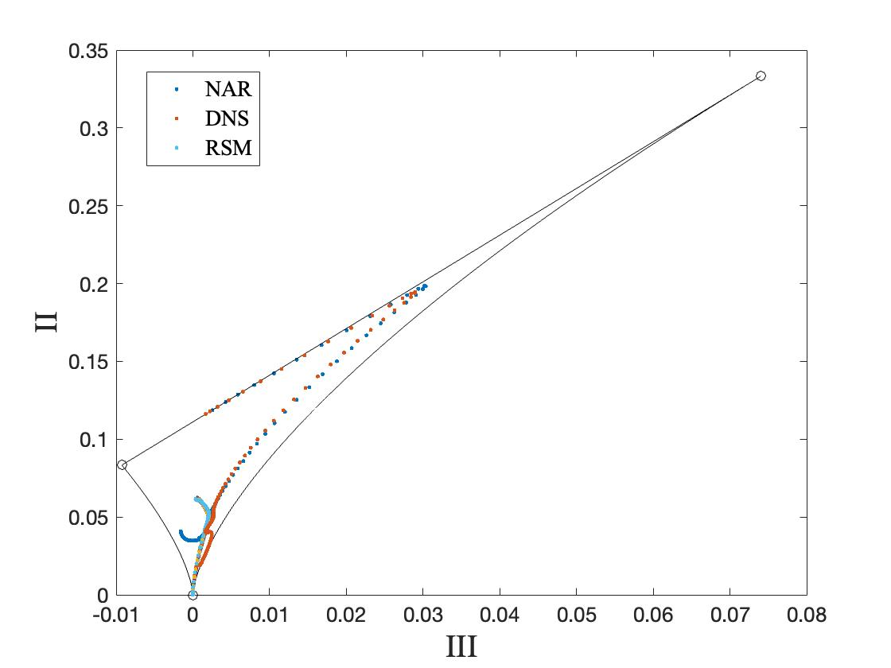
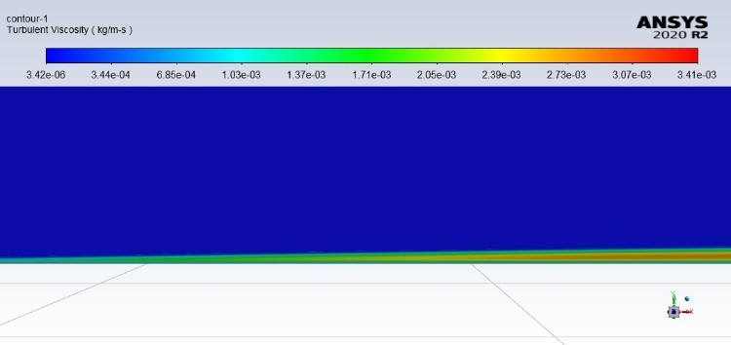
Results: Reynolds Stress Model Comparison
- Closed loop network shows greater "comprehension" of turbulence anisotropy than RSM simulation with linear pressure-strain assumption.
- Anisotropies evolve from an initial, isotropic turbulence under rapid mean distortion.
Figure 8. NAR, DNS, and RSM comparison
Figure 9. Turbulent Viscosity Contour
Notes:
1) linear pressure-strain term is derivative of a homogenous turbulence assumption. Homogenous = time averaged properties are constant throughout the flow field. Isotropic = turbulent structures have no directional preference.
2) under the assumption of rapid mean shearing distortion commonly introducted by fluid solid interactions, linearized RDT assumes an initial isotropic turbulence.

Slide 13
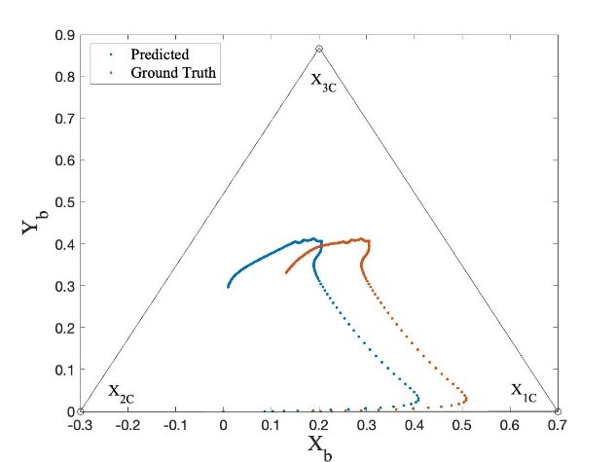
Results: Alternative Visualisation Techniques
Figure 10. Color Contour Mapping
Figure 11. Barycentric Triangle

Slide 14
Summary
- NAR can successfully predict the anisotropy invariant map of a flat plate turbulent boundary layer with a large horizon.
- Closed loop predictions can suffer from error recursion and amplification with little indication during training and development.
- NAR had a tendency of learning mean componentiality characteristics of training data.
- NAR was able to outperform the RSM prediction of turbulence anisotropy.

Slide 15
References
Schlatter, P. and Örlü, R. (2010). Assessment of direct numerical simulation data of turbulent boundary layers. Journal of Fluid Mechanics, [online] 659, pp.116–126.
Zhu, L., Zhang, W., Kou, J. and Liu, Y., 2019. Machine learning methods for turbulence modeling in subsonic flows around airfoils. Physics of Fluids, 31(1), p.015105.

